Slide 1
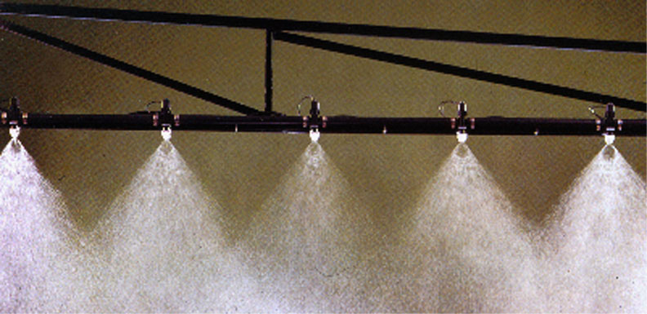
Spray Drift Management
Joanna E. Radford, Ag. Extension Agent,
Surry County Center
Wayne Buhler, PhD, Extension Specialist,
NC State University
Notes:
This slide presentation describes the various factors that can influence spray drift and how, as applicators, you can manage and minimize these factors.

Slide 2
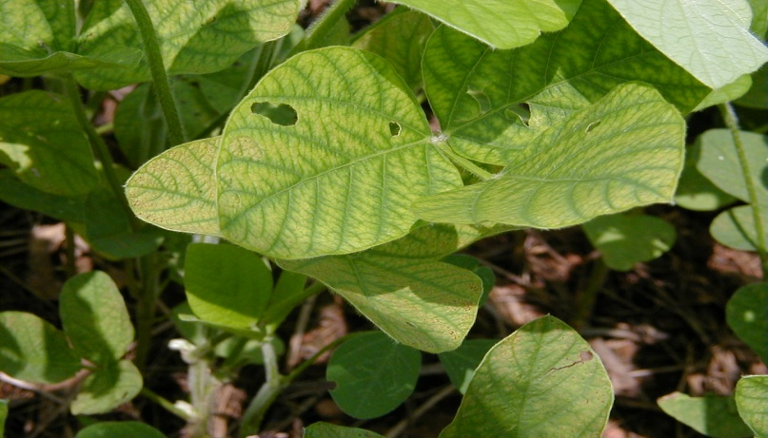
Pesticide drift is…
…the unintentional airborne movement of pesticides outside of the target area.
Glyphosate damage on soybean
Notes:
Before we move into discussing spray drift management, it is always a good idea to make sure everyone knows the language we are using. What is pesticide spray drift? For purposes of this presentation, drift is the unintentional airborne movement of pesticides outside of the target area. The formal definition differs by state. For example, North Carolina regulations define drift as the airborne movement of pesticides off-target causing personal injury, damage to personal property, damage to real property, damage to the environment or any combination of these (adapted from the NC Pesticide Law of 1971). The picture shows damage on soybean from Roundup drift.

Slide 3
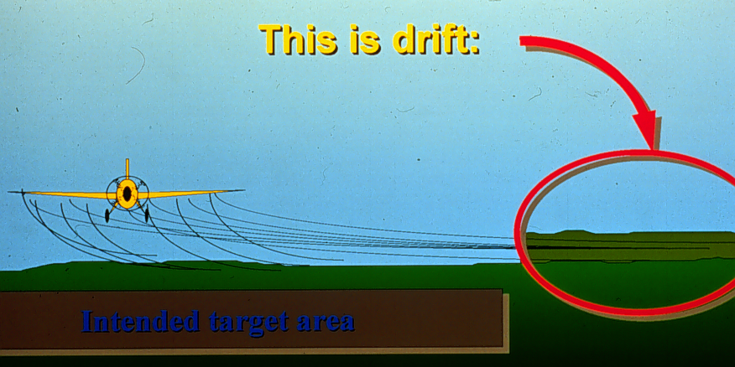
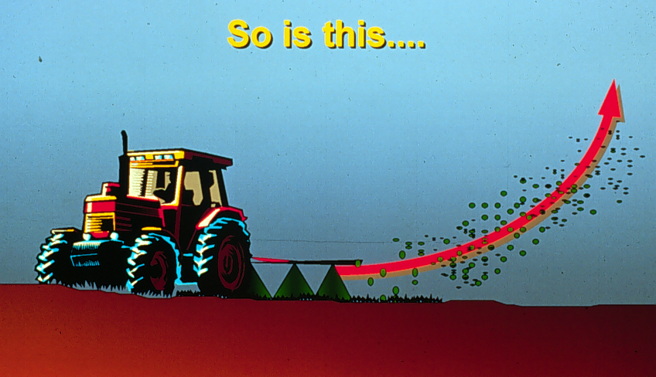
Drift
This is drift…
Intended Target Area
Drift
…so is this…
Notes:
These two diagrams illustrate what can be considered drift. In both of these cases the pesticide spray is being physically moved off-target by wind. In one case, the movement of pesticide particles is sideways and in the other, the movement is upward.

Slide 4
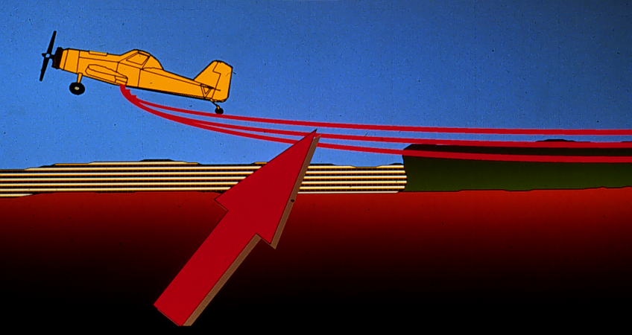
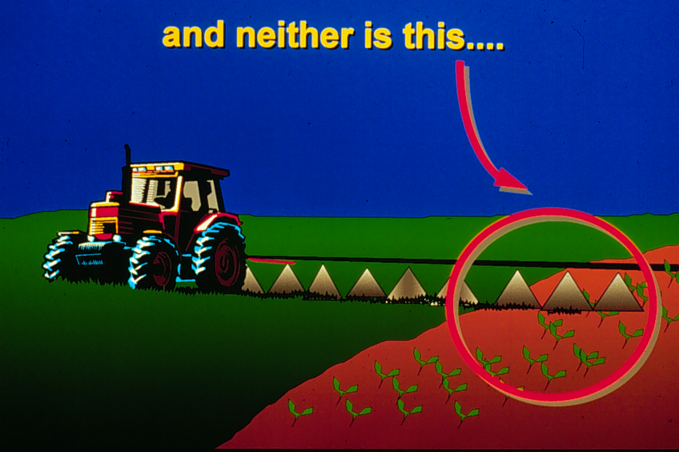
This is not drift…
Non-target
crop
Overspray
Target crop
Applicator Error
Equipment Problems
Overspray
…and neither is this.
Target crop
Non-target crop
Notes:
Here are two examples of what should not be considered drift. Applicator error and equipment problems are to blame for the misapplication in these two cases. The pilot did not shut off his boom at the end of the field and the ground rig operator failed to turn off nozzles that sprayed a non-target area.

Slide 5
Why is drift a problem?
Poor Pest Control
Wasted Chemicals
Damage to Off-Target Sites
Environmental Concerns
  Water Quality
  Air Quality
Public Awareness
Notes:
Why is drift a problem? Give your audience an opportunity to answer and interact with you at this time.
Drift is a problem because:
#1 Drift may result in inadequate pest control. This turns into a time and resource issue if you decide to re-apply the pesticide.
#2 Drift wastes chemicals. Chemicals are expensive and as an applicator, you want the best control for your hard-earned money. Your goal is effective pest control that provides the largest profit.
#3 Drift may cause damage to off-target sites. Friendly, happy neighbors may not be so friendly after damage is done to something of theirs. Applicators may have to pay for damages or worse yet, be forced to pay if North Carolina Department of Agriculture and Consumer Services, Pesticide Division is involved.
#4 Environmental concerns with drift must be considered. Water and air quality is extremely important. As more people move from city to country this becomes a real issue with their concept of quality of life. Which leads into the final issue, #5.
#5 Public awareness. People are very concerned today with what happens around them and how it will effect them.
Drift can have a huge impact on your time and money (clip art is last in the animation sequence).

Slide 6
Should YOU be concerned about spray drift?
Are there drift-susceptible, or organic, crops nearby?
Are you using highly active or nonselective herbicides?
Are there sensitive areas (rural homes, schools, honeybee colonies, surface streams, etc.) close by that you should protect from drift?
Are you trying to avoid litigation or conflict with your neighbors?
Notes:
If the answer to any of these questions is ‘yes’, you should be concerned about drift.

Slide 7

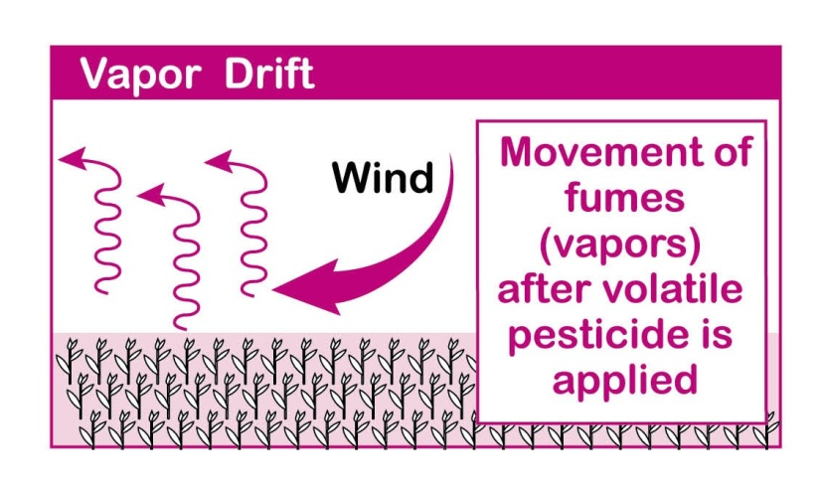
There are Two Types of Drift
1.
…
…and, 2.
Notes:
Before we begin a discussion of the ways to manage drift, it is important to realize that there are two basic types of drift: Particle and Vapor. Particle drift is the one that most people associate with drift, but vapor drift is also important to recognize especially with highly volatile herbicides such as 2,4-D, Banvel, and Command. Is the applicator responsible for vapor drift? Yes. The applicator should be familiar with the product to know if there is a potential for vapor drift. If there is, then steps should be taken to avoid it.

Slide 8
Avoiding Vapor Drift
Follow label directions!
Several active ingredients such as those in 2,4-D, Banvel, and Command are quite volatile and pose harm when the vapor moves off target
  Labels may state cut-off temperatures for application
  Labels may require pesticide to be incorporated into the soil
Temperature
Humidity
Higher
Volatility
=
Notes:
Vapor drift occurs when a pesticide changes to a gas and moves off-target. Precautions are listed on the product label if vapor drift is a concern. This occurs with several herbicides when temperatures warm up during the day. So look for cut-off temperatures listed for certain herbicides. Some labels state “do not apply if temperatures will exceed 85 degrees during the day”. High temperatures and lower humidity levels increase the potential for volatility.

Slide 9
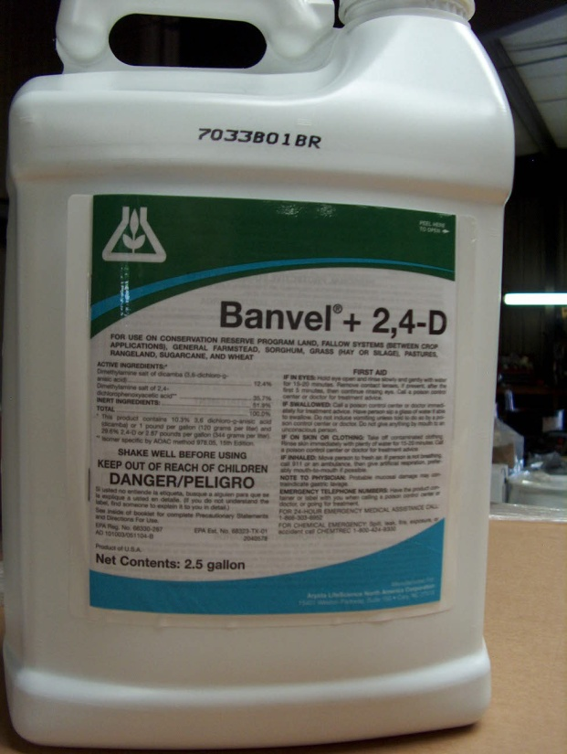
A Co$tly Case of Vapor Drift
From the Piedmont of North Carolina
Grassy area sprayed with broad-leaf herbicide in early July, 2007
6 days later, farmer of neigh-boring tobacco field noticed “2,4-D smell” when checking his field and saw deformed upper leaves
Owner of grassland failed to check directions on label and admitted wrongdoing
Tobacco buyer would not accept 8 acres of affected tobacco

Slide 10
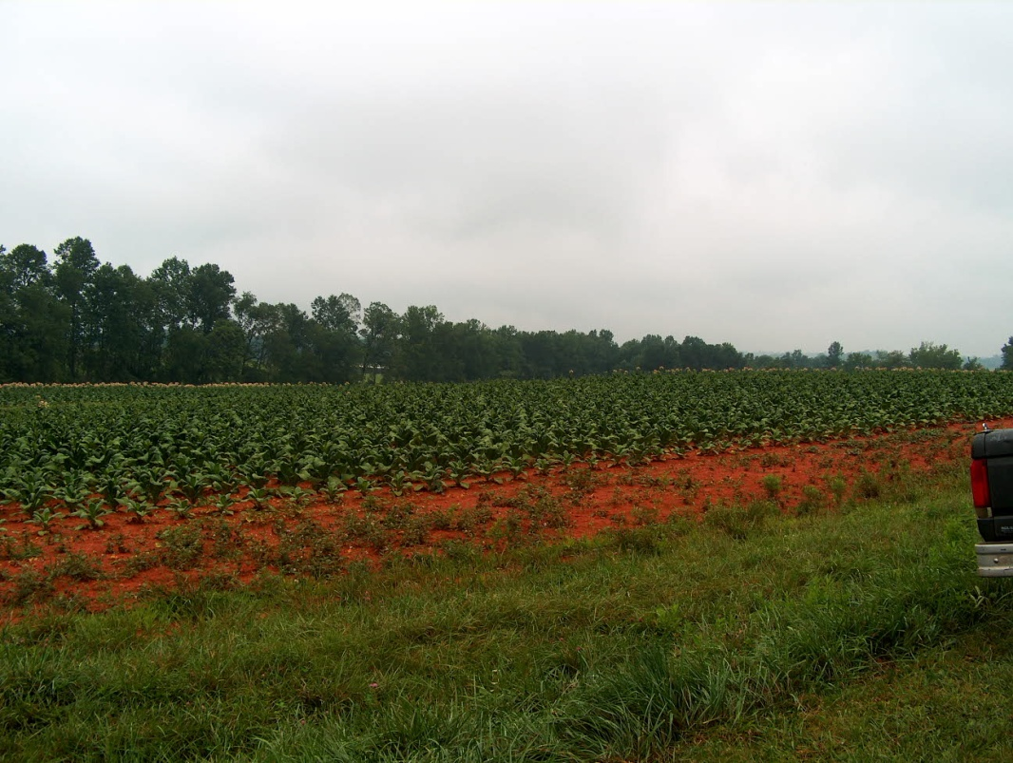
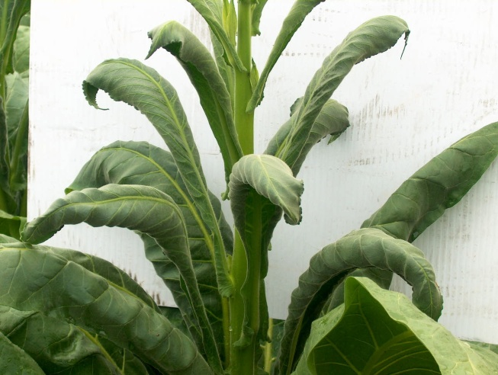
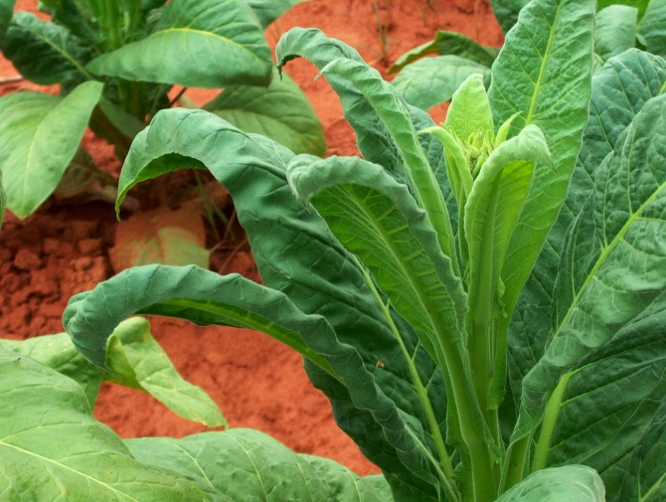
Grassland sprayed with herbicide adjacent to tobacco
Plant damage 50 ft from field edge
Plant damage 400 ft from field edge
Notes:
In these pictures taken by an NCDA Field Inspector, the damage to tobacco is obvious both near and far to the grassland sprayed with Banvel and 2,4-D. It is obvious that vapor drift has far-reaching (and costly) effects. Read and follow the label directions to avoid vapor drift!

Slide 11
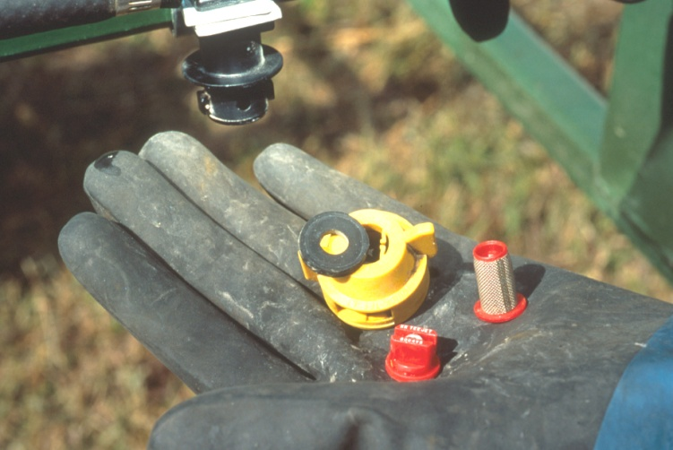
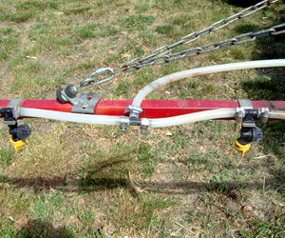
Factors Affecting Particle Drift
Equipment and Application
  Nozzle Type
  Nozzle Size
  Nozzle Pressure
  Boom Height
Notes:
What factors affect Particle drift?
Equipment and application factors such as nozzle type, size, pressure, and distance from the target (boom height) are critical.

Slide 12
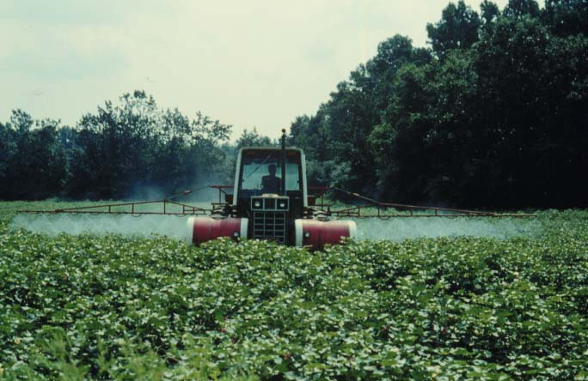
Factors Continued
Spray Characteristics
  Droplet size
  Chemical
  Formulation
  Additives
Notes:
Spray characteristics also affect drift. What droplet size will be most effective in managing the pest and minimizing drift? Some formulations may drift easier than others. Which one do you really need for the application at hand? Does the label require additives?

Slide 13
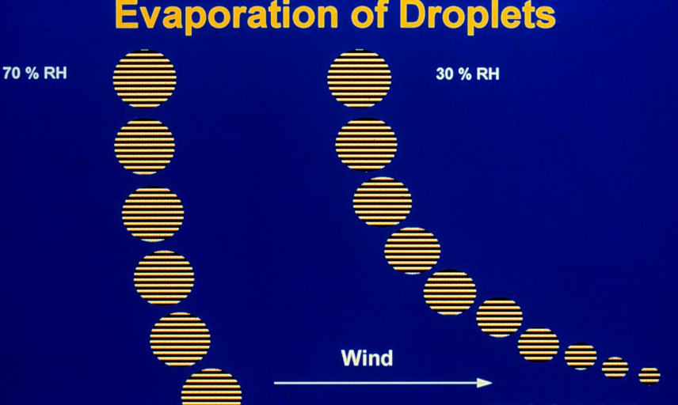
Factors Continued
Weather
  Wind
  Temp.
  Humidity
  Inversions
Humidity effects on droplet size
70% RH
30% RH
Notes:
Weather is another factor you must face. At times weather is not predictable, but weather reports may help in the planning process. What is the wind speed and direction? What temperature is expected? As temperature increases, droplets evaporate into smaller droplets. What is the humidity? (See diagram) Low humidity can increase the evaporation rate of the water in the spray droplet which leads to a smaller droplet size and more drift potential. Inversions may be an issue. We’ll talk about this in greater depth later.

Slide 14
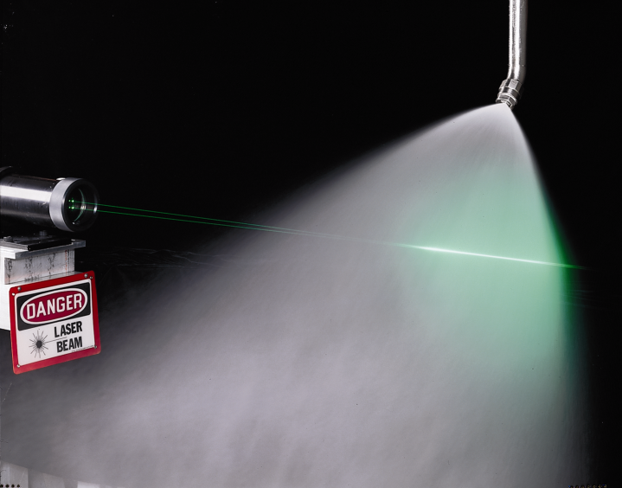
Drift and Droplet Size Relationship
All nozzle tips produce a range of droplet sizes that depend on the size of the nozzle tip opening and nozzle pressure
Spray droplets are measured in microns using laser beams
One micron (μm) =1/25,000 inch
Human hair is 100 microns in diameter
Notes:
Although weather factors such as wind are usually the first things that come to mind when thinking about drift. The most important factor relating to drift is droplet size. During application, the pesticide spray mixture is broken into spray particles or droplets of various sizes as it leaves the nozzle tip. The size of the droplets varies by the size of the nozzle tip opening and pressure. The smaller droplets are the major contributors to drift. Droplet size is measured in microns using a laser beam.

Slide 15
Volume Median Diameter
The “Midpoint” of the range of droplets formed from a single nozzle where half of all the droplets are larger and half are smaller is called the Volume Median Diameter (VMD)
VMD is an important indicator of the potential for drift and successful pest control.
VMD
50%
less
than
VMD
50%
greater
than
VMD
50% of the volume of
liquid in all the droplets
from one nozzle is
less than the VMD
50% of the volume of
liquid in all the droplets
from one nozzle is
greater than the VMD
Notes:
An important term relating to droplet size or the range of droplets formed from a nozzle is Volume Median Diameter. VMD is the “midpoint”…

Slide 16
Pesticide Effectiveness is
Based on Droplet Size
Droplet Class
VMD range
Pesticide Application
Very Fine
Fine
Medium
Coarse
Very Coarse
<119
119-216
217-353
354-464
>464
Insecticides
and Fungicides
Herbicides and
Postemergence
Soil Applications
of Herbicides
Notes:
As seen in this slide, the classification of droplet size (e.g., very fine, fine, etc.) is associated with a particular VMD range. Droplet size is important for pesticide effectiveness. For example, fine droplets are for post-emergence applications that require excellent coverage on leaf surfaces or for contact on the body of an insect. Medium to coarse droplets are used for systemic herbicides and pre-emergence surface applied herbicide.

Slide 17
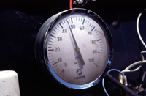
Droplets: Large vs. Small
Large Droplets: less potential to drift
  Fall more quickly
  Evaporate more slowly
  Are less affected by wind
Small Droplets result from:
  High spray pressure
  Small nozzle tips
  Wind shear across the nozzles (aerial)
Notes:
Droplet size matters in the potential for drift as well. The larger the droplet size, the less likely drift will occur. Large droplets fall more quickly to the ground, evaporate more slowly, and are less affected by wind. Small droplets have a greater potential to drift. They are a result of high spray pressure, small nozzle tip openings and wind shear across the nozzles.

Slide 18
The bigger they are the faster they fall…
Droplet | Width (in μm) | Time to fall 10 feet | Travel distance in 3 mph wind
Fog | 5 | 66 min | 3 miles
Very fine | 20 | 4 min | 1100 ft
Fine | 100 | 10 sec | 44 ft
Medium | 240 | 6 sec | 28 ft
Coarse | 400 | 2 sec | 8.5 ft
Xtra Coarse | 1,000 | 1 sec | 4.7 ft
Source: Akesson and Yates, 1964, Annual Rev. Ent.
Notes:
This table shows the impact of droplet size on drift. Large droplets are heavier and less likely to move off-target because they fall to the ground faster than small droplets. Small droplets tend to stay in the air for awhile prior to the effects of gravity causing them to settle to the surface. With a 3 mph wind, medium size particles can move about 30 feet from the intended target. Droplet sizes below 150 microns (fine, very fine) should be avoided because they can move much farther. You can manage drift by managing the droplet size. The next slide will show how nozzle manufacturers use color coding to specify droplet size.

Slide 19
Color Codes for Droplet Size
Category | Symbol | Color Code | Approximate VMD Range
Very Fine | VF | Red | < 150
Fine | F | Orange | 150 – 250
Medium | M | Yellow | 250 – 350
Coarse | C | Blue | 350 – 450
Very Coarse | VC | Green | 450 – 550
Extremely Coarse | XC | White | > 550
Notes:
This is an example of how droplet size is categorized. Droplet sizes are color coded as: very fine (red), fine (orange), medium (yellow), coarse (blue), very coarse (green), and extremely coarse (white) The colors note an approximate VMD range.

Slide 20
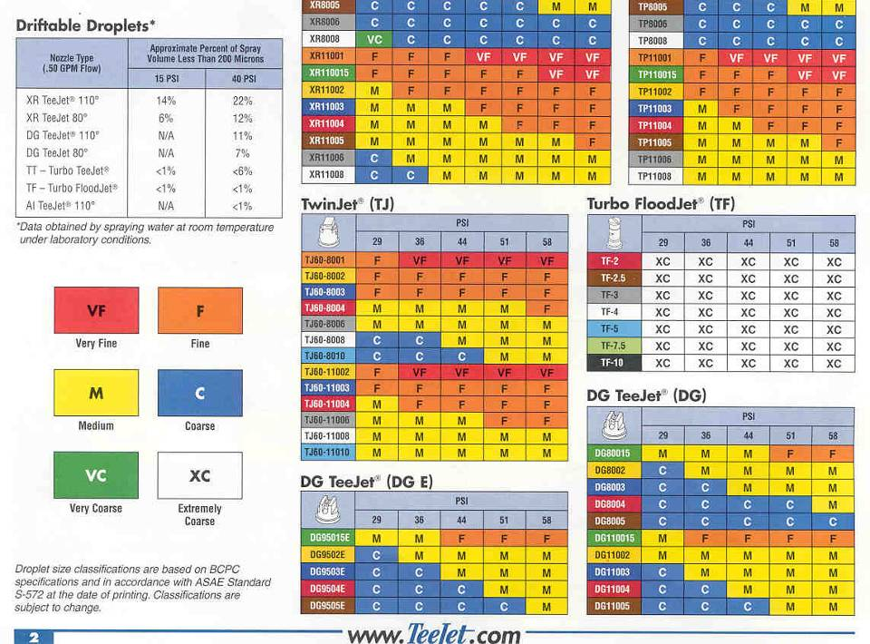
Notes:
Fortunately, you don’t need to get hung up on microns or VMD when selecting an appropriate nozzle. Nozzle suppliers like TeeJet make it easy for you to distinguish droplet sizes with the color coding system described in the previous slide. Here the yellow M indicates medium sized droplets and blue indicates coarse sized droplets. The chart shows what nozzle type, size and corresponding pressure gives what droplet class. Some labels specify the droplet size class you must use.

Slide 21
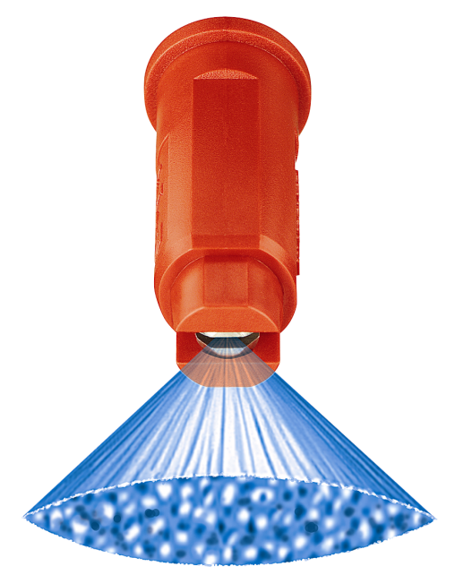
AI TeeJet™
(Air Induction)
Notes:
This slide shows the range of droplets from 6 different air induction nozzles (left column) under various nozzle pressures. Medium-sized droplets are produced under the highest pressures and extra coarse with lower pressure. This is what makes the AI nozzle a powerful drift reducing tool. We’ll discuss more about drift reducing nozzle tips later.

Slide 22
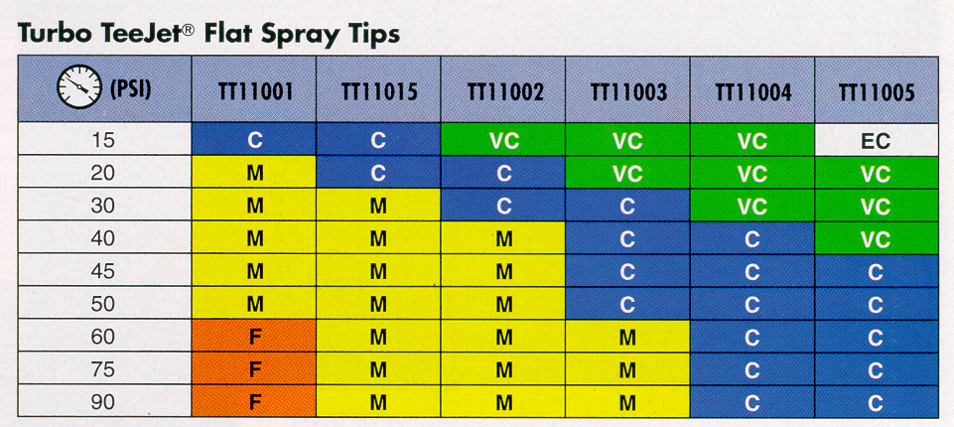
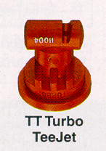
Choosing nozzles by droplet size
Notes:
This slide shows an example of the droplet sizes produced by a Turbo TeeJet nozzle at varying pressures. The blue and green shaded areas are coarse and very coarse droplet ranges. Notice that as the nozzle output decreases (top row from Right to Left) and pressure increases (first column top to bottom), the droplet size gets smaller. As we saw in an earlier slide, a smaller droplet size may be desirable. Most fungicides and insecticides require small droplets to achieve the coverage necessary for effective control. Consult the pesticide label for specific recommendations.

Slide 23
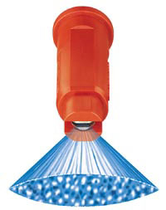
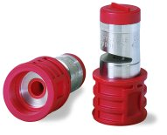
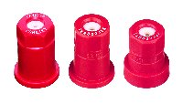
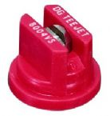
Nozzle Output
Nozzles are color coded by output
  All “red” nozzles pictured here have a 0.4 gallons per minute output at 40 PSI.
Notes:
Do not confuse the color coding of the droplet sizes as shown in nozzle suppliers catalogs in previous slides to color coding for NOZZLE OUTPUT. As you see here, these nozzles are all different. However, they do have one thing in common, the color red. All “red” nozzles from this company are nozzles that have a 0.4 gallon per minute nozzle capacity rated at 40 PSI. This differs from the colors used for droplet size categories.

Slide 24
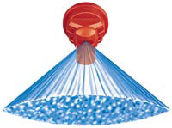
Nozzle Knowledge
Match nozzle type to the application at hand
  Type of pesticide (herbicide, insecticide, fungicide…) and whether its action is contact or systemic (coverage)
  Time of application
    PRE or POST
  Operating Pressure
  Susceptibility to drift
Notes:
Because one of the main functions of the nozzle tip is to create various droplet sizes in a pattern, and because droplet size is the most important factor in contributing to drift, it makes sense (actually dollars and cents) to choose tips wisely for each pesticide application. This is a drift management factor that YOU can control. It bears repeating that droplet size is also important for effective pest control. Therefore, you need to match the nozzle type and size to the application at hand. See list for factors to consider.

Slide 25
Choose Nozzles to Manage Pests & Drift
The “Nozzle Compromise”: Using nozzles and pressure to produce the largest droplet size possible (> 150 microns) while achieving good target coverage sometimes involves a tradeoff.
Notes:
To manage drift, you want the largest droplet size possible. Sometimes this will involve a compromise. While larger droplets reduce drift potential, they may also reduce the effectiveness of the pesticide application. Advances in nozzle technology have helped to overcome this compromise.

Slide 26
Drift reducing nozzle tips
Low pressure (extended range)
Pre-orifice
Pre-orifice and turbulence chamber
Air-induction
Notes:
In fact, technological advancements in the last 20 years have made available an array of nozzle tips that produce drift-resistant droplets at a wide range of pressures. In general, these tips fall within one of the four categories listed here.

Slide 27
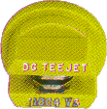
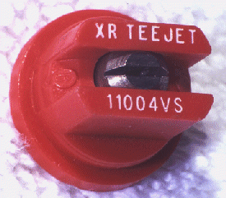
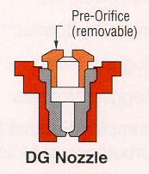
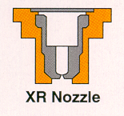
Low Pressure and Pre-orifice Nozzles
Extended Range
Drift Guard
Notes:
Here are two examples of nozzles that can be used to reduce drift. To manage for drift with conventional nozzle tips, you typically use lower pressures. However, if the pressure is too low (or too high), the spray pattern is distorted. The Extended Range flat fan nozzle tip can be used at lower pressure to create large droplets while retaining the flat fan pattern for uniform coverage. One of the first, low drift nozzles produced is the Drift Guard. This nozzle has a pre-orifice that reduces internal pressure to form larger droplets with fewer drift-prone ones.

Slide 28
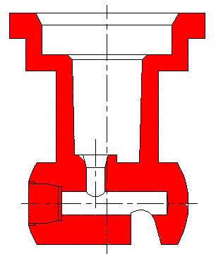
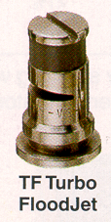
Turbulence Chamber Nozzles
Turbo TeeJet has a pre-orifice to create pressure drop and turbulence to slow liquid velocity
Notes:
Turbulence chamber nozzles have an internal chamber that absorbs energy within the tip. It maintains its pattern over a wide pressure range (15-90 psi). It is available in both the flat fan and flooding tip designs pictured in this slide.

Slide 29
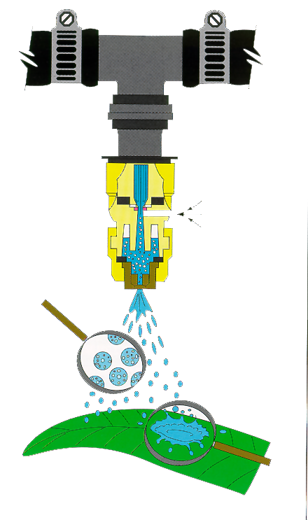
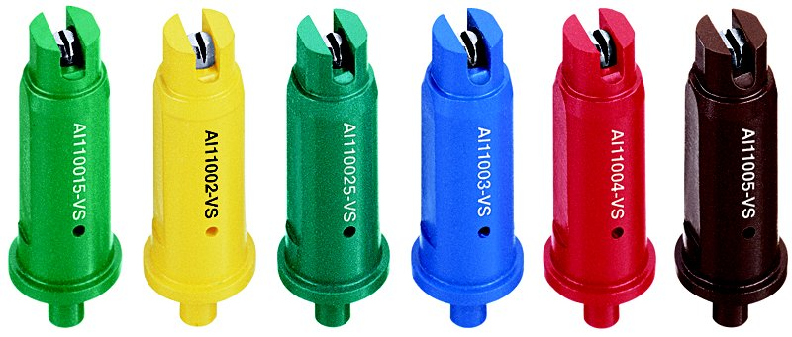
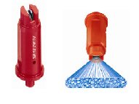
Air Induction Nozzles
Air Induction nozzles produce air-induced, larger droplets that “splatter” on contact.
Notes:
The air induction nozzle has a small hole on the side that allows air to move into the nozzle. The air and spray solution is mixed and then discharged. The large droplet splatters on contact.

Slide 30
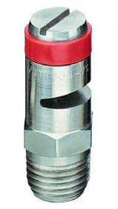
Massive Droplets
The TurfJet is a low-drift nozzle that is suitable for pre-emerge, soil incorporated applications.

Slide 31
Tip to Tip Comparison
1200
XR11006
1000
XR8006
TT11006
800
AI11006
TF-3
VMD
600
1/4TTJ-06
400
200
0
40 psi Pressure
Notes:
This chart shows the differences in droplet size (as measured by Volume Median Diameter) between 6 low drift nozzles at constant pressure. The XR11006 (Extended Range, 110 degree spray angle, 0.6 gallons per minute output) produces the smallest droplets of the 6 tips. The XR8006 (Extended Range, 80 degree spray angle, 0.6 gallons per minute output) produced slightly larger droplets which is expected from the narrower spray angle. The Turbo TeeJet (TT11006), Air Induction TeeJet (AI11006), Turbo FloodJet (TF-3), and Turbo TurfJet (1/4TTJ-06) produce progressively larger droplets in the Very Coarse to Extremely Coarse range. This is convincing proof of the influence of nozzle design in reducing the volume of small, drift-prone droplets.

Slide 32
Chemical Drift Retardants
Drift control agents
Check on compatibility
May affect nozzle pattern
Effective?
Notes:
To increase droplet size, you also may want to consider adding drift control agents to the tank. These chemicals are designed to increase the number of larger droplets or reduce droplet evaporation. They will also, however, reduce coverage of the plant surface, so be sure to use these adjuvants according to directions on the pesticide label. Some work well with one active ingredient, but not with others. Some spray retardants may distort the pattern of air-induction nozzles. Generally speaking, the “jury is still out” on their effectiveness.

Slide 33
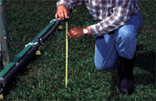
Boom Height
“Lower the boom”
  Shorter the distance a droplet has to travel, the less chance for drift
  Be careful to stay within manufacturer’s guidelines
Notes:
An important equipment factor contributing to drift is the distance between the nozzle and the target. Boom height directly affects how long spray droplets stay airborne. Drift potential is reduced when the boom is closer to the target. Of course, boom height can dramatically affect the spray pattern and coverage. Follow manufacturer guidelines for the spray tips and nozzle spacing you are using.

Slide 34
More Keys to Drift Management
Avoid adverse weather conditions
  Wind speed and direction
  Inversions
  High temps.
Know the location of all sensitive areas
  No-spray buffer zone
Notes:
Outside of equipment selection and use, most factors that contribute to drift are out of your control, but critically important to recognize before deciding to spray. These include the weather and location of sensitive areas. Wind and temperature inversions will be covered in more depth later. Do not spray when temperatures are high. As temperatures increase, droplets evaporate into smaller droplets which affects the ability of the product to get down into the treatment area. Know the location of all sensitive areas. These areas should always be separated from spray areas by a no-spray buffer zone.

Slide 35
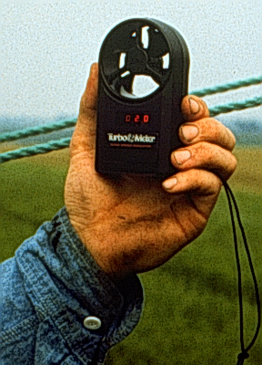
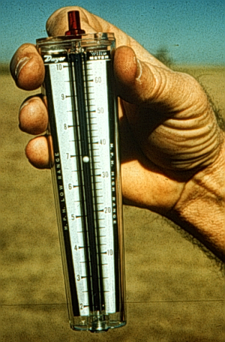
Don’t Get Blown Away!
Drift potential usually increases with increasing wind speed.
However, many factors (droplet size and boom height) can influence drift.
The effects of wind are reduced if small droplets are minimized and the application is made at the proper height.
Use a wind gauge and avoid spraying in winds above 10 mph.

Slide 36
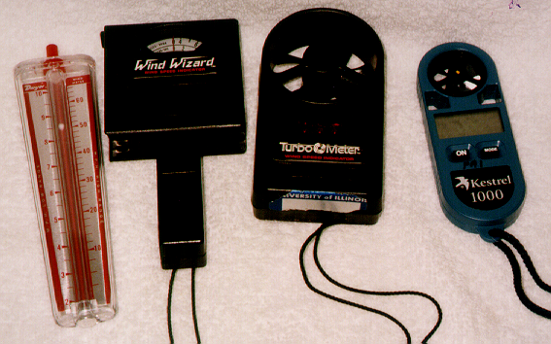
No room for guessing
Difficult to “guess” wind speed
Use a wind meter for most accurate results
Local weather station (or radio station) is a guide, but conditions can vary in a short distance
A wind meter is a sound investment for good recordkeeping
Notes:
An investment in a simple wind-speed gauge is highly recommended. Various, inexpensive wind meters are shown here. A reading with one of these devices at the application site is the best determination of whether or not the application should proceed. The conditions at the local radio station or airport are not the same as the conditions in the field and should not be used to determine if the application should take place. Record the wind speed and direction for all of your applications.

Slide 37
Which way is the Wind Blowing?
Wind direction is very important
Drift potential is lowest at wind speeds between 3 and 10 mph (gentle but steady breeze) blowing in a safe direction away from sensitive areas.
“Dead calm” (0-3 mph winds) conditions are never recommended.
Notes:
The wind direction during a spray application is very important. Spray when the breeze is gentle, steady, (between 3 and 10 mph) and blowing away from sensitive areas. Dead calm conditions are never recommended because of the likelihood of temperature inversions.

Slide 38

Be Aware of Temperature Inversions
Occurs when air is STABLE
    air at ground has cooled (heavier air)
    warm air has risen (lighter air)
Warm Air
Cool Air
result is stagnant, stable air = inversion
long distance drift can result from
applications made during inversions
Notes:
Applying during a temperature inversion can result in very damaging, very long distance drift. Inversions occur when warm air, that is light, rises upward into the atmosphere and the cool air, that is heavy, settles near the ground. With these conditions of warm air above cool air, there is no mixing of air, so the air is stable. With stable air, the droplets that drift are not dispersed but stay in a concentrated mass and move with any subtle air flow. Just this year, a contracting spray company treated several corn fields in the Piedmont with an herbicide and it migrated over one mile away causing damage to tobacco fields. The company paid for the damages caused.

Slide 39



When can a temperature inversion occur?
Can occur anytime
Usually develops at dusk
May continue through night
Breaks up when ground warms up in morning
It may appear ideal, but is not
Notes:
Temperature inversions can and do occur at anytime, especially in hilly or mountainous terrain. They typically form at dusk as the sun sets and the cool air settles. Inversions often continue through the night and don’t break until the sun is up and starts to warm the ground. Once the ground warms, the cool and warm air start to mix. The major problem with inversions is that applicators perceive little wind or air movement and assume this is a good time to spray. In actuality, it’s the worst time. If an application is made just as an inversion sets in, let’s say at 4 pm and it doesn’t break until 9 am; that allows for droplets to move with any airflow for 17 hours. With a half mile an hour wind, droplets could move in a concentrated mass for 8.5 miles.

Slide 40
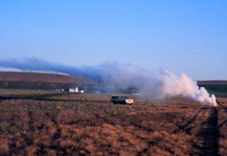
Stable Air Conditions:
Temperature Inversion
G.Thomasson and C. Ramsay, WSU
Notes:
Smoke is a good indicator of air stability or inversions. You can easily visualize the concentrated mass of smoke particles moving here. If these were spray droplets, they would travel for miles.

Slide 41
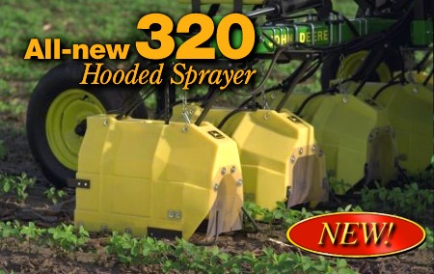
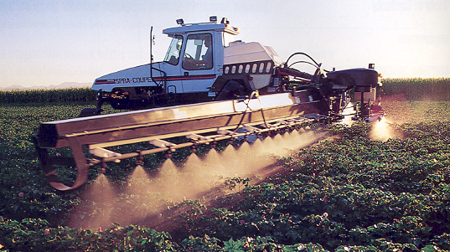
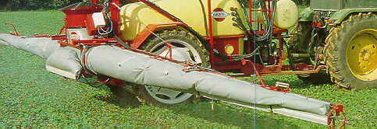
Costlier Pursuits of Drift Reduction
Consider using these sprayer technologies:
  Spray Shields
  Electrostatic Sprayers
  Air-assisted Sprayers
1.
2.
3.
Notes:
As a final note on equipment and drift management, this slide depicts some of the technology that is being used in conjunction with low drift nozzles. Hoods and protective shields are used to help minimize spray drift. Individual row hoods are also used to protect sensitive crops from application of certain herbicides between the crop rows. Electrostatic sprayers have been developed for spraying agricultural chemicals. The electric charge given to the spray mixture enhances its attraction to plants and the ground. Air-assist sprayers are popular for applications of fungicides and insecticides in heavy crop canopies. They are designed with either a solid tube or canvas bag that will distribute high volumes of air along the boom. Openings along the boom allow the air to be directed at the crop canopy.

Slide 42
Summary
Drift management depends on proper planning and decision making
Choose the right tip and pressure.
  The goal is to get the largest droplets without sacrificing good target coverage.
  Drift reducing nozzles do not eliminate drift, they only reduce it.
Lower the boom as far as possible
Assess weather conditions
  Deciding not to spray or stopping in the midst of poor spraying conditions is the best way to prevent drift!

Slide 43
In Conclusion
You have the most important role
in lessening spray drift problems.
Do your part to keep agrichemical
applications on target.

Slide 44
Acknowledgments
  Western Crop Protection Association; D. Gardisser & P. Spradley, Univ. of Ark; and, R. Wolf, Kansas State Univ.
  Spraying Systems Co.
  Brent Prignitz, Iowa State University
  Carol Ramsay, “Applying Pesticides Correctly” training materials, Washington State University
  Choosing Drift-Reducing Nozzles, Vern Hoffman and Jim Wilson, South Dakota State University

Slide 45
Disclaimer
Brand names appearing in this presentation are for identification and illustration purposes only.
No endorsement is intended, nor is criticism implied of similar products not mentioned.

