Slide 1
Bee Aware!
What You can do as a Private Pesticide Applicator
to Safeguard Bees from Pesticide Poisoning.
A presentation for the Private Applicator Recertification Program, 2015-2017.
By Bill Skelton, Haywood County Cooperative Extension and Wayne Buhler, NC State Univ.
Photo Source: CrystalGraphics.com

Slide 2
Introduction This presentation will help you understand:
The importance and status of pollinators
How pesticide applicators can help protect pollinators
How pesticides can be used to control pests with minimal risks to pollinators
The potential effects of treating crops during the flowering period of the crop and adjacent blooming crops and plants

Slide 3
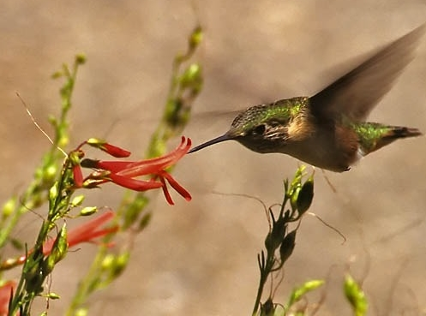
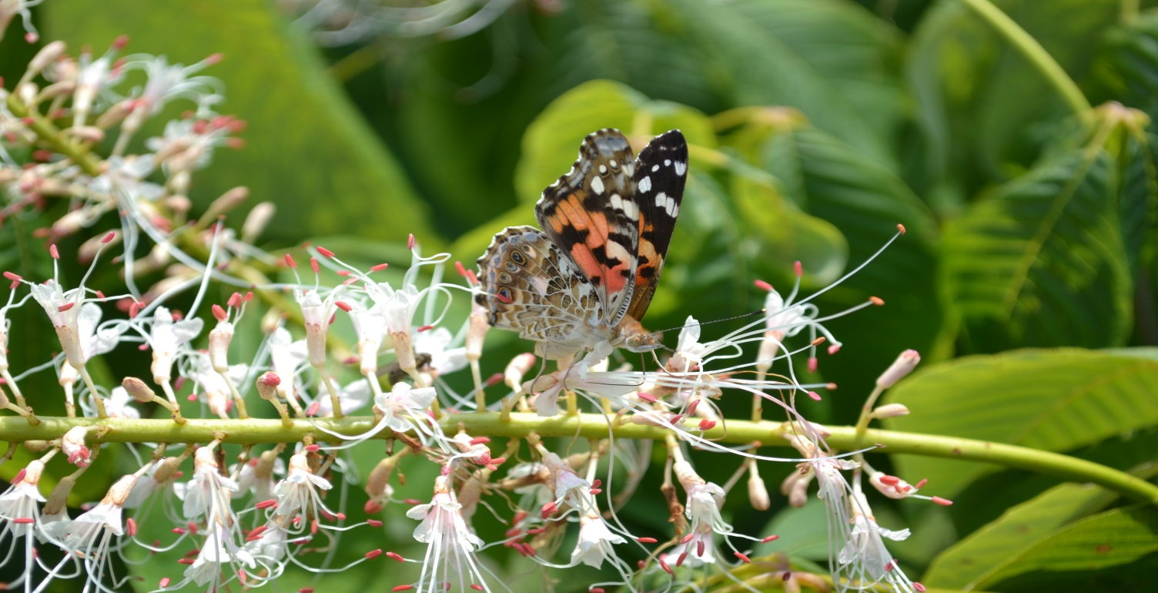
Why care about pollinators?
80 % of all flowering plants require animal pollinators
Wild lands and the environment – the value is incalculable
Tom Butzler, Penn State Extension
Notes:
The value of pollinators to our environment is incalculable. Pollinators visit flowers in search of pollen and/or nectar, and in the process, the pollen grains often stick to their bodies and are carried from flower to flower. In this way, they facilitate the process we call pollination.

Slide 4
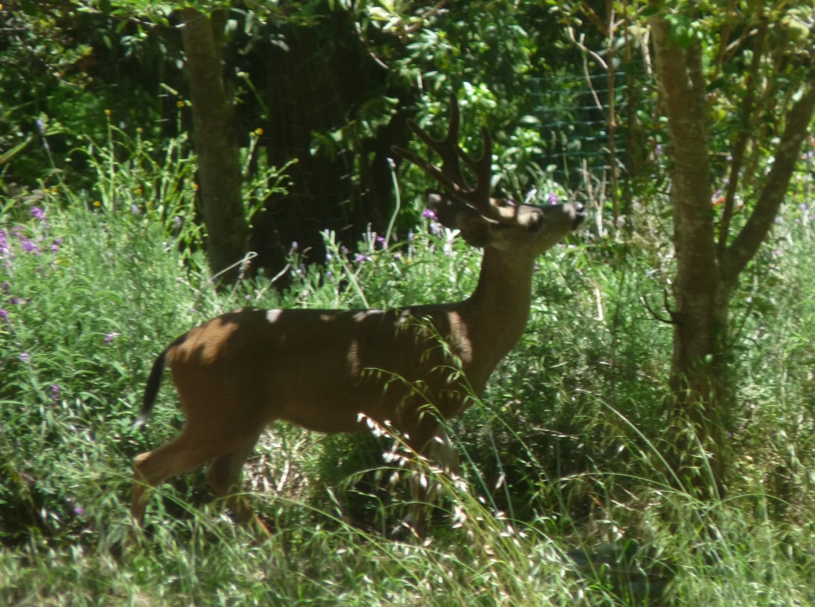
Why care about pollinators?
--Fruit and seed production needed for the survival of the majority of flowering plants in our environment.
Food for wildlife
Song birds
Wild turkeys
Sage grouse
Bear
Deer
Elk
Notes:
Without pollination, seed and fruit production in animal-pollinated plants can not be successful, not only for our food crops, but for wildlife diets, too.

Slide 5
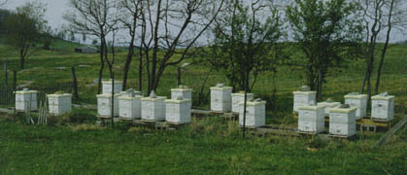
Importance of Pollinators
Essential to the production of more than 90 crops in the U.S.
1 out of every 3 bites of food we eat daily
can be attributed to pollinators.
Notes:
Humans depend on pollinators for our well being. An estimated 1 out of every 3 bites of food we eat each day result from the work of pollinators.

Slide 6
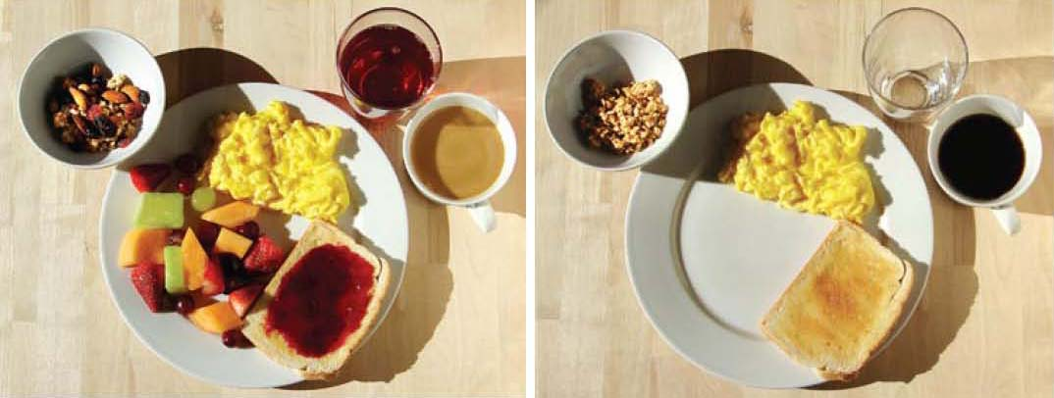
Your breakfast without bees
Your breakfast
with bees
Scientific American April 2009
Value of crops in US that depend on pollination: >$18.9 billion
$217 billion worldwide
Source: Scientific American ‘09; M. Spivak, UMinn
Notes:
Case in point: your breakfast with and without bees.

Slide 7
Your Grocery Store Without Bees
Marla Spivak, UMinn
Notes:
Undoubtedly, our grocery store shelves would look quite different without bees pollinating our crops. We are left with mostly grains and starches.

Slide 8
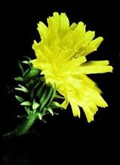
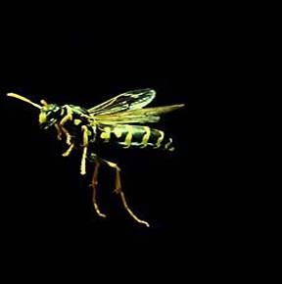
The Wild World of Pollinators
Insects are the most common and abundant
Honey bees
Bumble bees
Blueberry bees
…and also
Butterflies
Beetles
Flies
even, Wasps
When a pollinator is visiting a bloom in search of
nectar (carbohydrate) and pollen (protein), it is called “foraging.”

Slide 9
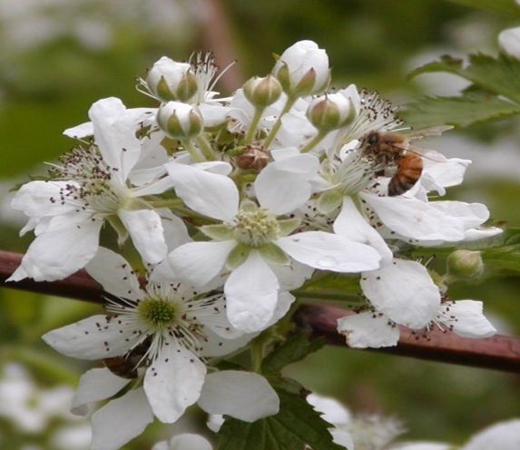
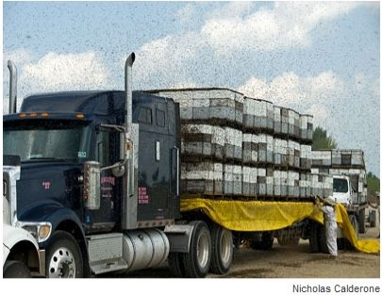
Champion Pollinator of Food Crops: The European Honey Bee
Honey bees are relied on to perform most of the commercial pollination.
Tom Butzler, Penn State
A truckload of honey bee colonies is delivered for blueberry pollination in Maine
Notes:
Honey bees are the most important pollinator for food crops

Slide 10
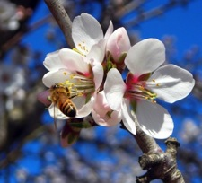
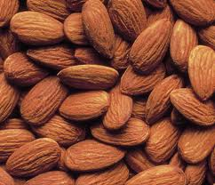
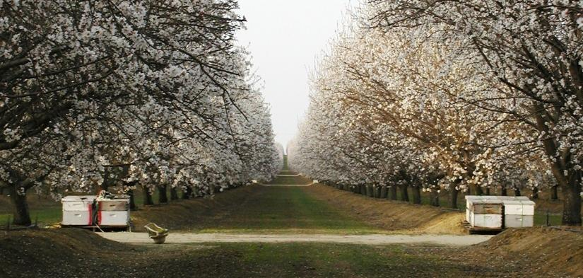
750,000+ acres of almonds in Central CA require 1.5 million colonies of honey bees for pollination
Photo source: Coy’s Honey Farm
No Bees, No Nuts
Slide source: M. Spivak, UMinn
Notes:
Some crops, like almonds, are completely dependent upon honey bees for pollination. 80% of the world’s supply of almonds comes from California.

Slide 11
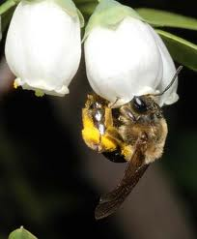
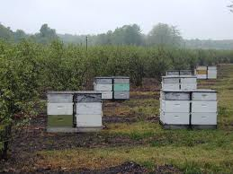
72,000 acres of blueberries across U.S. require 150,000 colonies of honey bees for pollination
90% of the pollination of blueberries is done by honey bees!
Slide source: M. Spivak, UMinn
Notes:
One of NC’s most important crops, blueberries, also requires honey bee pollination.

Slide 12
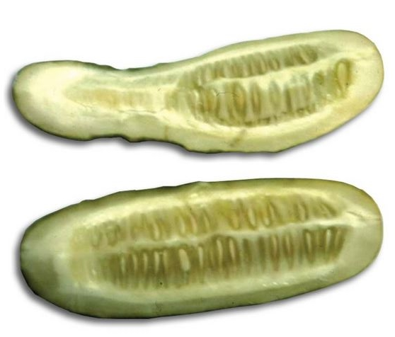
Why care about pollinators?
In NC…
Apples
Blueberries
Cucumbers
Squash
Pumpkin
Watermelon
Strawberries
Peaches
Blackberries
Raspberries
Others
A partially pollinated cucumber (top) compared with a completely pollinated one (bottom). The seed did not form throughout the poorly pollinated cucumber and consequently the fruit did not grow around that portion.
Notes:
Besides blueberries, other important crops grown in NC are highly or somewhat dependent on honey bees for pollination. For some crops, like cucumbers, lack of honey bee pollination causes misshapen or underdeveloped fruit.

Slide 13
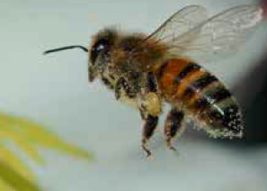
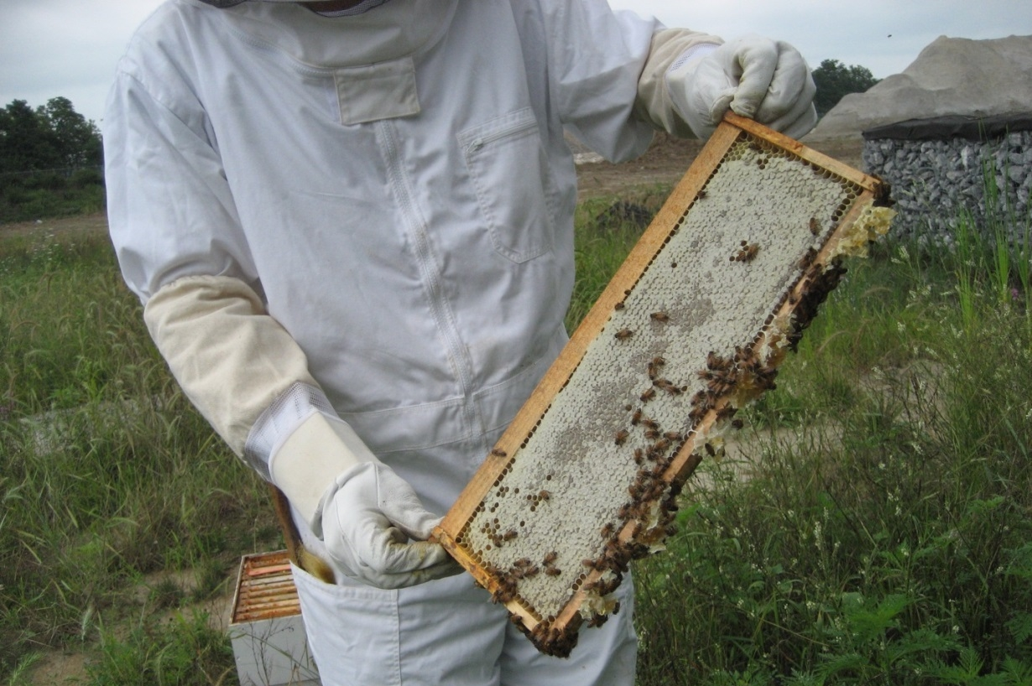
What is the current status of pollinators?
2013-2014 Honey Bee Overwintering Losses – 23.2% died over the winter (an unsustainable number)
-USDA /Bee Informed Survey
Notes:
Some pollinators, such as bees, are suffering losses both in population sizes and in species numbers. This is putting stress on our ability to produce food and ensure environmental stability.

Slide 14
Causes of pollinator decline??? Several possible factors or a combination of them
Source: Marla Spivak, Univ. of MN
Notes:
It is believed that pollinator (especially, honey bee) declines can be caused by a combination of factors including predatory mites and parasites, pathogens, nutritional stress, and pesticides, though the exact combination and impact of each factor remains uncertain.
As you might imagine, pollinators can be highly sensitive to many pesticides, especially insecticides.

Slide 15
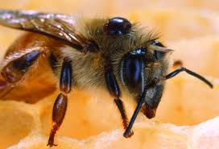
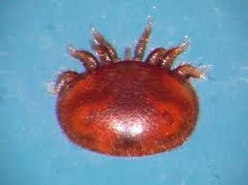
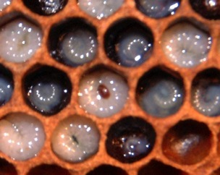
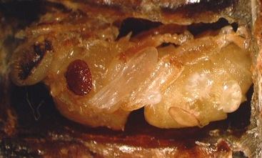
Varroa mite is the chief menace
Large mite sucks bee blood
Circulates bee viruses
Mite feeding on adult bee
Mite feeding on immature bees (brood)
Photo Source: M. Spivak, UMinn
Notes:
The Varroa mite is a large mite that behaves much like a tick. It sucks the blood of adult and immature bees. Immature bees are called brood. The mite is also capable of passing several viruses as it feeds.

Slide 16
Questions
Why is it important to protect pollinators?
Humans are highly dependent on pollinators for crops
Many plants need animal pollinators
Pollinators are important for wildlife
All of the above
Notes:
d) All of the above

Slide 17
Questions
Which of the following foods depend on animal pollination?
Apples
Blueberries
Cucumbers
Wheat
Notes:
a), b), and c)

Slide 18
Questions
In addition to honey bees, what other animals can pollinate flowers?
Butterflies
Birds
Bats
Flies
Cattle
Notes:
All but cattle

Slide 19
Questions
What are the factors affecting pollinator health?
Mites and parasites
Nutrition and forage
Pesticides
A combination of these and/or other factors
Notes:
d. is correct

Slide 20
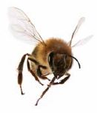
Pesticide applicators can help by reducing risks to honey bees and other pollinators
Understand How Pesticides Can Harm Bees
Recognize Pollinator Foraging Habits
Read the Label
Use IPM
Follow Best Management Practices
Notes:
As a pesticide applicator, it’s important that you understand how pesticides can harm bees, recognize the daily habits of bees, read the label to help select appropriate pesticide materials, and consider application methods and strategies (such as IPM and BMPs) to minimize exposure to bees.

Slide 21
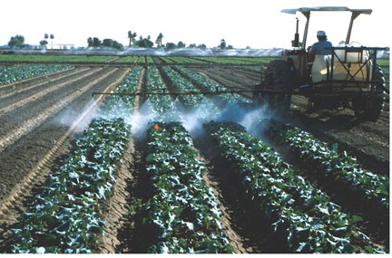
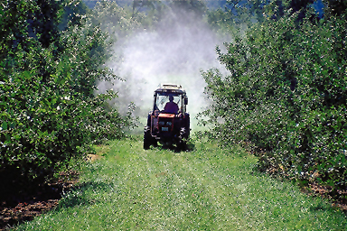
Did You Know?
Most pesticides are not toxic to honey bees and other pollinators.
As a general rule, insecticides are more toxic to pollinators than fungicides and herbicides.
However, not all insecticides are toxic to pollinators.
UMinn

Slide 22
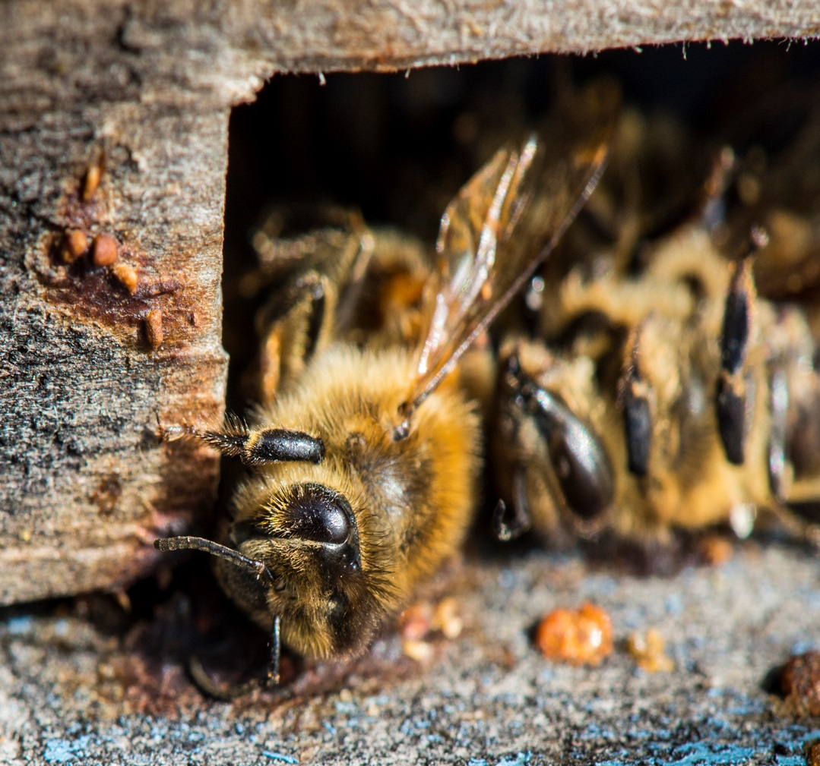
Pollinator poisoning can occur from:
Direct exposure during application
Residues picked up through foraging (pollen and nectar) and taken back to the hive
Residues from non-crop plants (ground cover, field edges, ditches, etc.)
iStockphoto.com
Notes:
Those pesticides that are toxic to bees can cause harm in one or more of the following ways: Direct Exposure; Residues picked up through foraging; and, Residues from non-crop plants. It is very important to understand that in addition to honey bees, there are hundreds of species of native bees that live in the ground or in stems. On some occasions, honey bee colonies can be moved to protect them (although that is not feasible for most beekeepers and in most situations), but the native bees remain and are more affected by bee-toxic pesticides because they are mostly solitary and get a direct dose.

Slide 23
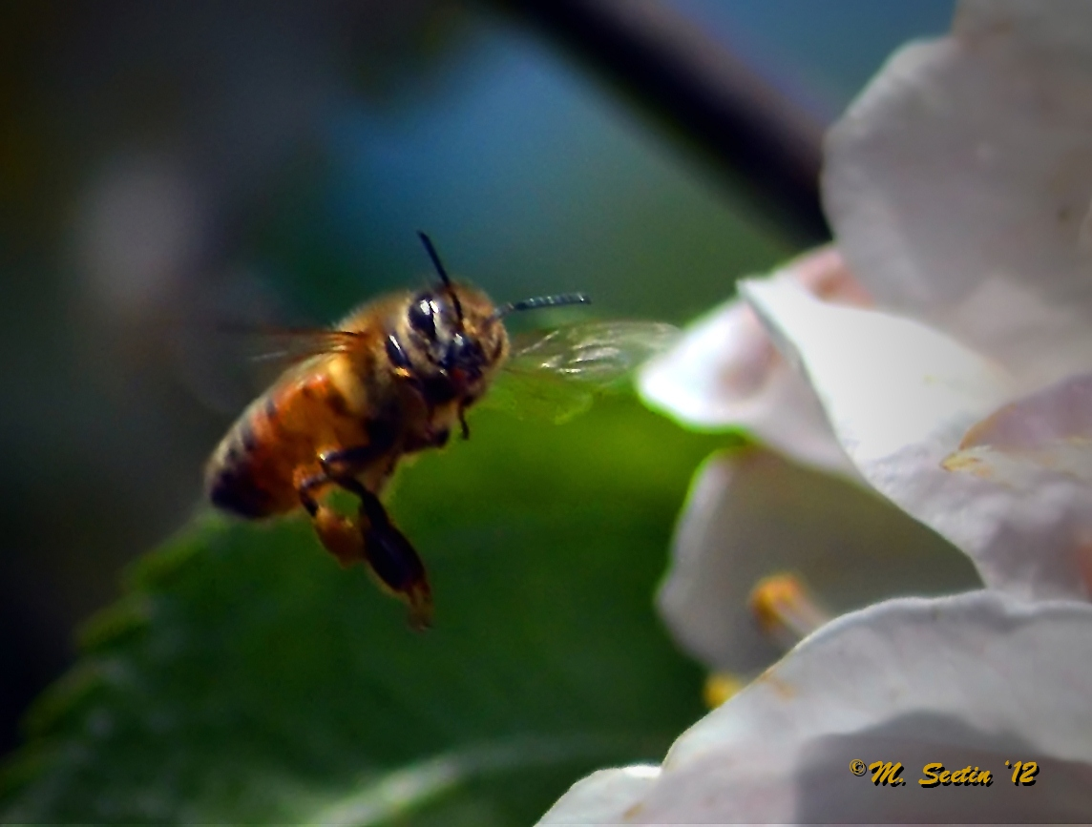
Recognize Residual toxicity
Some pesticides remain toxic to bees for some time after the application is made via contact with residues on the treated plant, including bloom. This is residual toxicity.

Slide 24
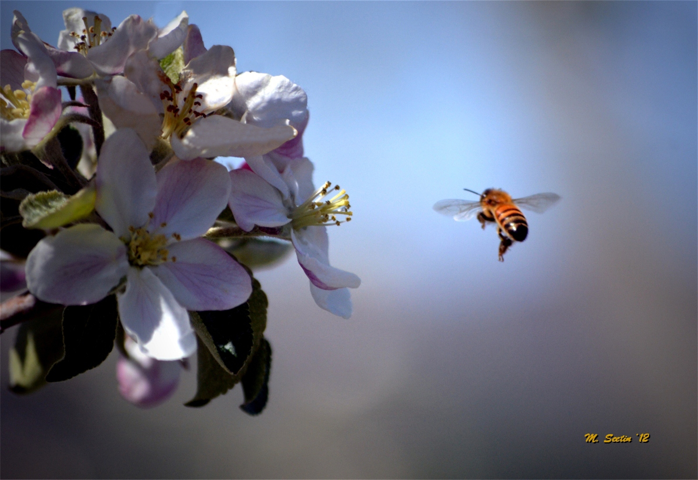
Extended Residual Toxicity (ERT)
Compounds that remain toxic to bees for an extended period of time following foliar applications are referred to as Extended Residual Toxicity or ERT.
ERT pesticides may not be applied to blooming crops or weeds.
Notes:
If products remain toxic for an extended period of time following foliar application the product is referred to as having an Extended Residual Toxicity or ERT. ERT pesticides may not be applied to blooming crops or weeds when pollinators are present or will be visiting soon after application.

Slide 25
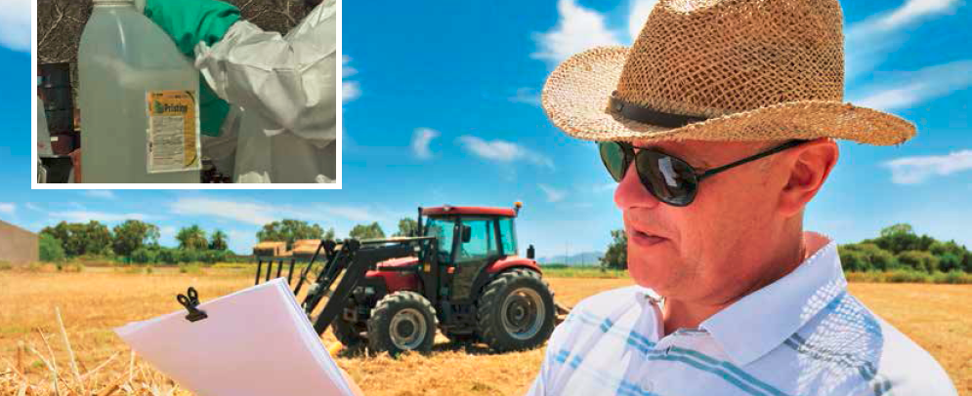
Pesticides with Extended Residual Toxicity
The families of pesticides most commonly associated with ERT include:
Organophosphates (e.g., acephate, chlorpyrifos, malathion) Carbamates (e.g., carbaryl) Neonicotinoids (e.g., imidacloprid) Pyrethroids (e.g., deltamethrin and cyfluthrin)
Always read the label to determine
if a pesticide leaves residues
that are toxic to bees!

Slide 26
A Honey Bee’s (Daily) Life
Honey bees forage sun up to sun down unless it’s raining
# of foragers
Sun up
Sun down
Time of Day
Source: Marla Spivak, UMinn
Notes:
Most pollinator poisoning occurs when bee-toxic pesticides are applied to crops during bloom. This is a time when pollinators are most likely to be attracted to the crop while actively searching for pollen and nectar. A honey bee will take to flight when temperatures are 55 degrees or above. They are most active from late morning through mid afternoon.

Slide 27
Best time for pesticide application: Dusk to Dawn
OK if no residue
Kills Bees
Best
OK if little residue
# of foragers
Sun up
Sun down
Time of Day
Source: Marla Spivak, UMinn
Notes:
The worst time of day to apply bee-toxic pesticides, therefore, is from late morning through early afternoon. Some bee-toxic pesticides can be applied from dusk till dawn as long as little or no toxic residue is left behind.

Slide 28
Pesticides and bloom
When crops or ground cover are in bloom consider using pesticides that have a short activity period (i.e., non-ERT). Preferably apply them between late evening and early morning
The bottom line: DO NOT apply pesticides that have an ERT during bloom!

Slide 29
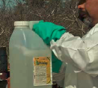
Read and understand the label
Pollinator Protection Statements on the label instruct you to:
Check the status of the application site for the presence of blooming plants and pollinators
Eliminate the exposure of bees and other insect pollinators when they are foraging on pollinator-attractive plants at the application site
Do this BEFORE you schedule an application
Notes:
Pollinator Protection Statements on the label instruct you to:
Check the status of the application site for the presence of blooming plants and pollinators
Eliminate the exposure of bees and other insect pollinators when they are foraging on pollinator attractive plants at the application site
Do this BEFORE you schedule an application

Slide 30
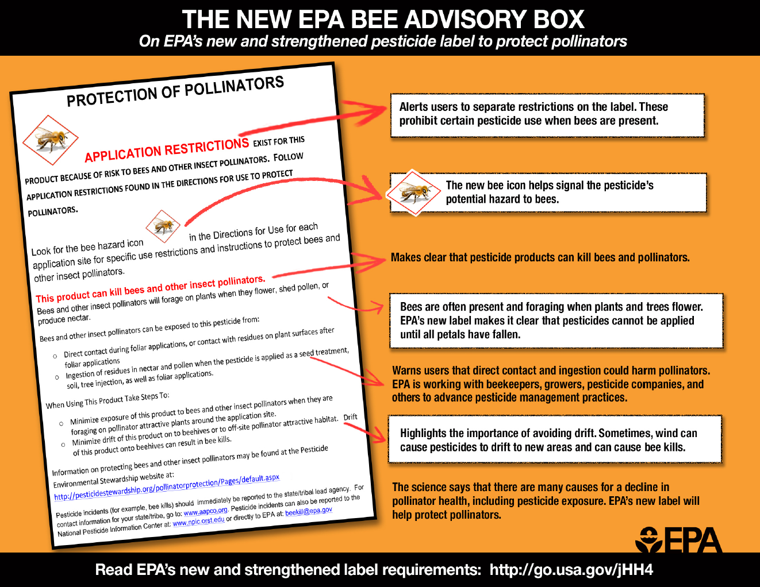
The “Bee Advisory Box”
Notes:
For several newer insecticides on the market, there is a “Bee Advisory Box” in the Environmental Hazards section of the label. On pesticides determined to be highly toxic to honey bees the label language may not be exactly like what is depicted, it will be similar and follow the same principles.

Slide 31
Pollinator protection statements should inform you of pesticide selection--and application timing--decisions
REMEMBER:
Take time, uninterrupted and undisturbed, to read and understand the label
Your actions must protect bees during application (and afterwards!).
Notes:
As the applicator, it is your responsibility to follow all statements and instructions on the label. Pollinator protection statements are called by a variety of names – “Bee Caution”, “Bee Hazard”, “Bee Warning” among others. These statements are based on the evaluated risk to honey bees. Don’t assume that all pollinator protection statements are the same. READ and FOLLOW label restrictions. Watch closely for label changes.

Slide 32
Key questions to consider
What is the growth cycle of the crop?
When will the crop be in bloom?
What are the predicted dates that pests will need to be treated?
What else is blooming in or near the field?
Cover crops
Weeds
Fencerow vegetation
Adjacent crops or orchards
What pollinator activity is nearby?
Can (non-crop) blossoms be removed by mowing or other methods before applying bee-toxic pesticides?
Notes:
With this information in mind, there are a number of key questions to consider when using pesticides in or near crops that are attractive to bees.

Slide 33
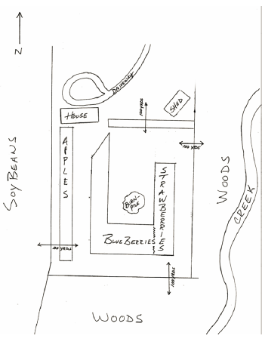
Know the landscape
Observe the surroundings
Observe fields and adjacent areas
Notes:
Be familiar with your fields and the surrounding areas so you will know which areas may have potential pollinator activity. Note what other plants (weeds, plants in hedgerows, in drainage ditches, etc.) are present and may be blooming.

Slide 34
Develop an IPM Plan
Use a variety of tools beyond chemical controls only
Use pesticides only when needed
Determine the need for treatment through pest scouting or monitoring
When using pesticides, prevent drift!
Notes:
Develop an Integrated Pest Management plan and consider other methods of pest prevention or control. Be sure you have a pest problem before applying pesticides through scouting or monitoring for the presence of pests in damaging numbers. Use pesticides wisely and prevent drift.

Slide 35
Cooperate and Communicate with Beekeepers
Get contact information
Maintain open dialogue before problems
Locate beekeepers in the area
Build consensus
When we help the beekeeper, we’re helping ourselves.
Image source: Coalition for Urban/Rural Environmental Stewardship
Notes:
To protect pollinators, communication is key. The underlying cause of most bee poisoning incidents is a lack of information or awareness, rather than intent to do harm. Most pest management programs can be modified so that little or no be poisoning occurs, without undue cost or inconvenience to the grower. Both beekeepers and pesticide applicators benefit from forming working relationships and familiarizing themselves with each other’s management practices. The more you learn from others, and educate others, the better off you will be. Good communication will help you avoid problems from occurring.

Slide 36
Questions
What has the EPA recently changed with regard to pesticide labels that will help protect pollinators?
a) The color
b) Pollinator protection language
c) Added a bee hazard icon
Notes:
B and C

Slide 37
Questions
What does it mean to have foraging bees on the intended application site?
You can apply any pesticide when you like
You can apply non ERT pesticides from dusk until dawn
You should avoid applying pesticides
Notes:
b) You can apply non ERT pesticides from dusk til dawn

Slide 38
Questions
When are pollinator poisonings most likely to occur?
Whenever pesticides are used
Whenever pesticides are sprayed from the air
When pesticides are applied to crops during the bloom period
Notes:
c. When pesticides are applied to crops during the bloom period

Slide 39
Questions
What additional information might be useful to you when deciding what, where, and when to spray? (indicate all that apply)
Location of the field
What was in the field last year
What is flowering in, around, and downwind of the target field
Are there any sensitive areas (bee yards, natural areas, etc.) downwind of the target field?
Notes:
A, C, and D

Slide 40
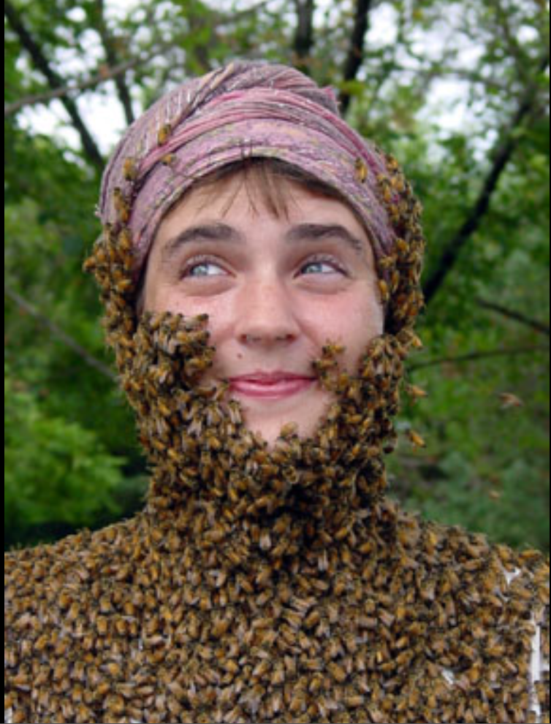
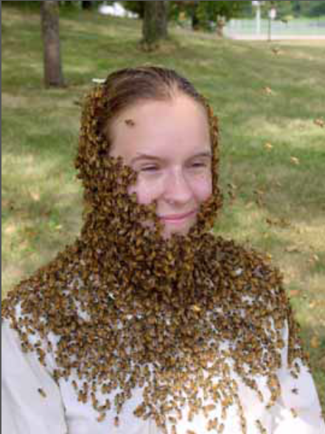
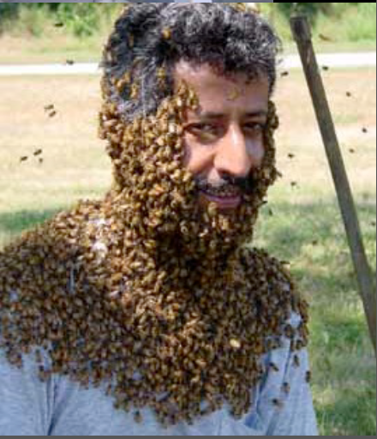
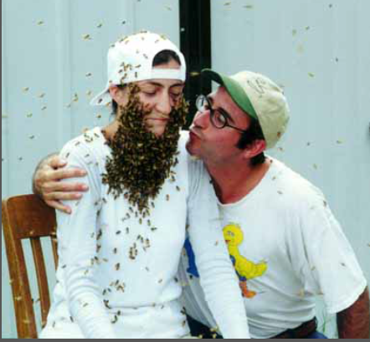
The End
Bee Beard Photos from Dr. Marla Spivak,UMinn (pictured top left)

Slide 41
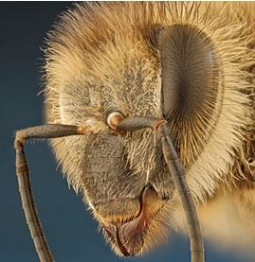
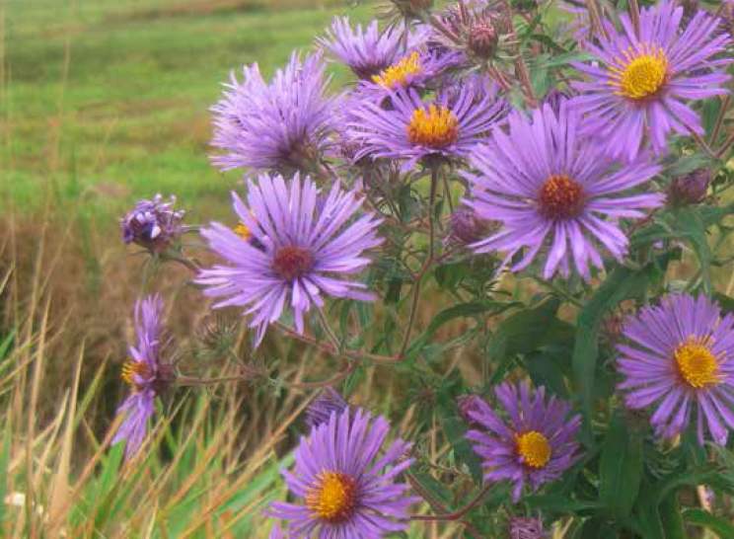
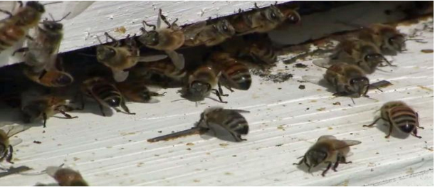
Resources
Pollinators and Pesticide Stewardship. Penn State Pesticide Education Program. extension.psu.edu/pesticide-education Protecting Pollinators, A Training Module for Certified Pesticide Applicators. North American Pollinator Protection Campaign.
Photos and Text were extracted from a presentation entitled, Bees: Protecting our Pollinators.
Marla Spivak, PhD, University of Minnesota.

