Slide 1

Introduction to Pesticide Registration and the
Endangered Species Act
Speaker’s Name
Content current as of December 2024

Slide 2
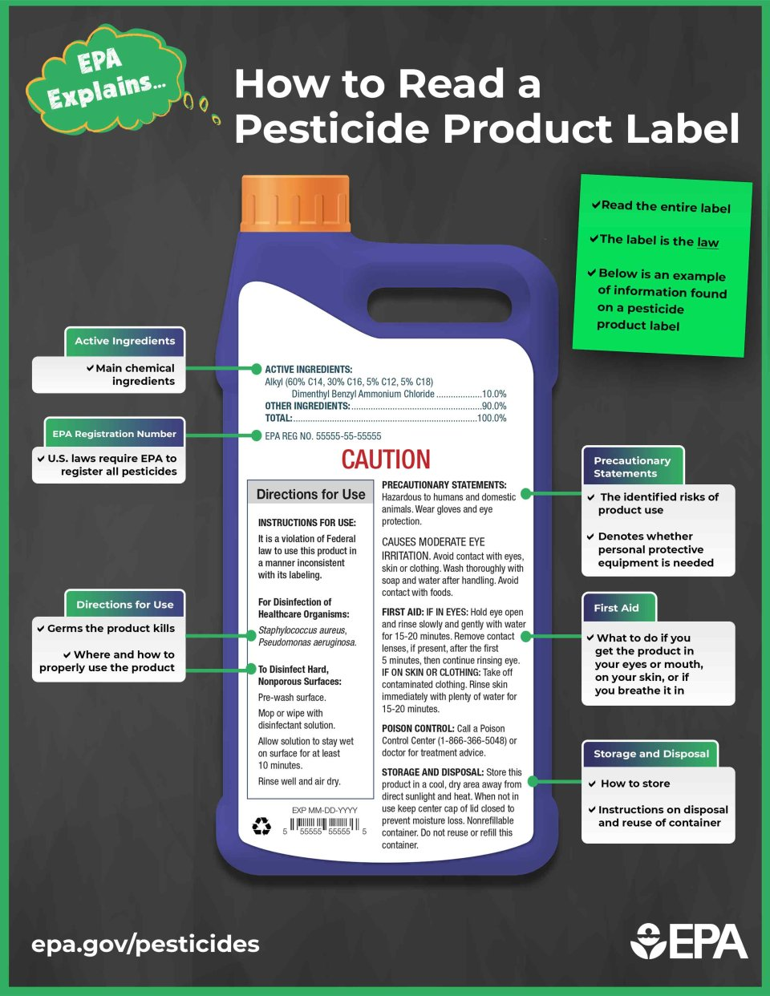
Pesticide Labels Will Be Changing To Protect Threatened and Endangered (Listed) Species and Their Habitat
Only a few labels will be changing this year!

Slide 3
What is the Endangered Species Act (ESA)
The ESA was first passed in 1973.
  Requires government agencies to ensure any actions they take will not jeopardize any species that have been federally listed as endangered or threatened or their designated critical habitats
As listed in the statute the agencies that enforce the ESA are the U.S. Fish and Wildlife Services and/or the U.S. National Marine Fisheries
EPA assesses the risk and consults with "the Services" as needed.
If there is potential harm, the agency will modify the labels as needed to mitigate risk.

Slide 4




Government Agency Roles
EPA
Regulates pesticides and approves labels
FWS
Protects listed terrestrial and freshwater species
NMFS
Protects listed marine (saltwater) species
USDA
Analyzes impacts of mitigations for agriculture
The “Services”

Slide 5
Why Now? “Megasuit” settlement was finalized on Sept 12, 2023
"...the EPA may not avoid compliance with the ESA..."
Migrant Clinicians Network vs EPA. Dec 2023, 9th Circuit
It's déjà vu all over again. EPA comes before this court once more because of its failure to abide by the law....EPA cannot flout the will of Congress-of the people-just because it thinks it is too busy or understaffed.
Center for Food Safety v. Regan, Dec. 2022, 9th Circuit
"Before registering a pesticide, EPA must consult with the statutorily specified agencies that have expertise on risks to species' survival. But for decades EPA routinely skipped that step when it registered pesticides...."
Center for Biological Diversity v. EPA, Dec. 2022, DC Circuit
EPA has long had a fraught relationship with the ESA. It has made a habit of registering pesticides without making the required effects determination.
In re: Center for Biological Diversity and Center for Food Safety, Nov. 2022, DC Circuit
Notes:
Though ESA was passed in 1973, EPA undertook ESA assessments for pesticide registrations/re-registrations fewer than 5% of time. This resulted in multiple lawsuits, with a megasuit settlement in September 2023.

Slide 6
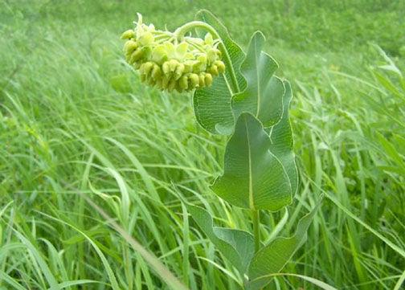
Timeline: When Could Labels Change?
Individual labels will have to be changed after notice and comment period
This has started now and will continue for years to change pesticide labels
Strategies are coming for all types of conventional pesticides:
  All strategies should have similar mitigation elements
  Herbicides finalized (August 2024),
  Insecticides (2025),
  Fungicides (2026), and
  Rodenticides finalized (2024)
Mead’s Milkweed
US FWS
Notes:
Changes will be slow - Liberty® Ultra (glufosinate-p) herbicide is the first label to be changed to reflect ESA mitigations as described in Herbicide Strategy.
Changes to pesticide labels ongoing but all changes would take 15 plus years.

Slide 7
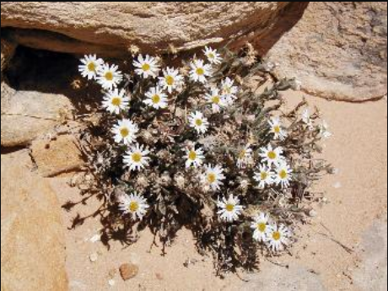
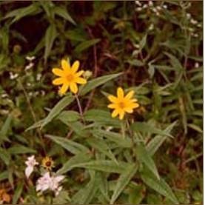
ESA is Successful: 99% of Listed Species are Still Alive and 291 Species Have Been Delisted (some examples)
Animals | Plants
Bald eagles | Eggert’s sunflower
Peregrine falcons | Maguire daisy
Manatees | Mountain golden heather
Sea turtles | Robbins’ cinquefoil
Southern sea otter | San Clemente Island bush mallow
Maguire primrose | San Clemente Island lotus
Black-footed ferret | San Clemente Island paintbrush
Gray wolf | sandplain gerardia
 | seabeach amaranth
 | small whorled pogonia
 | Tennessee coneflower
 | Texas wild rice
 | Virginia round-leaf birch
 | Santa Cruz Island Dudleya
 | Santa Cruz Island bedstraw
Maguire Daisy
US FWS
Eggert’s sunflower
CBD
Notes:
99.8% of listed species have survived

Slide 8
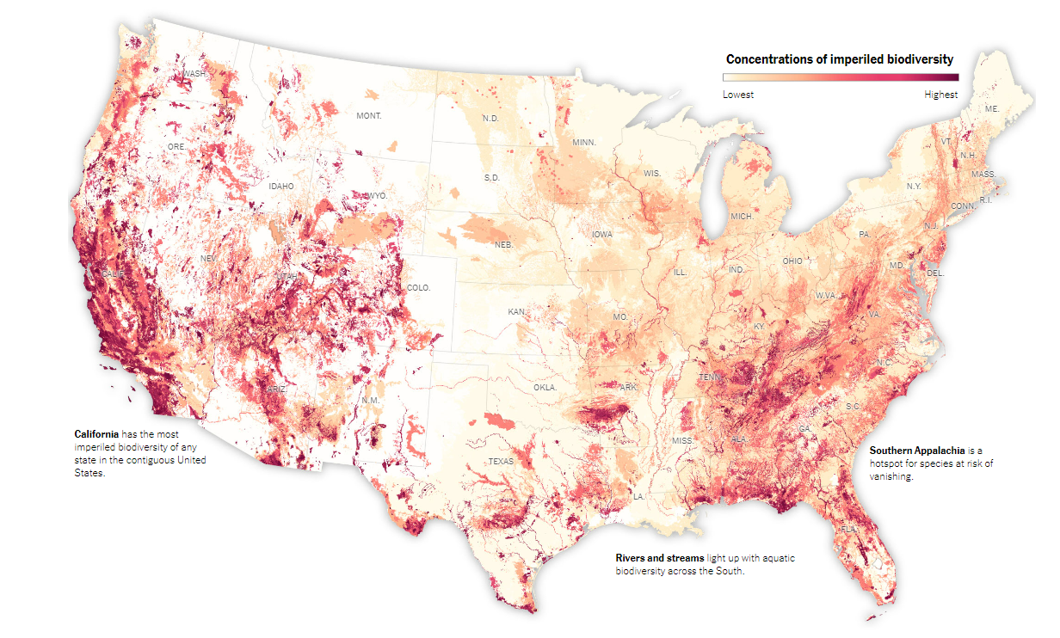
ESA Protection: People Say this is Too Complicated. But the EPA or Courts Have Three Main Registration Choices
Option 1: Remove pesticide from the U.S. marketplace
  Any pesticide that could impact listed species or critical habitat could have its registration removed
Option 2: Restrict its use to only crops/sites in counties or states without listed species or critical habitat
  Map of listed species, more red shows larger populations (NY Times 2022 Map)
Option 3: Add mitigations to protect species
  Minimizes the number of impacted users, allows use in many crops/ sites and areas
Outlook: Would you prefer to not have access to the product or have access to it with mitigations?
Notes:
These are the options that the courts and EPA had at the beginning of the process. Now that the process has been started the options may look different.

Slide 9
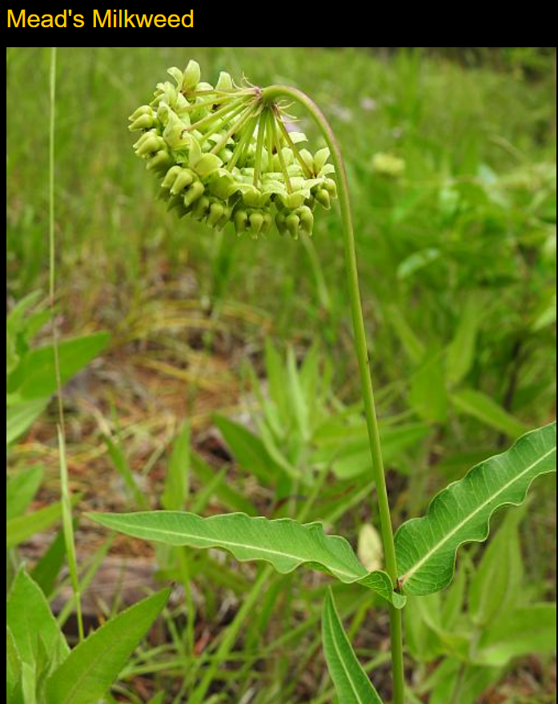
ESA: Compliance and Will It Go Away
Compliance with label mitigations.
  State Lead Agencies will enforce labels.
  Each state will decide the best way to do that.
Will it go away?
  Any modifications would require bipartisan support (e.g., some years Congress can’t even pass the Budget).
  The ESA has been successfully functioning for 50 years, and people want to protect golden eagles, Florida manatees, etc.
Mead’s Milkweed

Slide 10
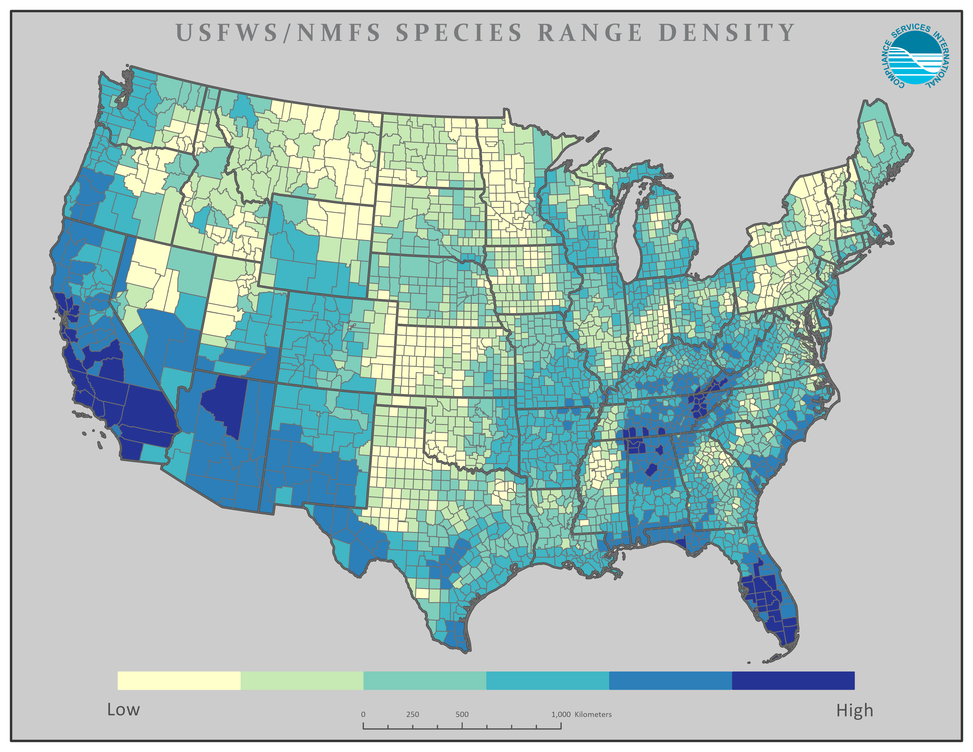


A National Situation with Local Implications
Every county in the US has at least one ESA-listed species and impacts are local. These need to be addressed locally by the end user.
Darker the color the greater density of species
Notes:
Map thanks to Compliance Services International (CSI)
CSI has offered to produce individual state maps of species and habitat’s if requested. Contact Ashlea Franks (afrank@complianceservices.com) or Leah Duzy (lduzy@complianceservices.com). See slide 27 for an example map of Alabama.

Slide 11


Over 1,700 Species are on the Endangered Species List
Plants
Birds
Fishes
Mammals
Snails
Amphibians
Clams
Insects
Reptiles
Crustaceans
Coral
Arachnids
U.S. Fish & Wildlife Service
NMFS
Over 900 species are potentially impacted by herbicides.
Over 850 species are potentially impacted by insecticides.
Notes:
Graphics from Ryan DeWitt, NMFS, NOAA
450 listed species are plants
This strategy supports EPA’s commitment to achieve early protections for over 900 listed species and
their critical habitat potentially directly or indirectly affected by conventional herbicides. This strategy focuses on developing and implementing mitigations to
protect listed species earlier in the registration and registration review process before EPA makes ESA
effects determinations or completes any necessary consultation with FWS for more than 450 listed
plants. It also includes identifying mitigations to protect nearly 580 listed species that depend on plants
for food or shelter and explaining how the strategy would be implemented in FIFRA actions.

Slide 12
Label Changes to Protect Listed Species and Their Critical Habitat
Herbicide Strategy: First example Liberty® Ultra
There are three types of label changes possible, aimed at mitigating the following:
Spray drift
Runoff/Erosion
Impacts to specific geographic locations where listed species or their critical habitat are found, Pesticide Usage Limitation Areas (PULAs)

Slide 13
Herbicide Strategy: Finding Required Mitigations
For conventional agricultural uses, mitigations have to be determined for each field, not an entire farm
Required spray buffer and runoff/erosion mitigation can be different for each herbicide and crop combination.
Mitigations may appear on up to 3 places:
On the product label
Label may direct user to Bulletins Live! Two (BLT) webpage https://www.epa.gov/endangered-species/bulletins-live-two-view-bulletins
Label may direct user to Mitigation Menu webpage https://www.epa.gov/pesticides/mitigation-menu
Additional Information
Pesticides and Endangered Species Education Resources Toolbox https://www.epa.gov/endangered-species/pesticides-and-endangered-species-educational-resources-toolbox

Slide 14

Spray Drift Buffers – Percent Scale
Buffers are downwind only
Buffers are to protect “unmanaged areas”
Managed areas outside of the treated area can be part of the spray drift buffer, such as agricultural field, roads, CRP land, and mowed areas
USDA NIFA
There are over 15 ways to reduce buffer distances.
Some applications do NOT need buffers such as spot treatments, tree injections, chemigation.

Slide 15
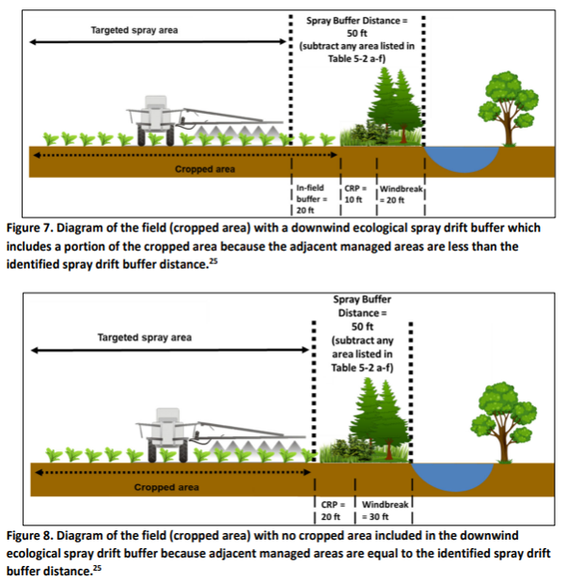
Spray Drift Example: 50 Foot Buffer Requirement

Slide 16
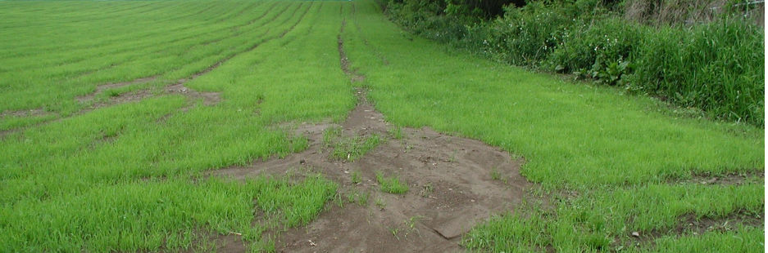
Mitigation for Runoff/Erosion – Point System
Designed to protect listed species and critical habitat up to 1,000 feet downslope.
Some areas outside of treated area can be included in the 1,000 feet, such as ag fields, roads, gravel surfaces, field buffers, conservation reserve land, etc.
Herbicides will need 0 to 9 mitigation points, which will be listed on label
There are ~40 ways to reduce runoff/erosion mitigations.
Some applications do not need buffers, such as spot treatments, tree injections, chemigation, field has permanent berms, or tailwater return systems, etc.

Slide 17
Runoff/Erosion DRAFT Points – each herbicide by crop combination can have different points
Crop | 2,4-D | Dicamba | Diuron | Metolachlor | Oxyfluorfen | Paraquat | Pendimethalin | Trifluralin
Alfalfa | NA | NA | 9 | NA | NA | 0 | 3 | 5
Citrus | 3 | NA | 9 | NA | 5 | 0 | 3 | 5
Corn | 6 | 6 | 6 | 6 | 7 | 0 | 3 | 5
Cotton | NA | 6 | 6 | 6 | 5 | 0 | 3 | 5
Grapes | 3 | NA | 9 | NA | 7 | 0 | 5 | 5
Other Orchards | 6 | NA | 9 | NA | 5 | 0 | 3 | 5
Other Grains | 6 | 3 | 6 | 1 | NA | 0 | 3 | 5
Rice | NA | NA | NA | NA | NA | 0 | NA | NA
Soybeans | 6 | 6 | NA | 6 | 5 | 0 | NA | 5
Vegetable/ Ground Fruit* | 6 | 6 | 6 | 6 | 5 | 0 | 3 | 5
Wheat | 6 | 6 | 6 | NA | NA | 0 | NA | 5
Metolachlor / s-metolachlor = points range from 1 to 9 depending on PULA area (soybeans, VGF, & aquatic areas are higher ).
NA = not applicable because not registered.
Notes:
Number of points required can change on final labels.
The reason for different points is potentially because of different application rates, application methods, and the sensitivity of species found near those crops.
Overall we are looking at exposure potential, there could be different application methods, rates, and pesticide physiochemical properties that determine runoff potential
These are draft numbers from Draft Herbicide Strategy. They are subject to change based on refined assessments.
*MCPA, Metribuzin, Propanil, Thiobencarb not shown.

Slide 18
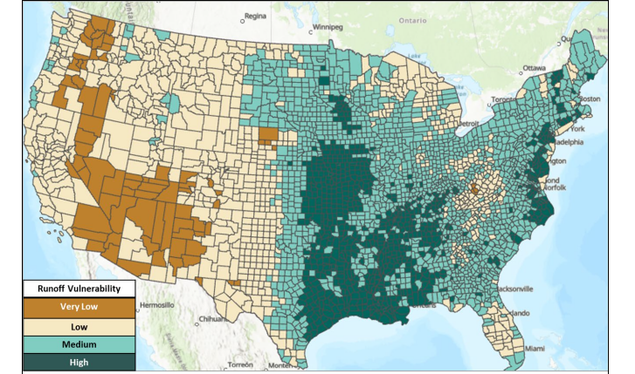
Pesticide Runoff Vulnerability at County Level
Notes:
Mitigation Relief Points: dark green gets 0 points, light green gets 2 points, tan gets 3 points, and dark brown gets 6 points.
This map is from EPA's Mitigation Menu Measure Descriptions document. EPA analyzed the runoff Vulnerability of counties across the lower 48 on rainfall, soil, and other lines of evidence and developed the map shown here to determine the level of runoff/erosion mitigation needed for each county.
Areas with higher runoff potential require more points than areas with lower runoff potential.

Slide 19
Pesticide Use Limitation Areas (PULA) and Bulletins Live! Two
The label may direct you to a website to see if your pesticide application is within a Pesticide Use Limitation Area (PULA)
  https://www.epa.gov/endangered-species/bulletins-live-two-view-bulletins
Bulletins Live! Two lists additional mitigations to protect listed species and critical habitat.
EPA identifies geographic areas most critical to conserve a listed species and then adds buffers (1,000 feet or less) to account for potential offsite transport from a treated field.
If Bulletins Live! Two shows your field is outside of a PULA, it is in your best interest to document that there are no limitations within the month of your pesticide application.
  You can check Bulletins Live! Two up to 6 months before the application

Slide 20
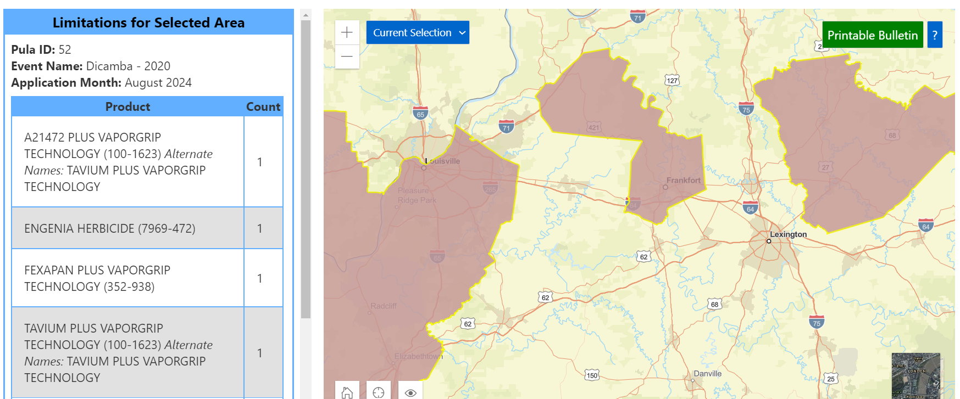
Example ESA Bulletins Live! Two: Pesticide Use Limitation Area (PULA)
Dicamba – Aug 2024 application, Lexington KY
Areas in pink are to protect listed species, 310 foot in-field wind-directional spray drift buffer and a 57-foot omnidirectional in-field buffer. Website has a lot more details.
You can use state, city or longitude then latitude of field application site and see if it is part of a PULA
Map has satellite view
Make sure to in zoom enough so you can see the application area – especially if it is on the edge of a PULA.
Notes:
Herbicide used was Vaporgrip Dicamba, Pesticide ID 100-1623

Slide 21
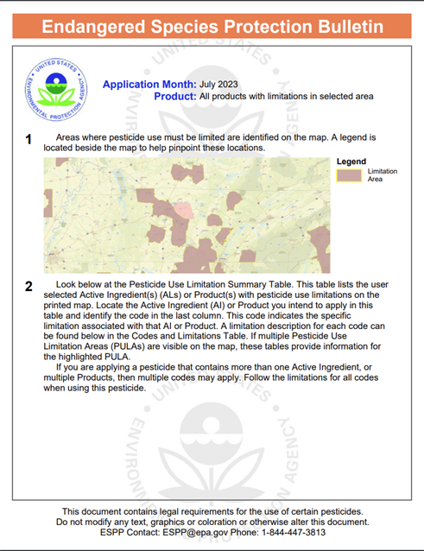
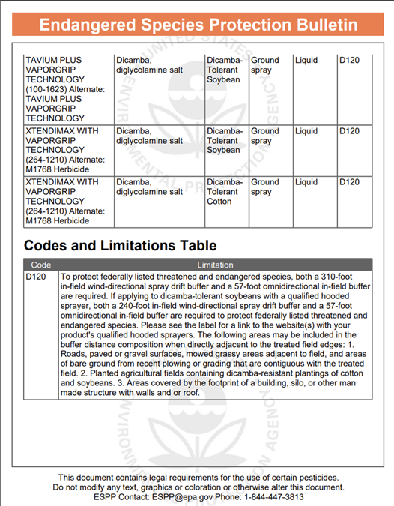
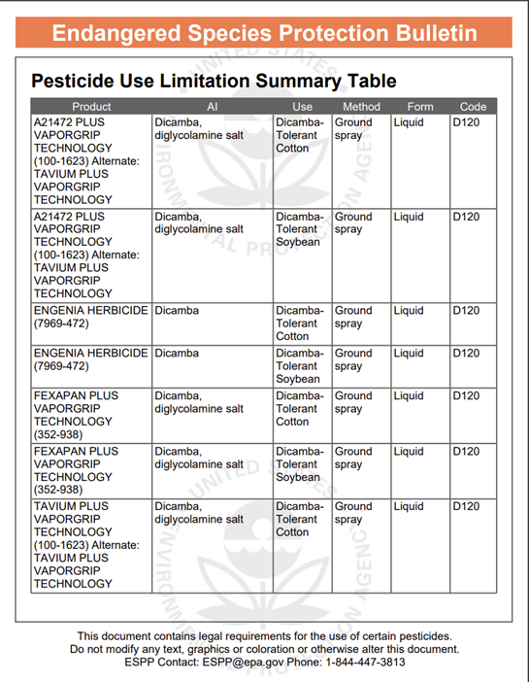
Notes:
This is all products that have restrictions in the counties selected in TN.
You can update this for your own state if you would like.

Slide 22
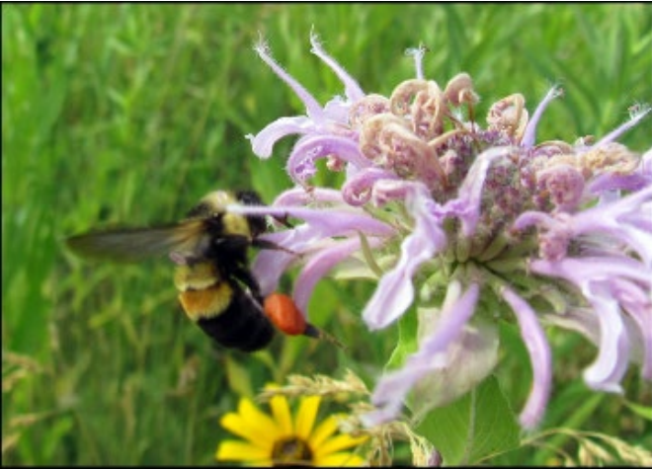
ESA Resources
Rusty patch bumblebee
EPA Endangered Species Main Page
https://www.epa.gov/endangered-species
Pesticides and Endangered Species Educational Resources Toolbox
https://www.epa.gov/endangered-species/pesticides-and-endangered-species-educational-resources-toolbox
EPA Bulletin Live! Two (BLT)
https://www.epa.gov/endangered-species/bulletins-live-two-view-bulletins
EPA Mitigation Menu
https://www.epa.gov/pesticides/mitigation-menu
Weed Science Society of America webpage – definitions, handouts, and presentations
https://wssa.net/endangered-species/
Mitigation Strategy Tool from by CropLife America and Compliance Services International
https://mitigationstrategytool.org/
Pesticide Environmental Stewardship Website from the Center for Integrated Pest Mgtt
  https://pesticidestewardship.org/
Notes:
There are also webinar recordings that could be helpful for the presenter and the applicators.
EPA does have a detailed webinar on Bulletin Live! Two (BLT) listed in the Toolbox
Located on The Pesticide and Endangered Species Educational Resources Toolbox

Slide 23
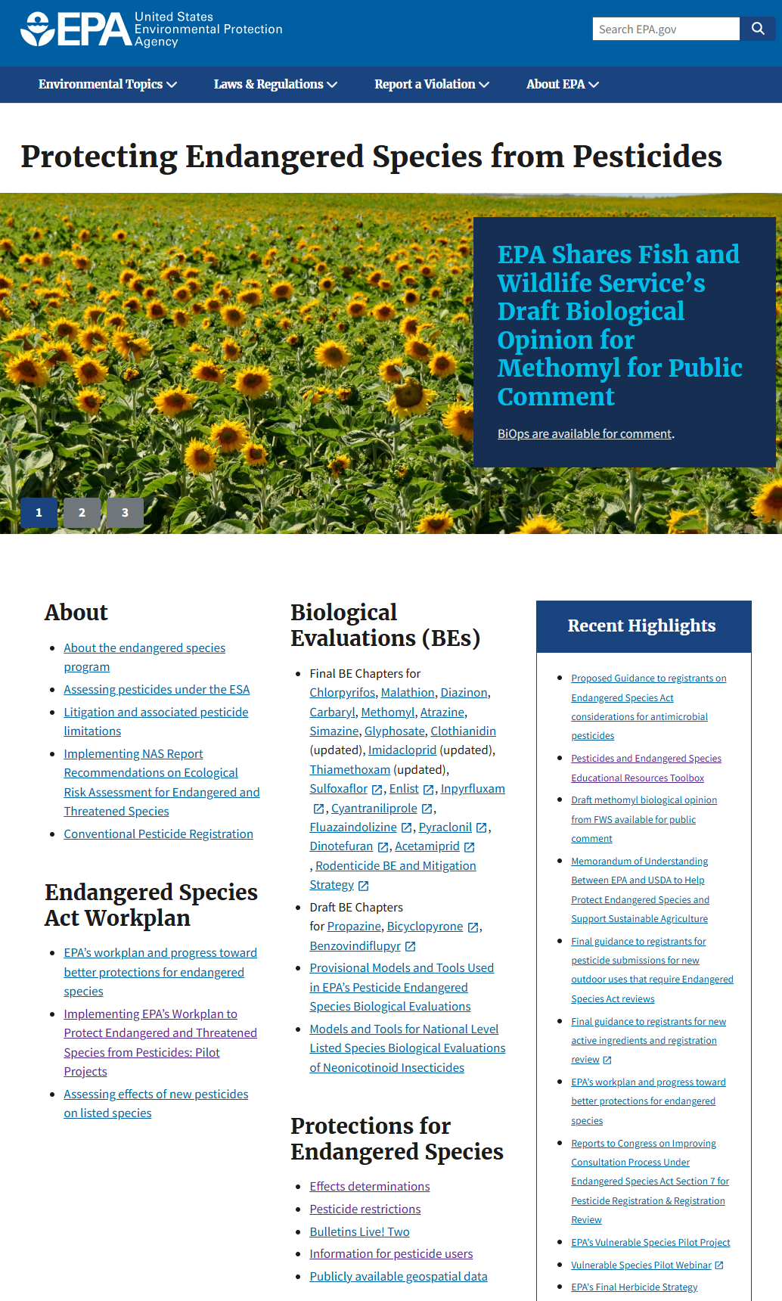

EPA Endangered Species Main Page
Notes:
QR code to get all EPA ESA resources

Slide 24
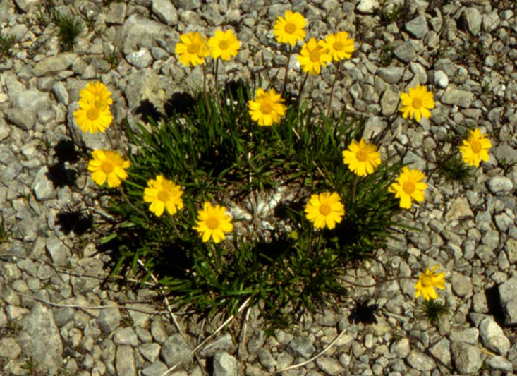
Conclusion & Space For State Information
Work collaboratively
The ESA assessment process is very new and still evolving
Growers will have to look at drift, runoff/erosion, and PULAs on a field-by-field basis
ESA changes will happen gradually over several years
Any other state specific information?
Is there a state contact person?
Lakeside daisy
Notes:
We will have more in depth information as we move forward.

Slide 25
Collaborative Effort – December 2024
Weed Science Society of America, Endangered Species Act Committee
  Bill Chism, Chair
American Association of Pesticide Safety Educators
  Niranjana Krishnan, University of Maryland
  Kim Brown, University of Tennessee
U.S. Department of Agriculture, Office of Pest Management Policy
  Cameron Douglass
  Elyssa Arnold
Support from U.S. Environmental Protection Agency
  Any mention of trade names, manufacturers or products does not imply an endorsement by the US Government of the United States Environmental Protection Agency. EPA and its employees do not endorse any commercial products, services, or enterprises.

Slide 26
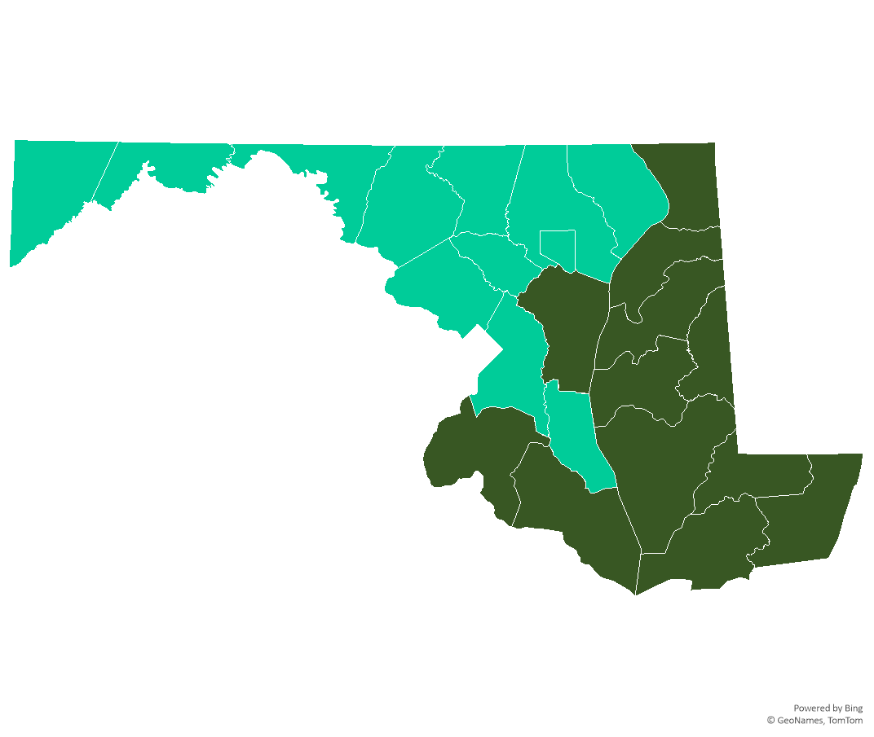

Back Pocket Slide
Maryland Mitigation Relief Points for Conservation Practices
0 to 6 Relief Points Possible
No counties with 6 points
No counties with 3 points
Light green = 2 points in 12 counties
Dark green = 0 points in 12 counties
From: https://www.epa.gov/pesticides/mitigation-menu#map
Notes:
This map was created using the list of mitigation points per county in each state from http://www.epa.gov/pesticides/mitigation-menu#map . The data for state, county, and points was imported into Excel and a map was created using the chart design feature.

Slide 27
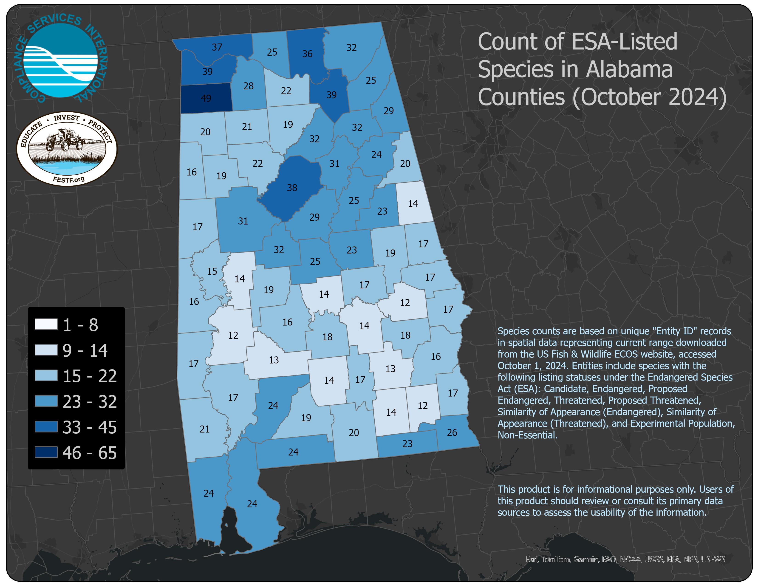
Back Pocket Slide
Notes:
These maps are provided courtesy of Compliance Services International (CSI) and the FIFRA Endangered Species Act Task Force (FESTF). Beginning in January 2025, additional maps can be found under the Resources section of the FESTF website at www.festf.org.

