Slide 1
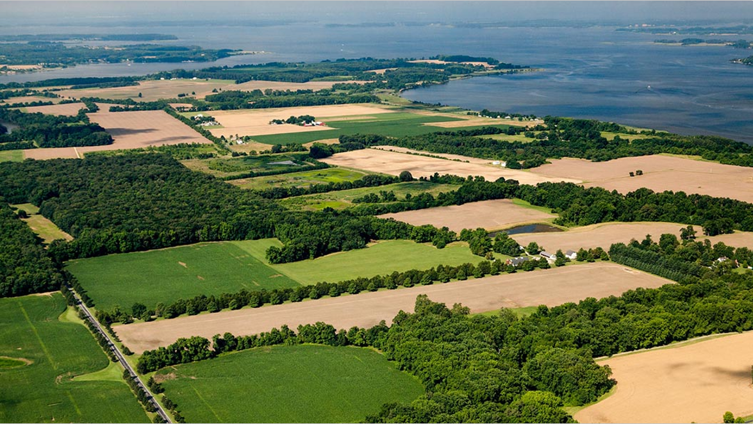
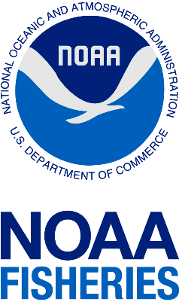
National Marine Fisheries Service
(NMFS)
Ryan DeWitt
Office of Protected Resources

Slide 2
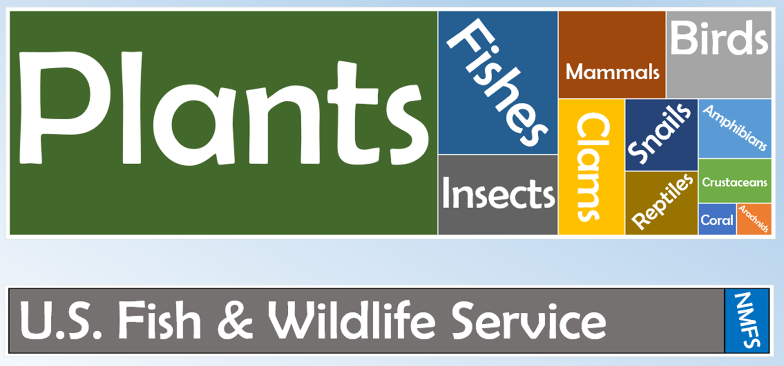
About 1,700 Species on the Endangered Species Act

Slide 3
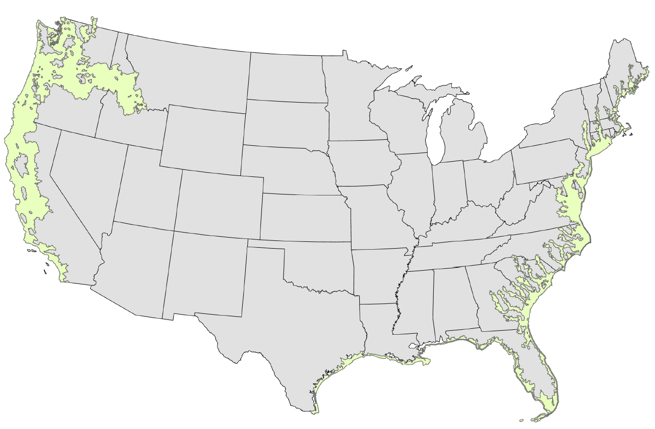
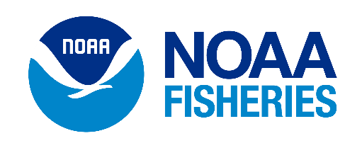

Slide 4
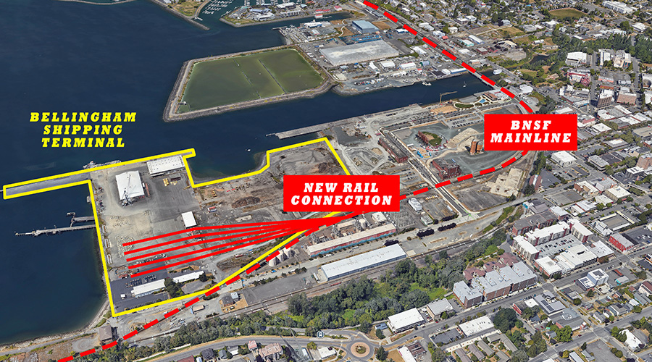
“Section 7” of the Endangered Species Act
Requires federal agencies to insure that any federal Action authorized, funded, or carried out is not likely to jeopardize
ESA-listed species/habitats.
Example:
Bellingham Shipping Terminal Modernization
The Action:
Replacement of piles, dredging ~ 22,000 yards, etc.
Federal Agency:
U.S. Department of Transportation funding
ESA-mitigation:
In-water work window (when out-migrating salmonids are less likely to be present), runoff reduction e.g. wattles, silt fences, etc.

Slide 5
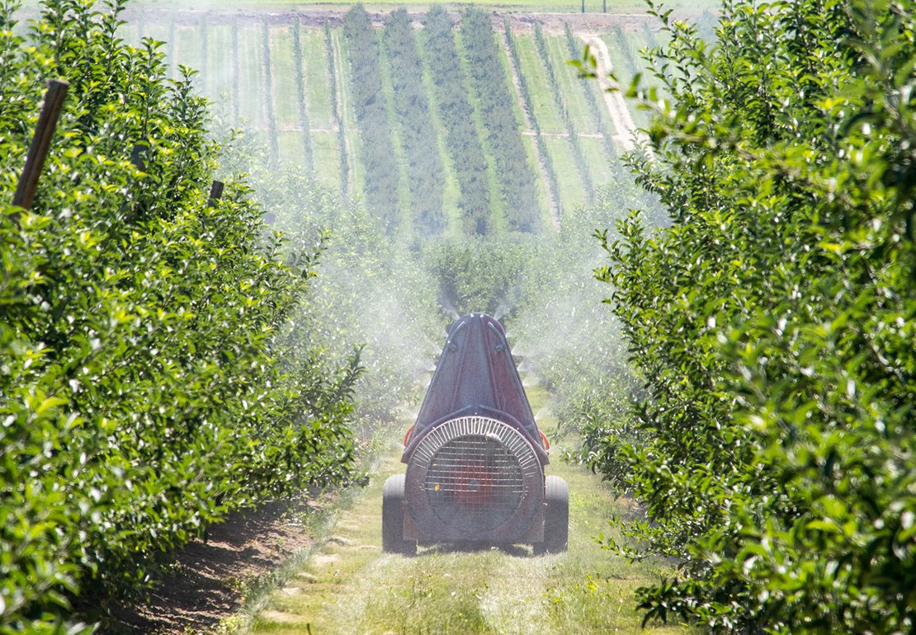
“Section 7” of the Endangered Species Act
Requires federal agencies to insure that any federal Action authorized, funded, or carried out is not likely to jeopardize
ESA-listed species/habitats.
Example:
FIFRA Pesticide Registration
The Action:
Registration of pesticides as described on product labels (Directions for Use)
Federal Agency:
Environmental Protection Agency approval needed
ESA-mitigation:
Mitigations measures to reduce the off-field transport of pesticides via drift and runoff. E.g. vegetative filter strip

Slide 6
FIFRA Registration
General label changes
ESA-specific label changes
ESA Consultation

Slide 7
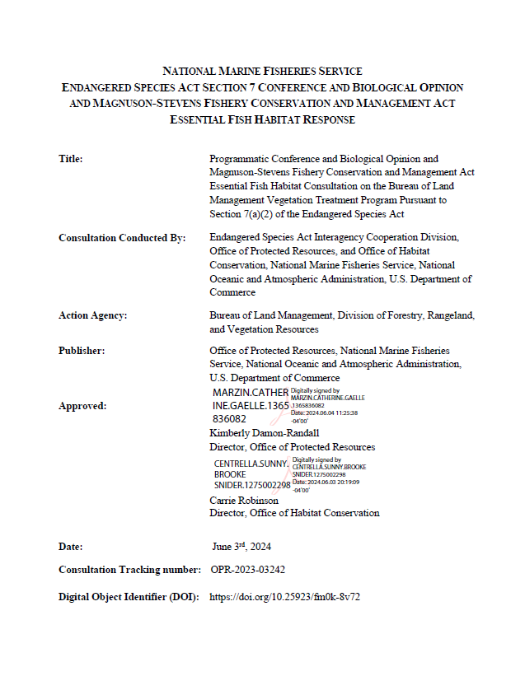
How do you know if ESA-protections are built into the label?
BPA Habitat Improvement Program (HIP, 2023)
BLM Vegetative Management Program (2024)

Slide 8
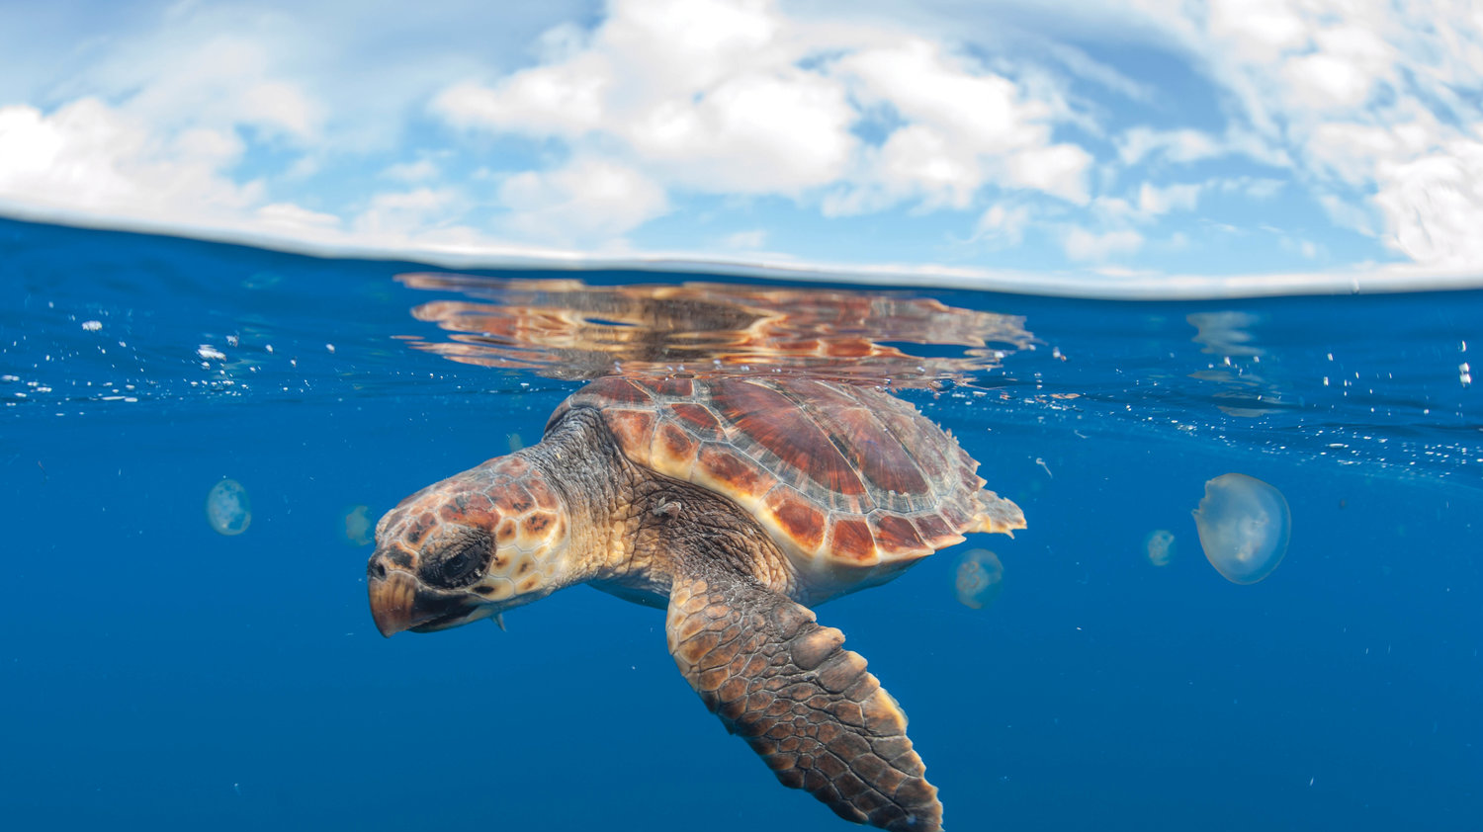
New framework for ESA-based mitigation
Geographically specific “Pesticide Use Limitation Areas”
List of mitigation options to choose from:
Drift
Runoff

Slide 9
The Approach to Mitigation is Evolving
Chlorpyrifos
Malathion
Diazinon
EPA’s new approach
“the strategies”
Bromoxynil
Prometryn
2022
2024
2021
2023
Now
1,3-D (Telone)
Metolachlor
Carbaryl
Methomyl

Slide 10
Step 1.
Does your product label contain the following language in the Directions for Use section?
ENDANGERED AND THREATENED SPECIES PROTECTION REQUIREMENTS: Before using this product, you must obtain any applicable Endangered Species Protection Bulletins (‘Bulletins’) within 6 months prior to or on the day of application…
If so, you need to access EPA’s Bulletins Live! Two website (go to step 2)
If not, there are no additional mitigations

Slide 11
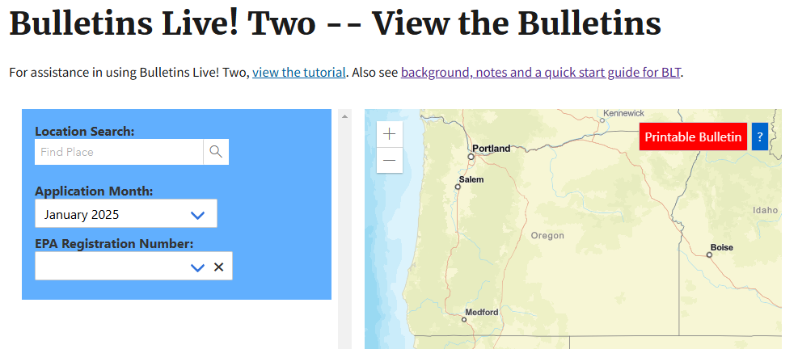
Step 2.
Is your application area in a Pesticide Use Limitation Area?
Bulletin’s Live! Two:
Location
Application month
EPA registration number
If so, click “Printable Bulletin” for a description of the additional mitigations
If not, there are no additional mitigations

Slide 12
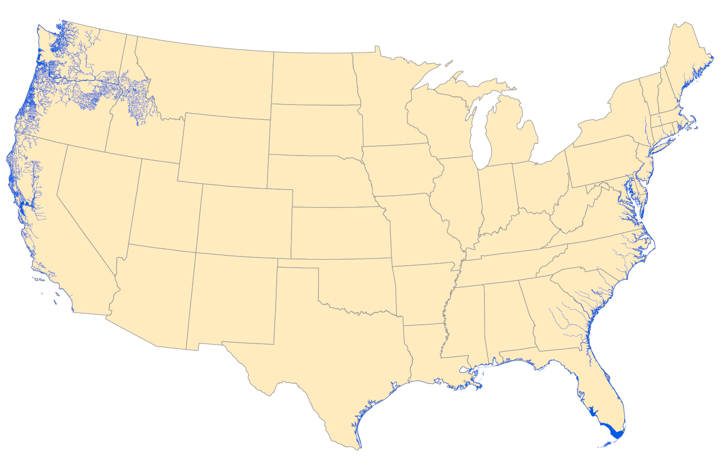
“Pesticide Use Limitation Areas” (PULA) for all NMFS species in Lower-48

Slide 13
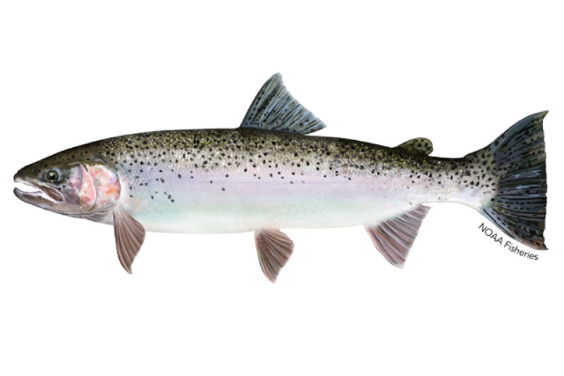
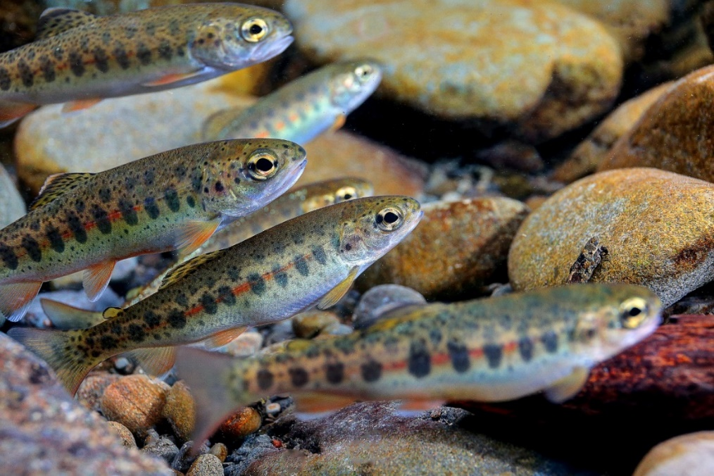
Middle Columbia River Steelhead

Slide 14
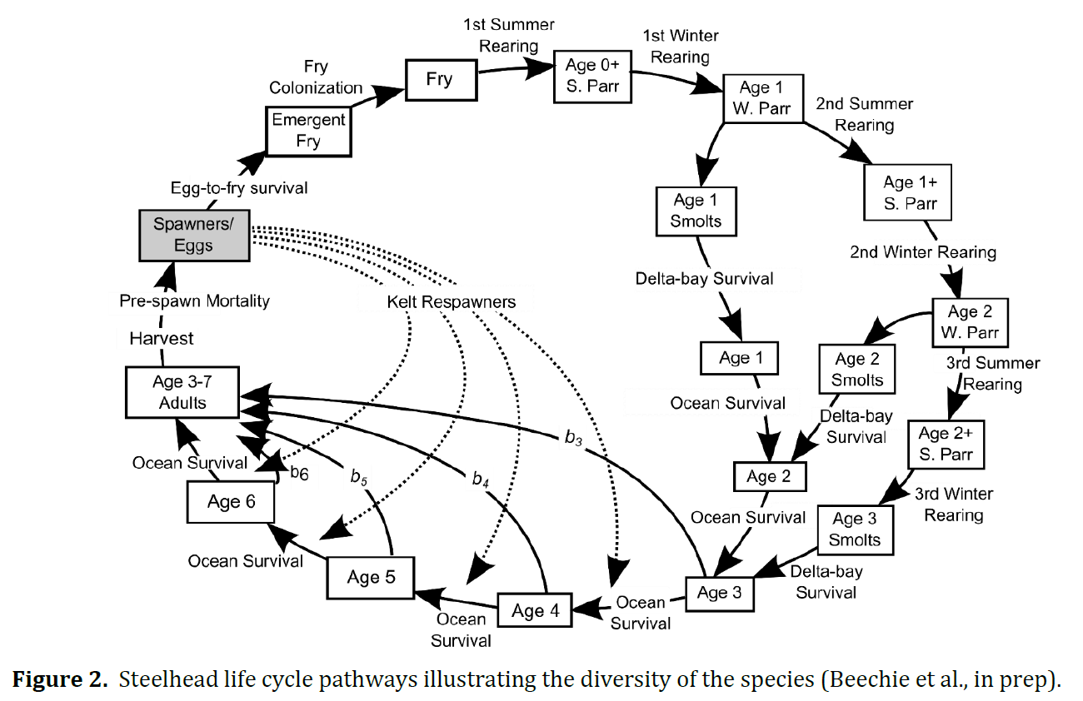

Slide 15
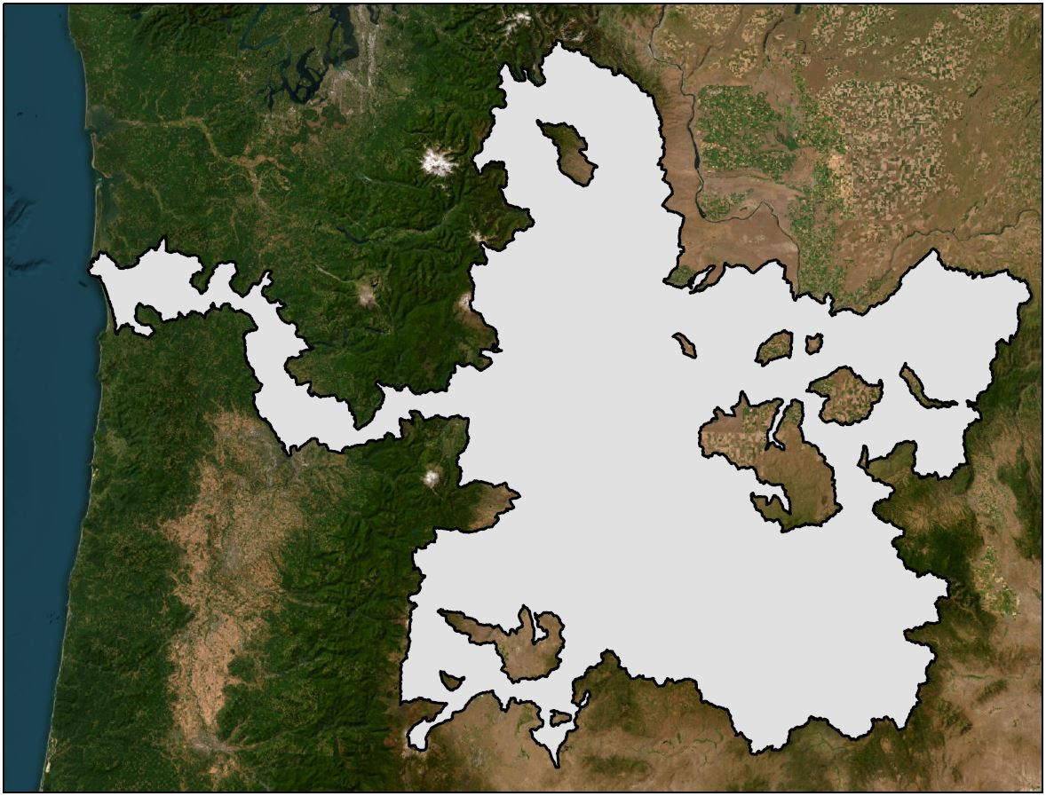
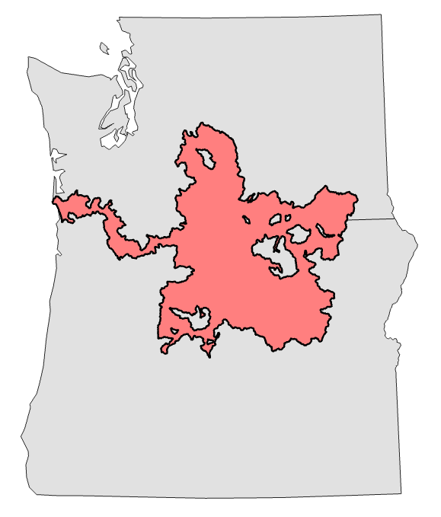
Middle Columbia River steelhead range
WA
OR

Slide 16
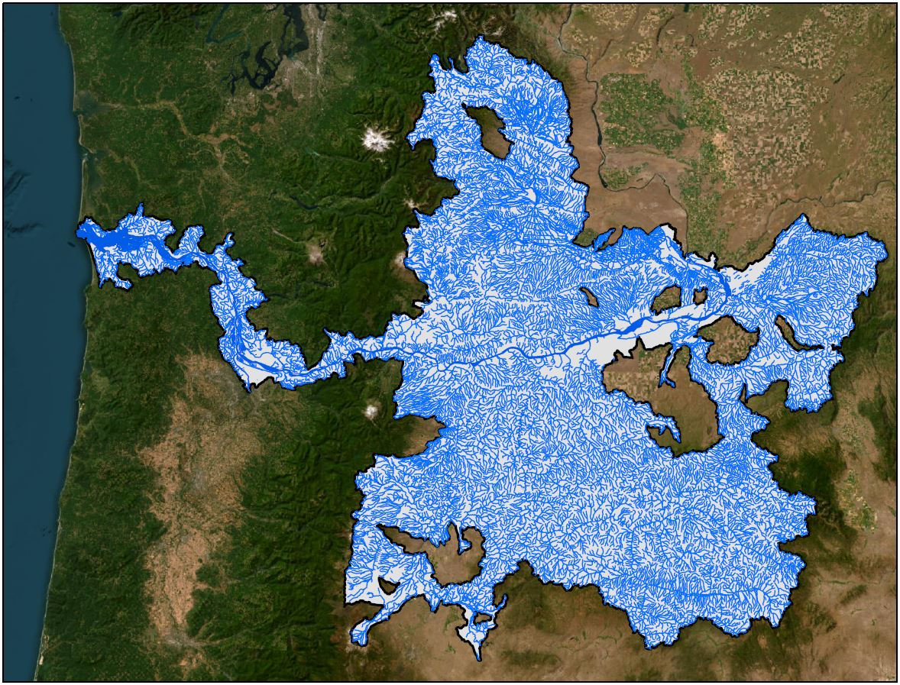
Middle Columbia River steelhead range
WA
OR

Slide 17
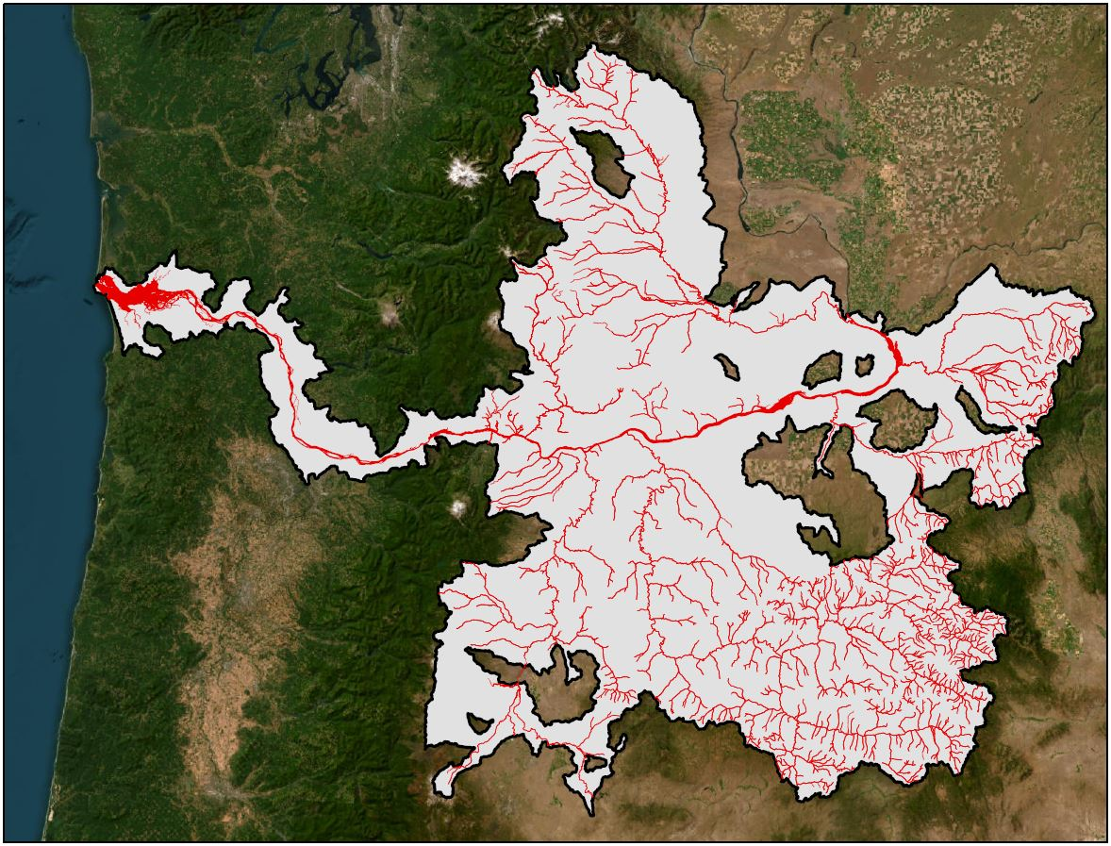
PULA
11.5% of the species range
WA
OR

Slide 18
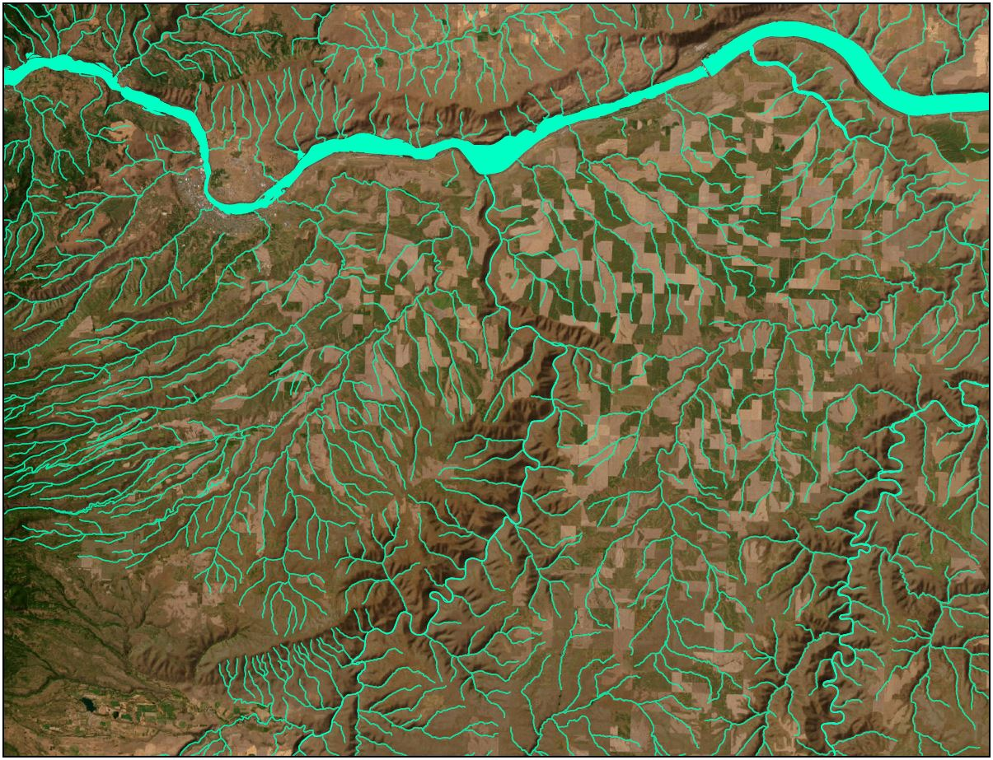
The Dallas
Species Range

Slide 19
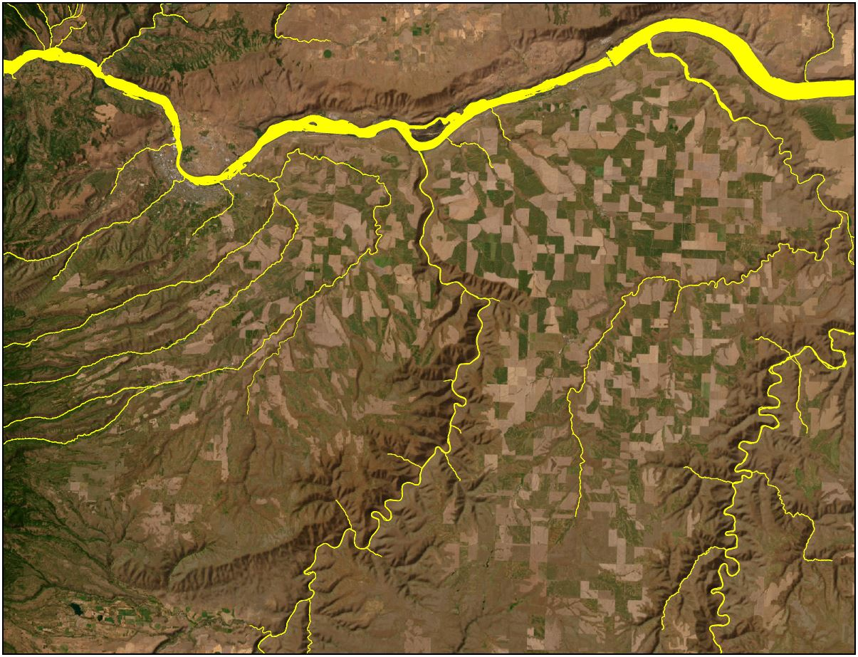
Most important habitat

Slide 20
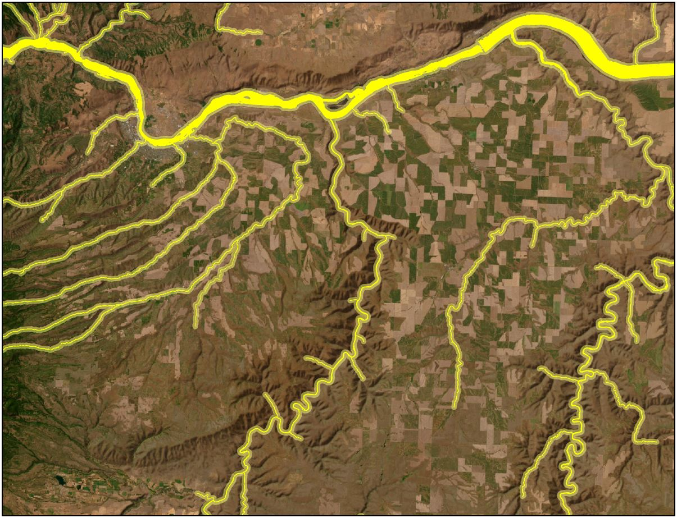
Buffered to 300 meters (the PULA)

Slide 21
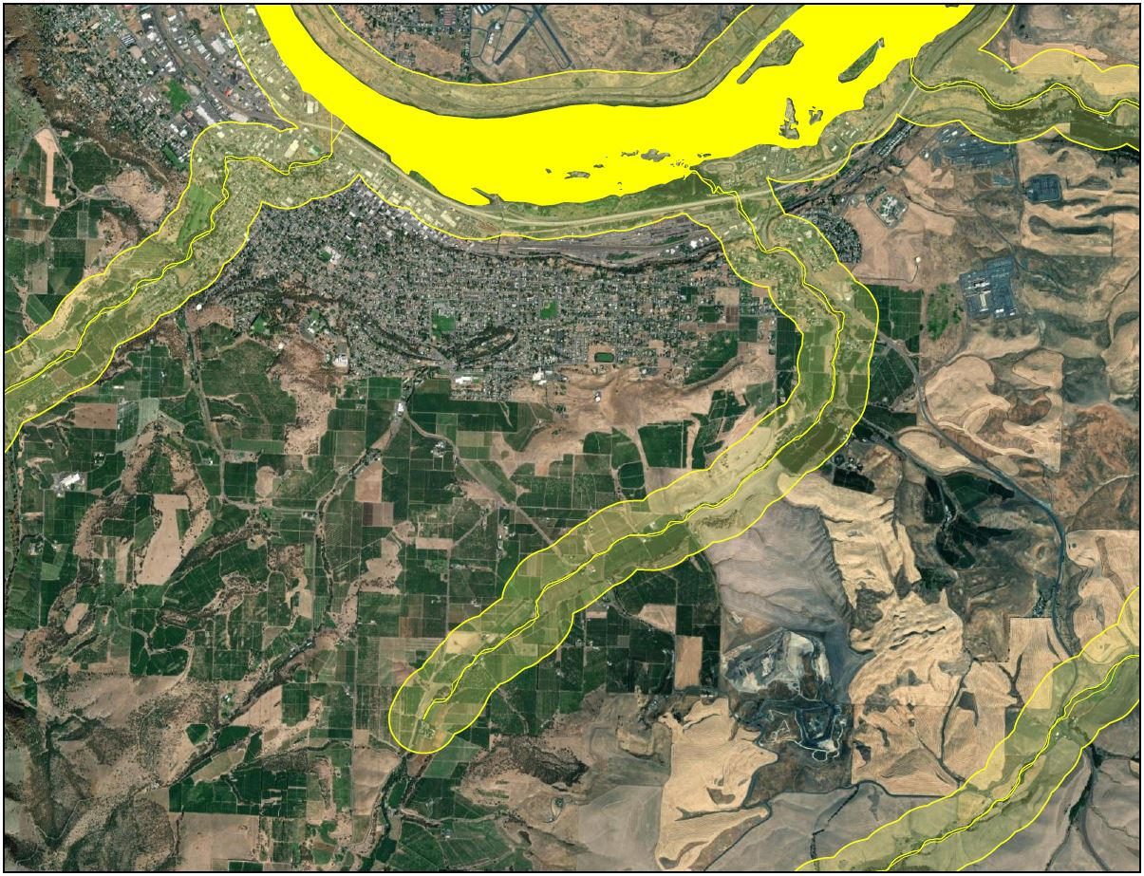

Slide 22
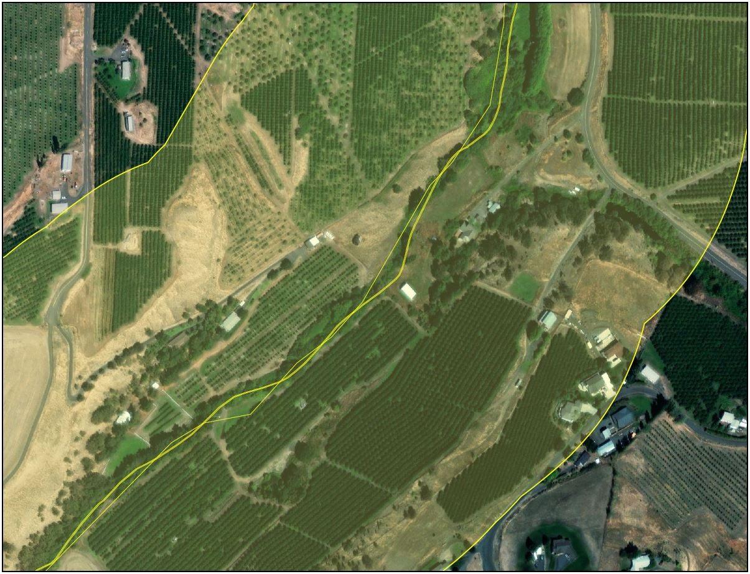

Slide 23
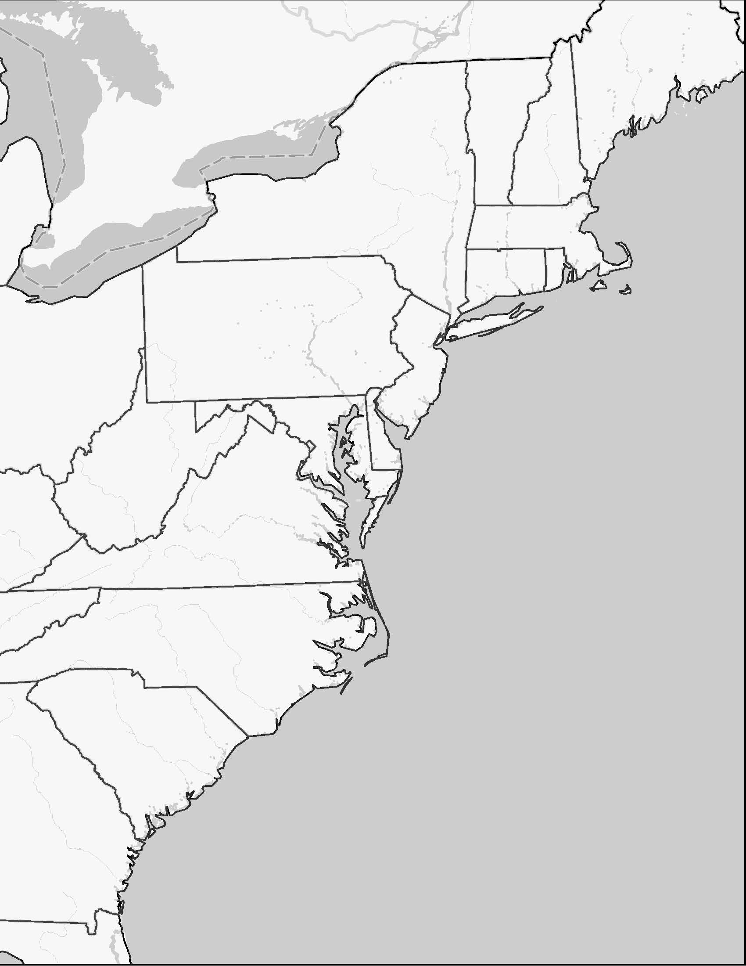
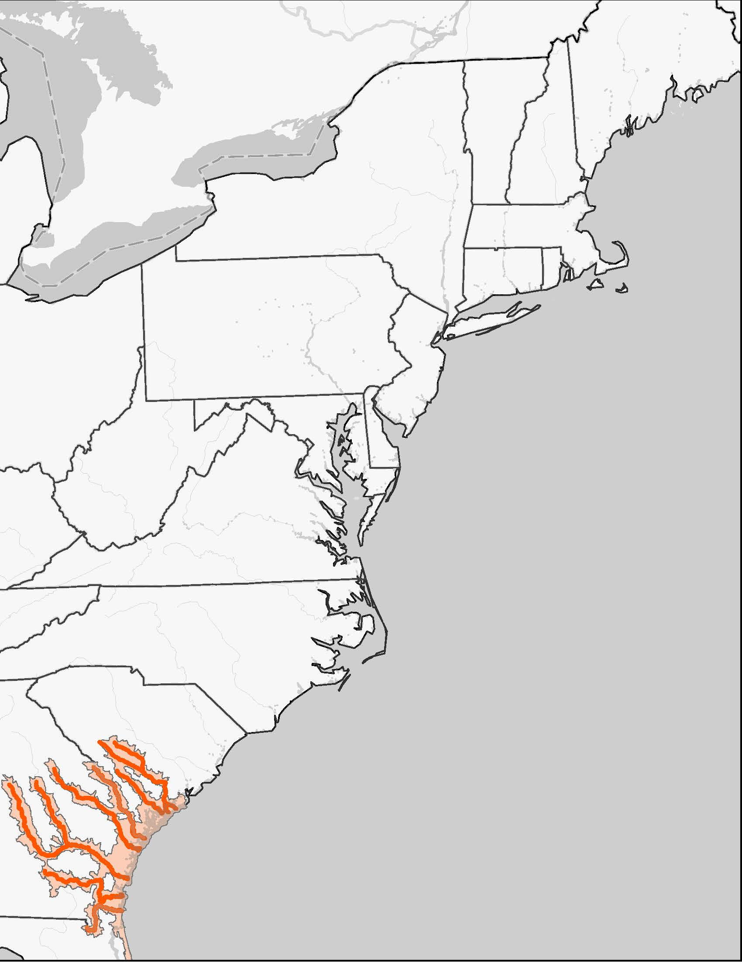
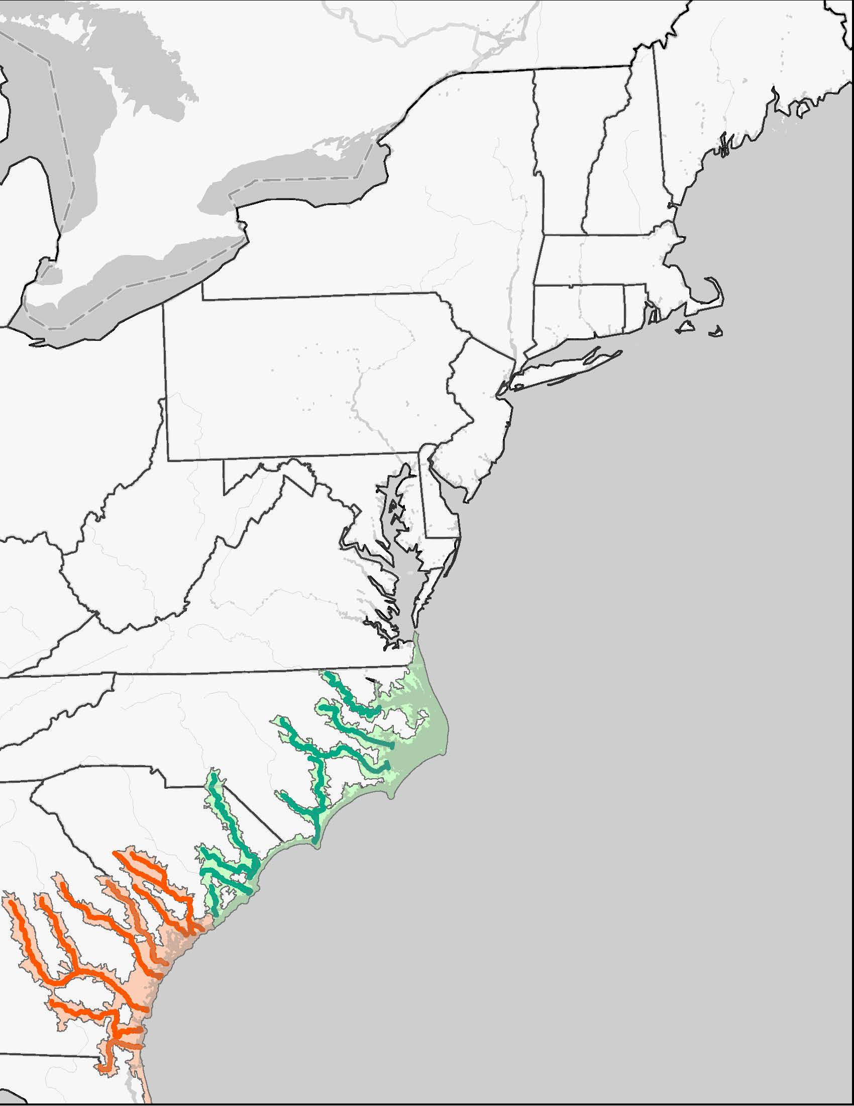
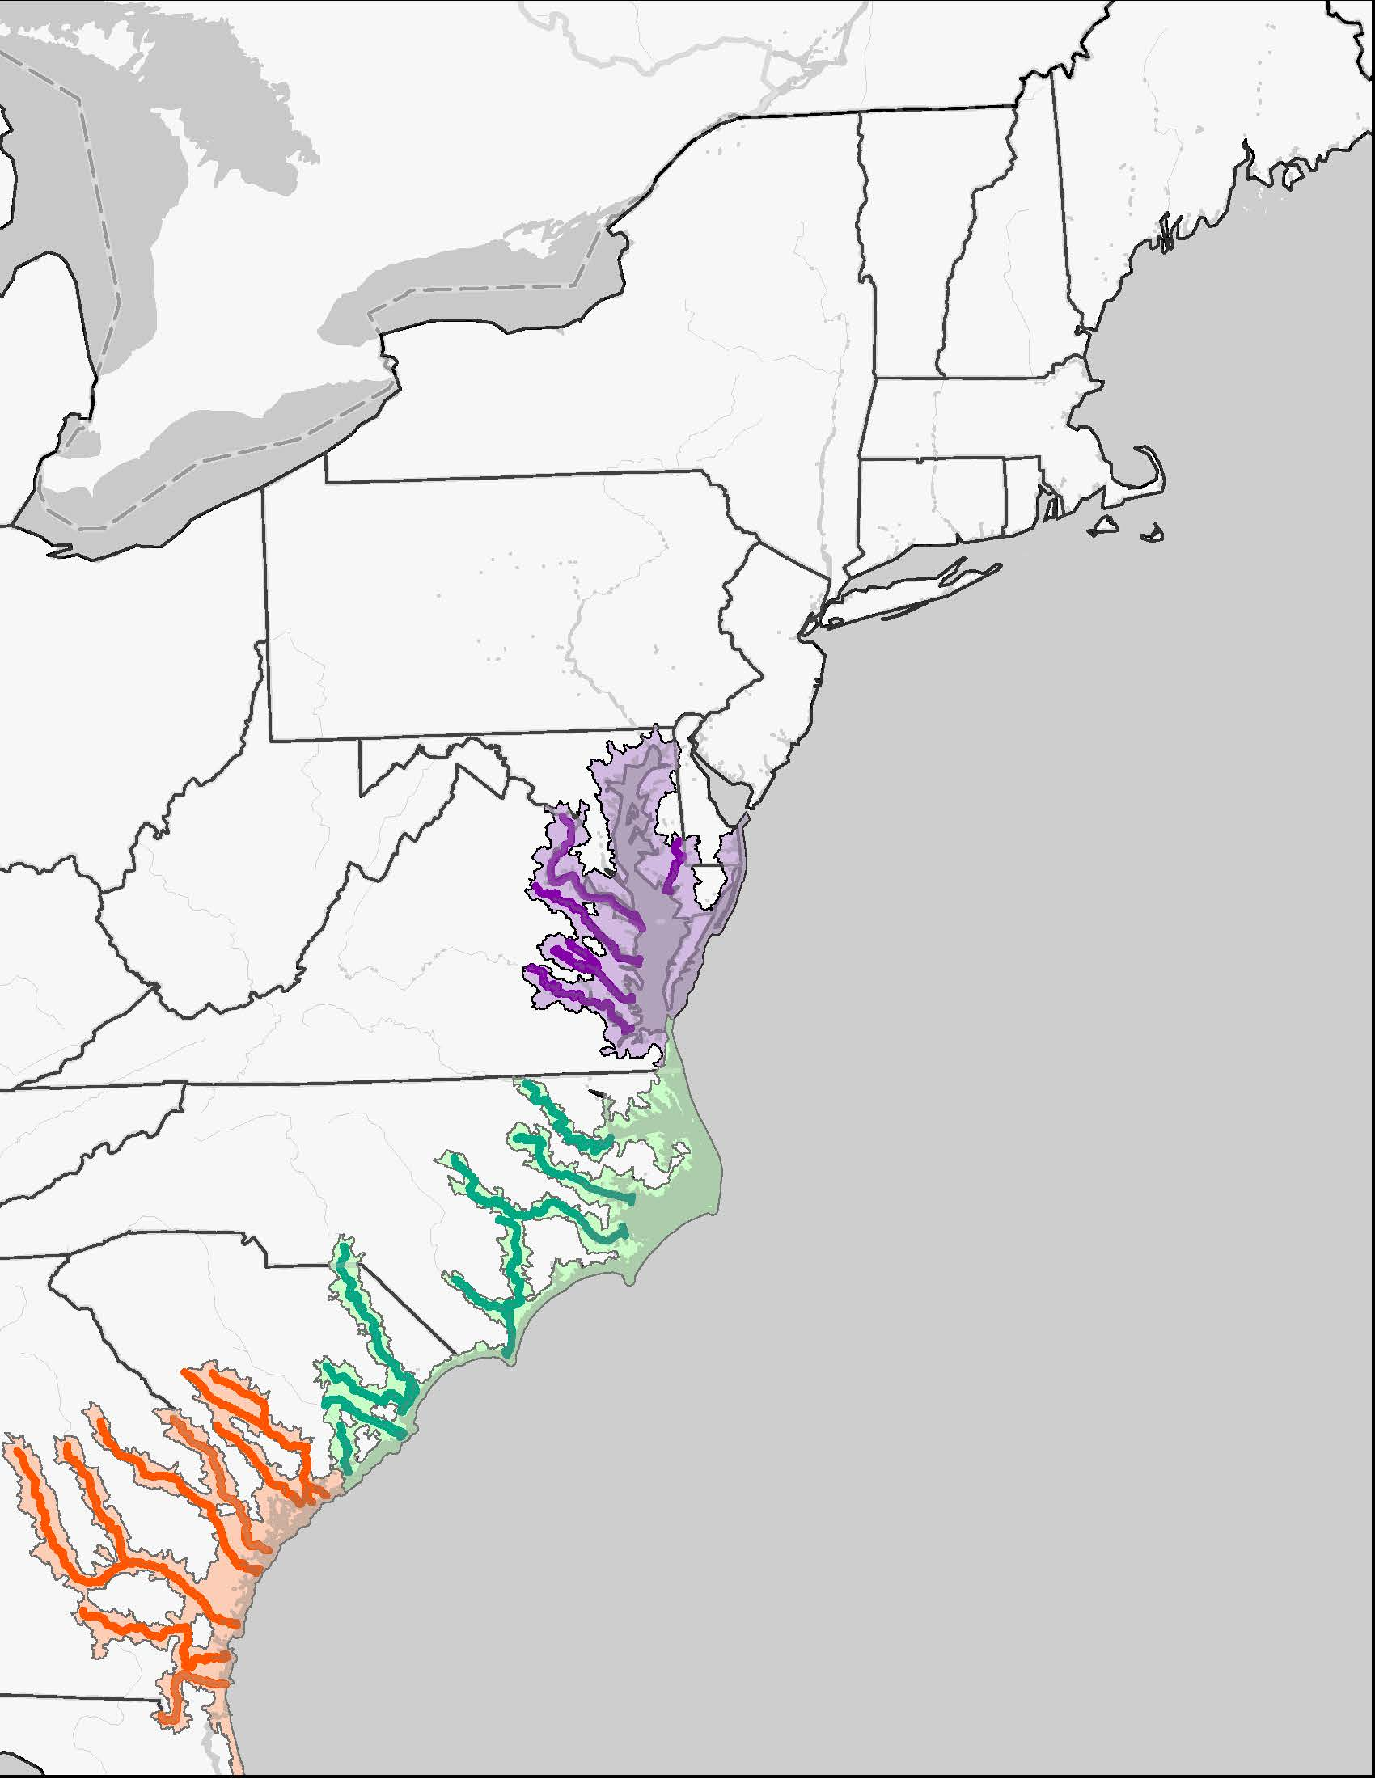
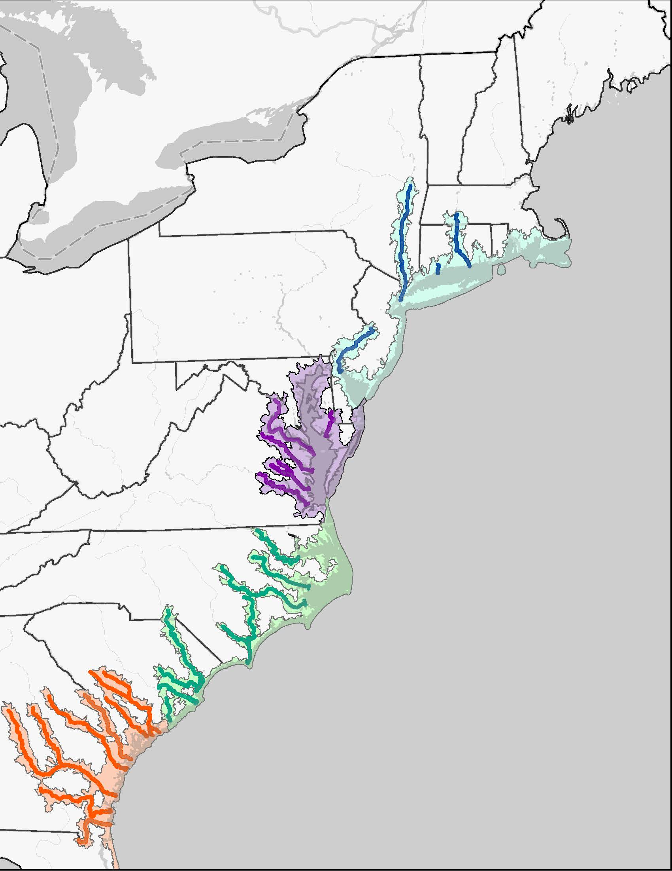
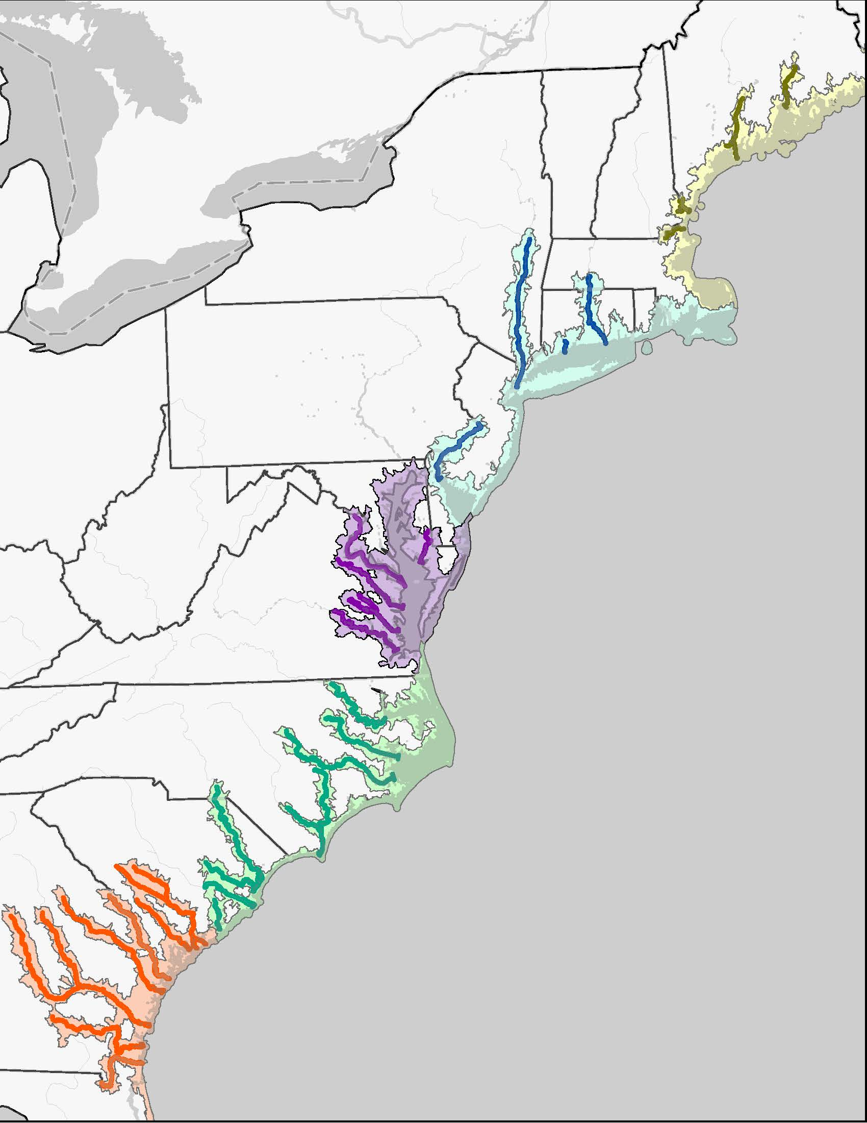
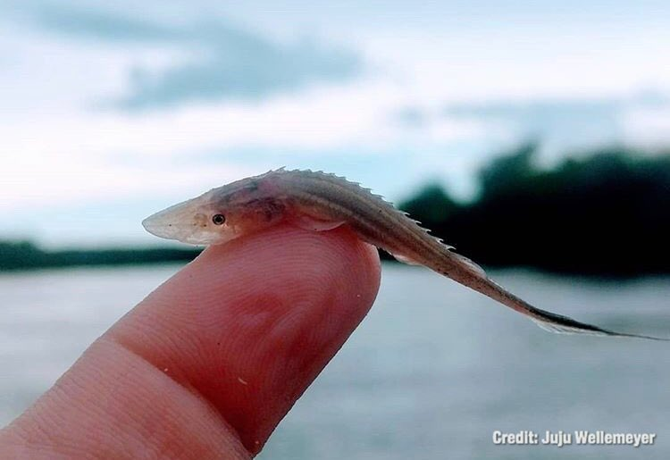
Atlantic Sturgeon
Five distinct population segments
South Atlantic
Carolina
Chesapeake Bay
New York Bight
Gulf of Maine

Slide 24
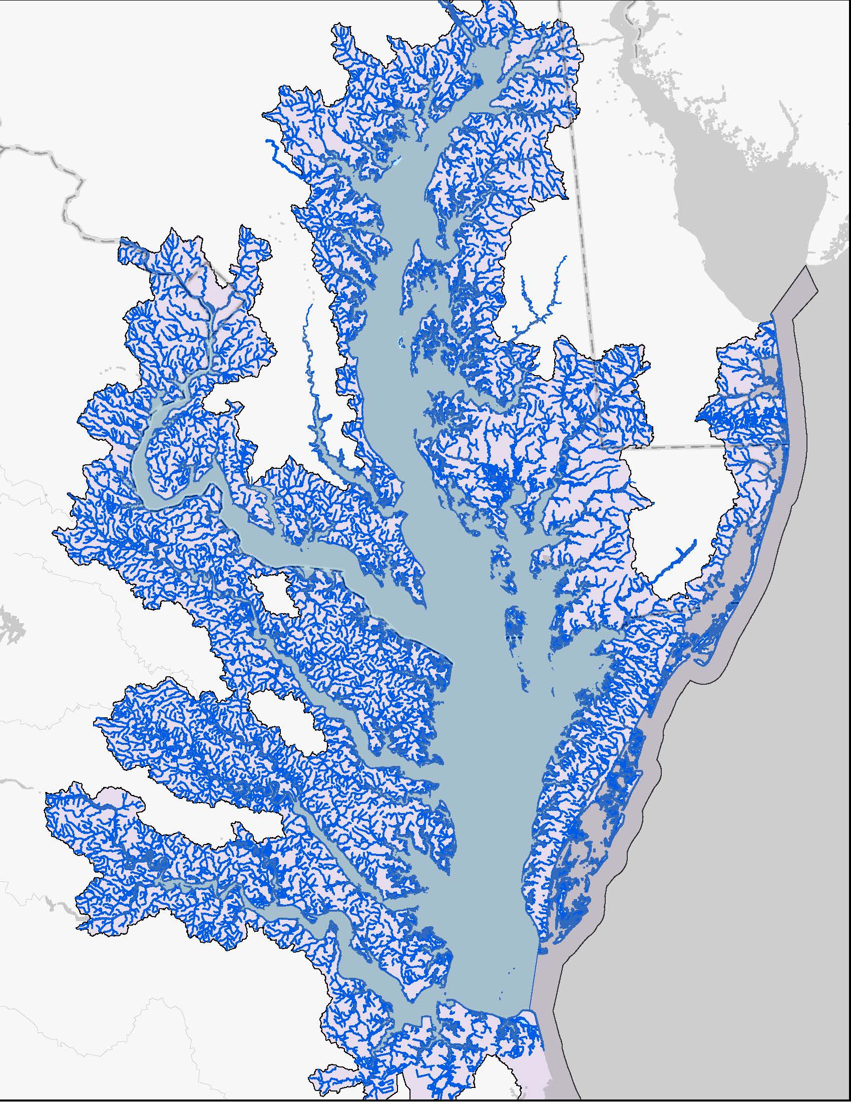
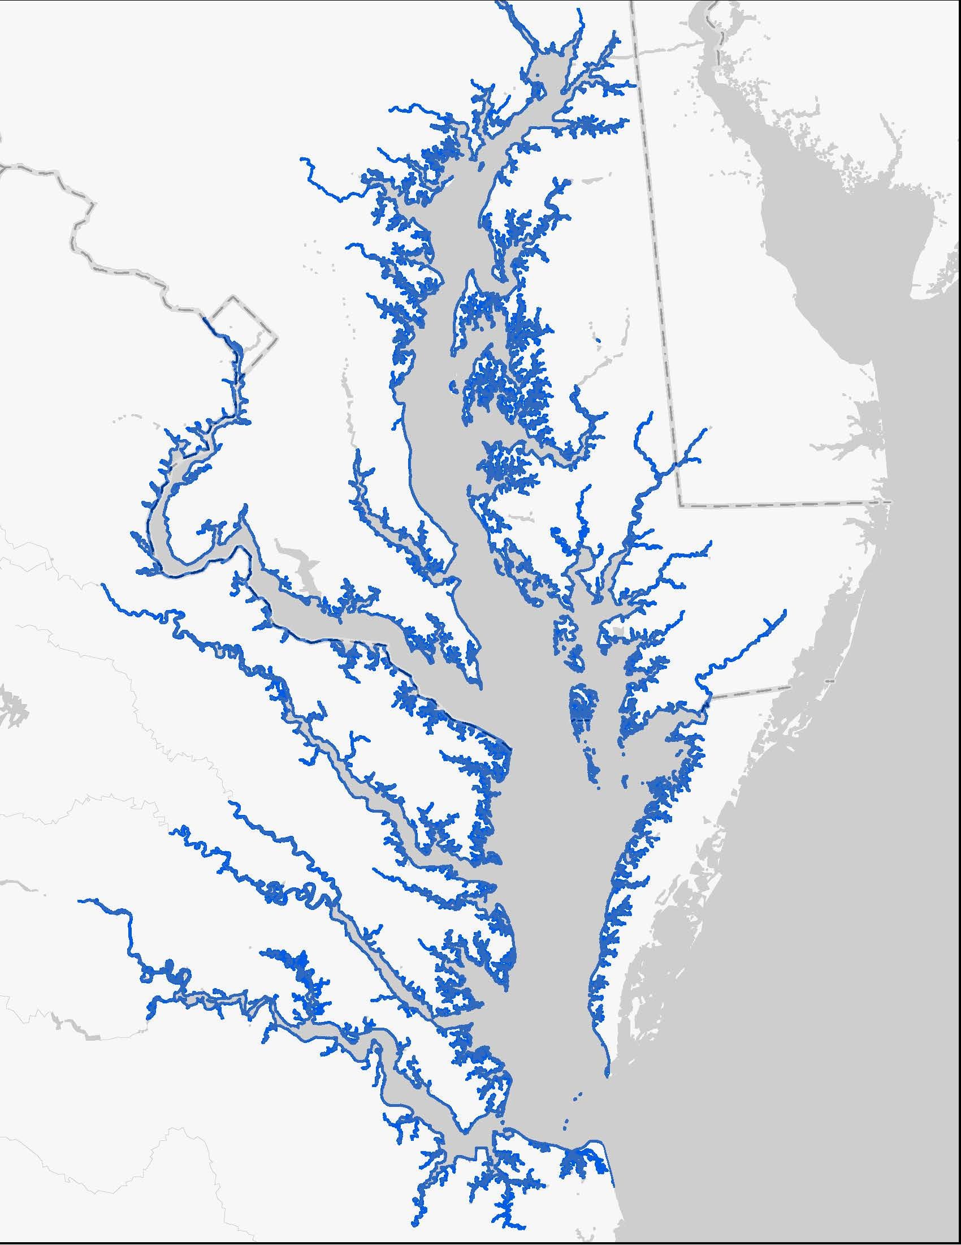
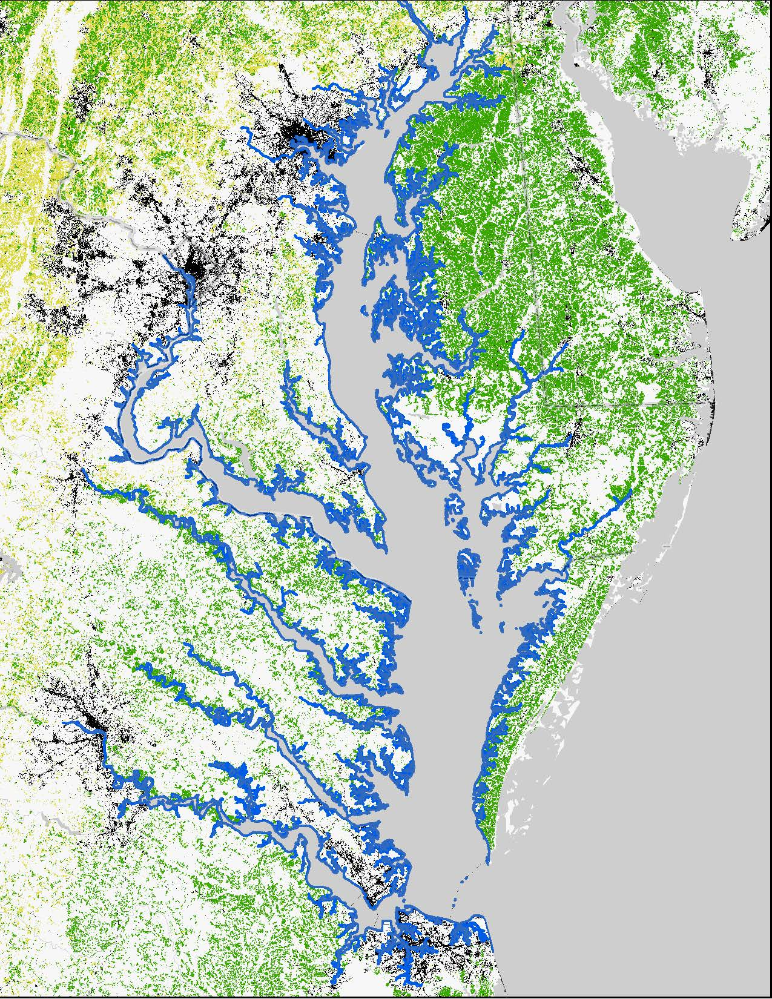
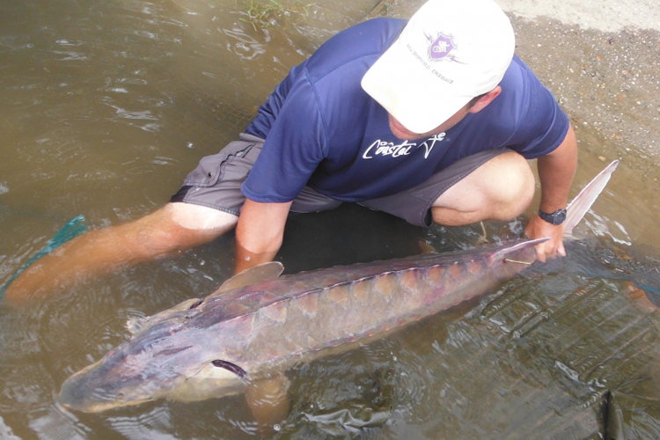
Atlantic Sturgeon
Spawning: April-May, also later in the Fall
Juveniles spend one to four years in freshwater
Sub-adults move to coastal and estuarine habitats
Adults spend most of their life (~ 25-64 years!) in the marine environment

Slide 25
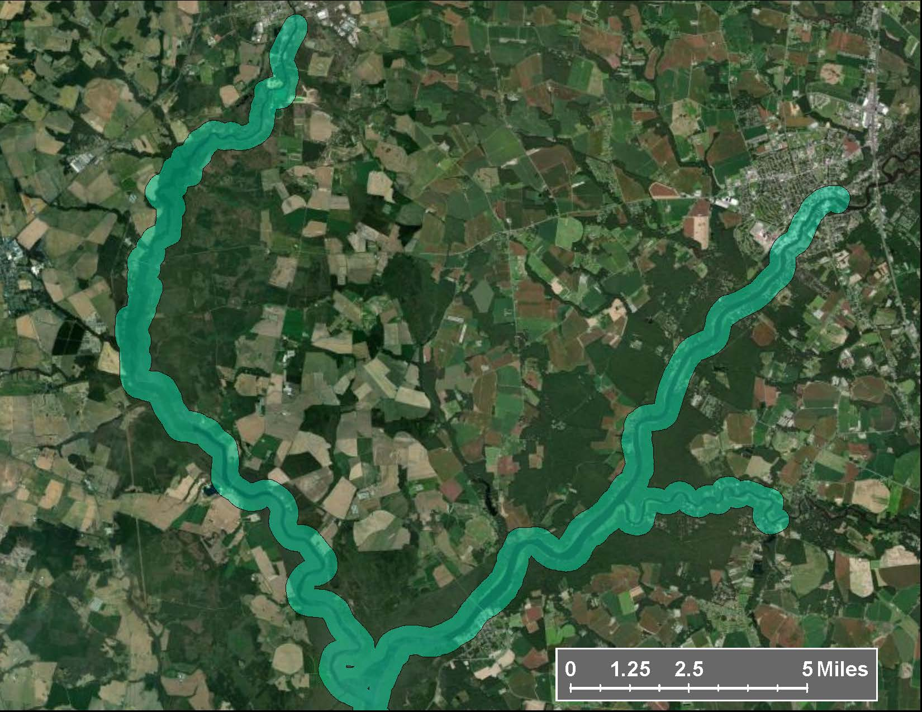
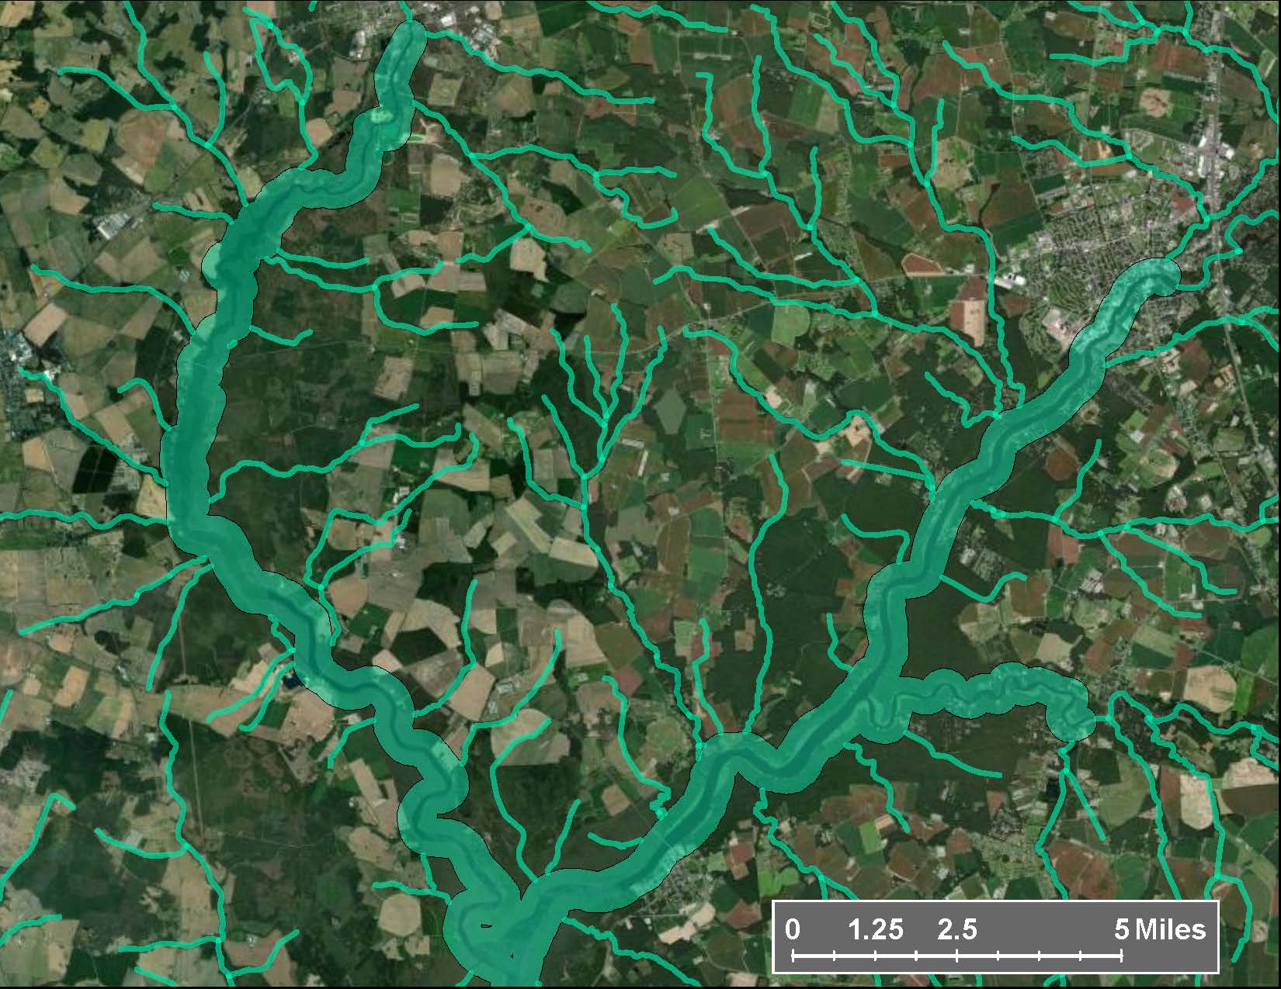
Atlantic Sturgeon
PULA: 300 meter from either edge of the habitat.

Slide 26
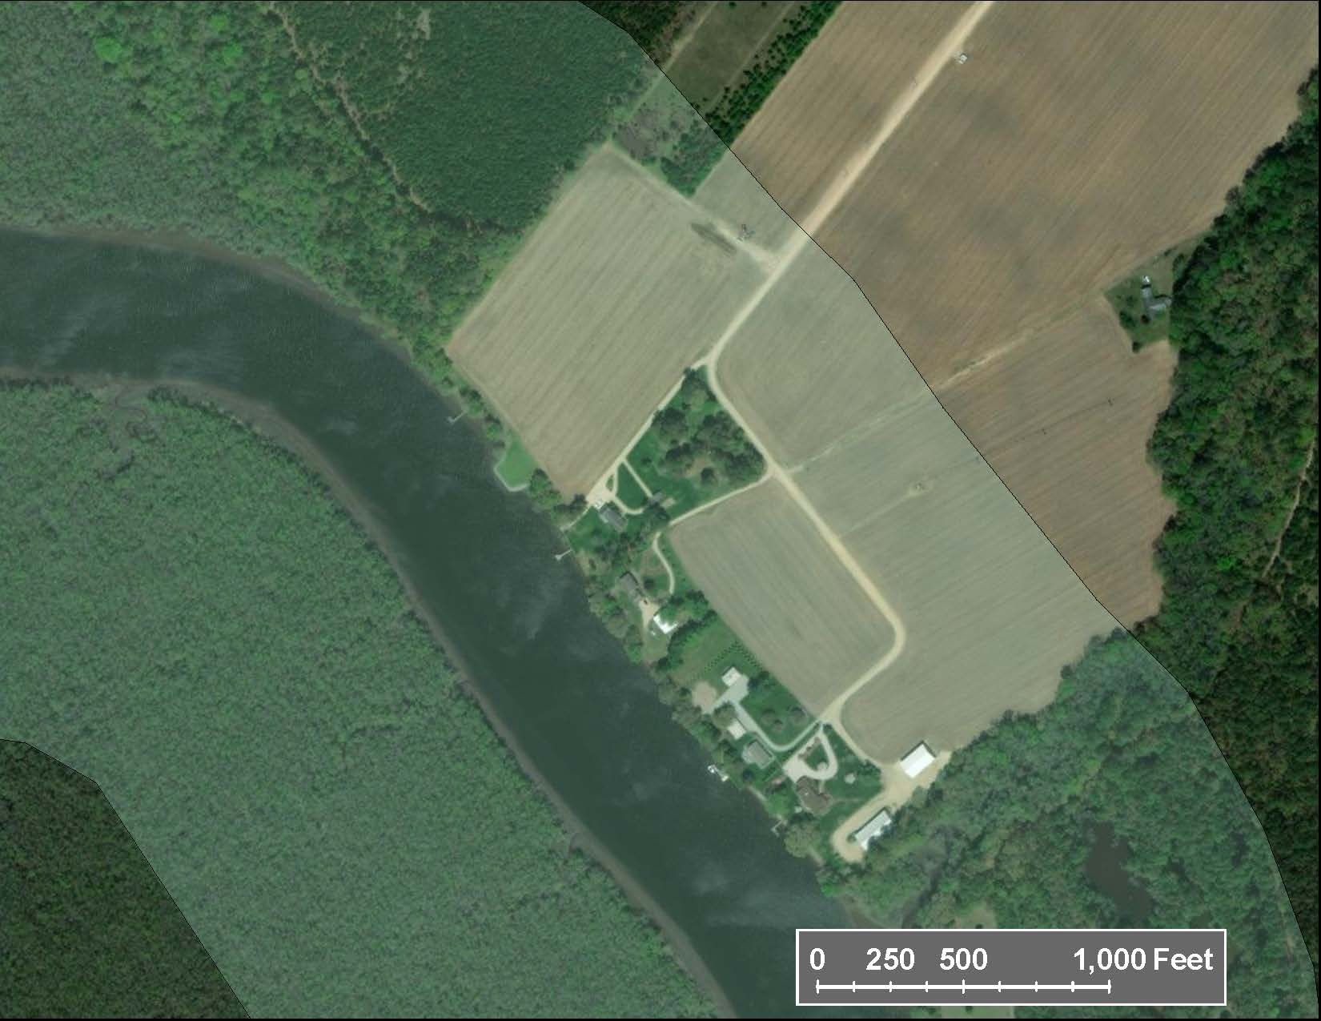
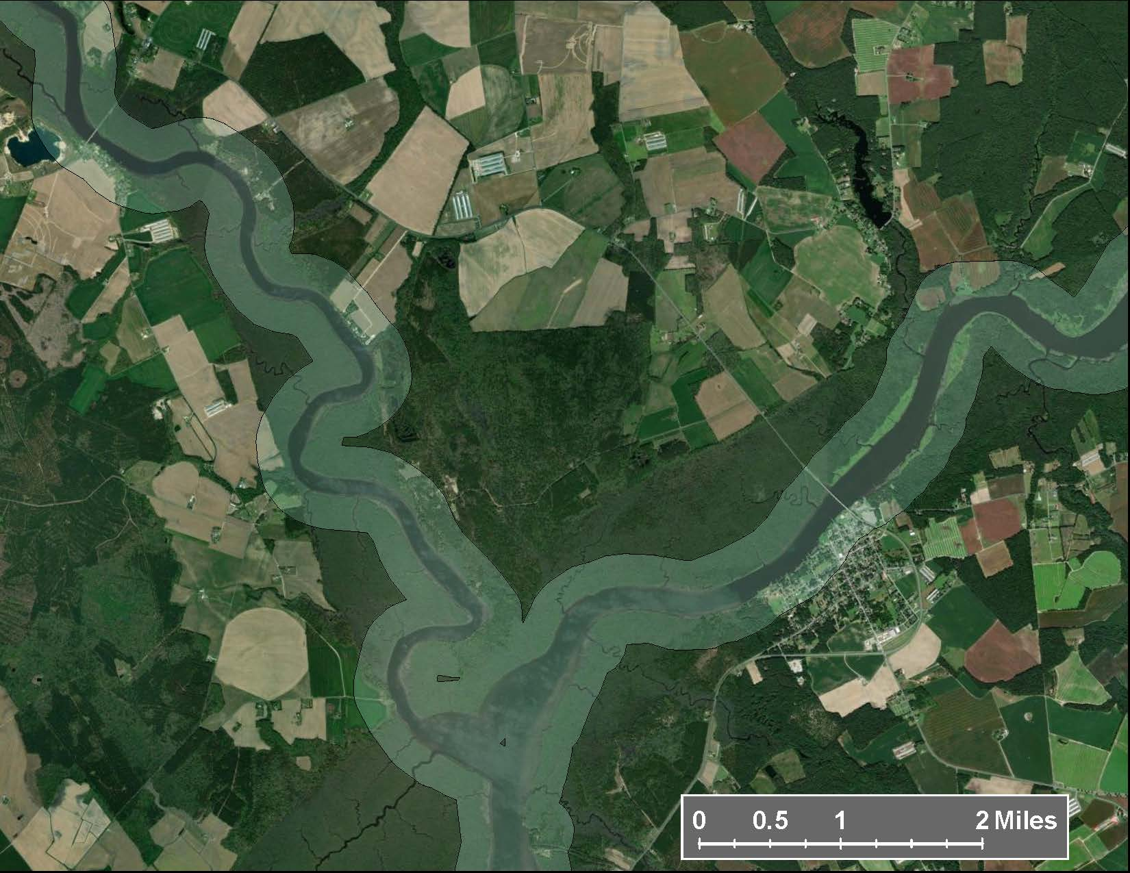
Atlantic Sturgeon
PULA: 300 meter from either edge of the habitat.

Slide 27
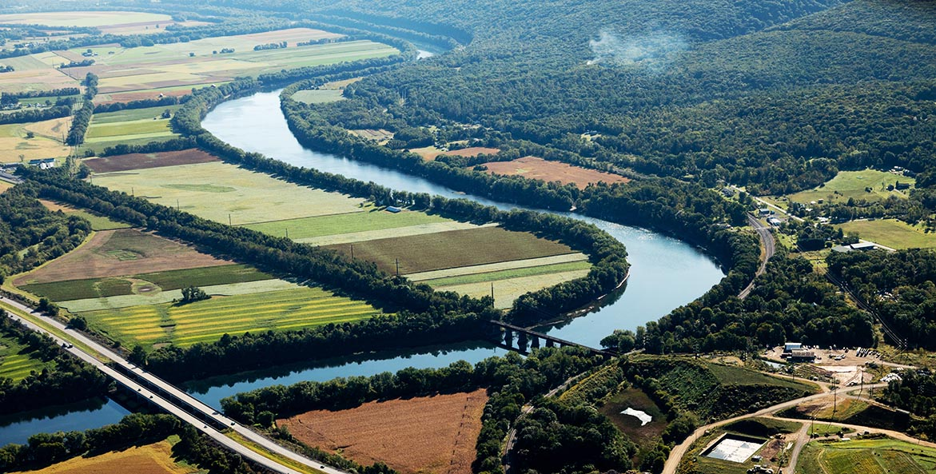
“Pre-strategy” Bulletins Live Two mitigations
Now
Bromoxynil
Prometryn
1,3-D (Telone)
Metolachlor
Chlorpyrifos
Malathion
Diazinon
Near future
Carbaryl
Methomyl
Cyantraniliprole

Slide 28
How are the additional mitigations presented?
The additional mitigations will be described in one of several formats:
Format A: Narrative
The most common approach, a prescriptive set of mitigations are described.
Format B: Pick-one
A list of mitigation options (e.g. vegetative filter strip) will be provided, with the instruction to pick any one to implement.
Format C: Point-based (on a 0-80 scale)
A number of points-needed will be specified, along with a list of mitigation options with their respective point values.

Slide 29
Metolachlor
When applying metolachlor products within 50 meters (164 ft.) of salmonid habitat:
Do not apply this product when soil is saturated, or when a storm event likely to produce runoff from the treated area is forecasted (by NOAA/National Weather Service, or other similar forecasting service) to occur within 48 hours following application.

Slide 30
Prometryn
When applying prometryn products within 50 meters (164 ft.) of salmonid habitat:
For ground applications with rates greater than 1.6 lbs. prometryn a.i./acre, implement one of the following risk reduction measures:
Do not apply within three meters (10 ft.) of salmonid habitat. For rivers, streams, lakes, and tidally influenced waters, measure from the ordinary high water mark. For flooded habitats (inundated floodplains e.g. Yolo Bypass), measure from the edge of the inundated area.
Presence and maintenance of riparian plantings (e.g., hedgerows) or functional riparian system (e.g., CRP riparian buffers).
Vegetative filter strip ≥ five meters (15 ft.) wide
Vegetated ditches
No-till or reduced tillage
Run-off retention pond
Apply pesticide as a spot treatment (application area < 0.1 Acres)

Slide 31
Carbaryl
Identify the number of points required for runoff in the table below.
Runoff Points Required
Application Rate (lbs. a.i./acre) | Points for Species Group A₁ | Points for Species Group B₂
>2.0 | 70 | 50
1.0-2.0 | 50 | 30
<1.0 | Implement any one measure | Implement any one measure
¹ Pacific eulachon, Pacific salmonids ² Sturgeon, Smalltooth sawfish

Slide 32
Runoff Mitigation Options for Carbaryl
Runoff/drainage mitigation option¹³ | Points
Vegetated filter strip¹⁴ 3 meter 5 meter 10 meter 20 meter Inter-row | 15 20 45 60 30
Filter Strip¹⁴ | 30
Contour buffer strips¹⁵ | 30
Strip cropping¹⁶ | 30
Contour farming¹⁷ | 20
Alley cropping¹⁸ | 20
Terrace¹⁹ | 15
Mulching with natural materials²⁰ | 30
No-till or reduced tillage²¹ | 30
Grassed Waterways²² | 30
Runoff/drainage mitigation option¹³ | Points
Vegetated ditches²² | 30
Field border²³ | 30
Functional riparian system alongside water ways > 10 meters wide | 80
Riparian forest buffer 5-10 meters wide²⁴ | 15
Retention pond²⁵ | 55
Water and sediment control basin²⁶ | 55
Constructed wetland²⁷ | 55
Irrigation and drainage tailwater recovery²⁸ | 55
Small Area Applications <0.1A²⁹ | 80
Hedgerow planting³⁰ | 15
Cover cropping³¹ | 5
Application area has a slope of less than 2% | 5
Surface roughening³² | 5
Sediment basin | 5
Footnotes upon request

Slide 33
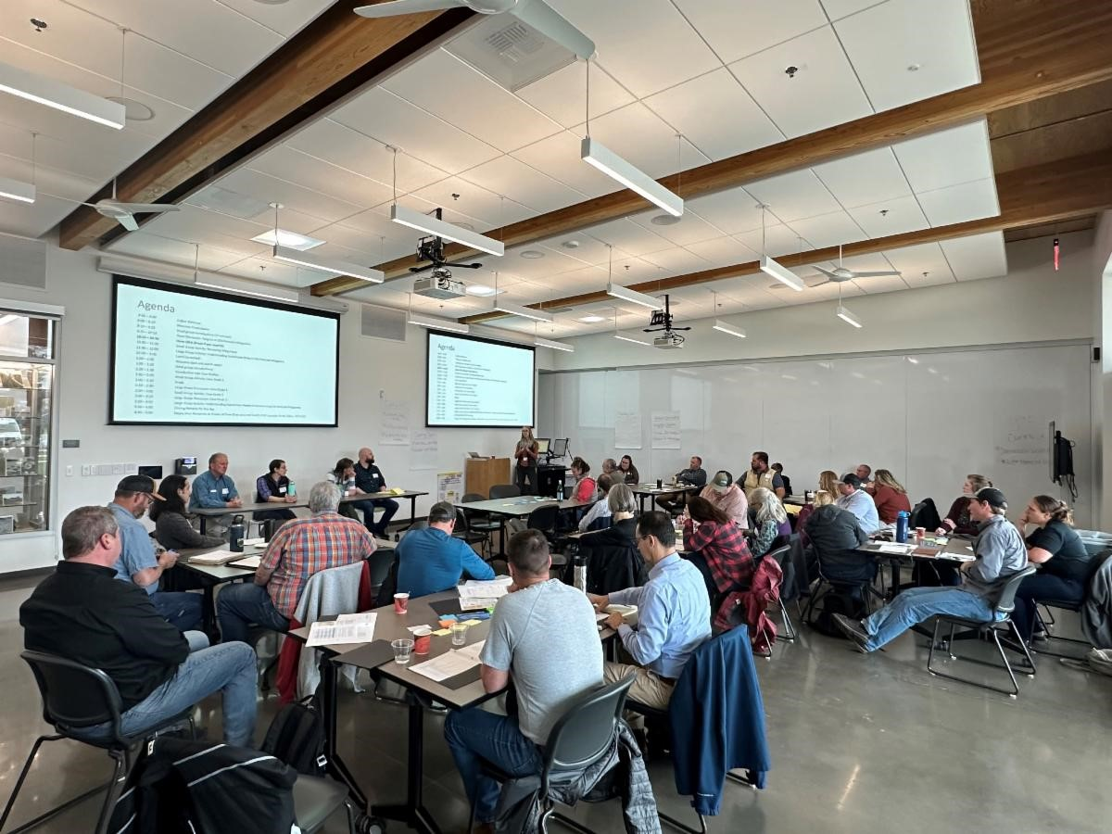
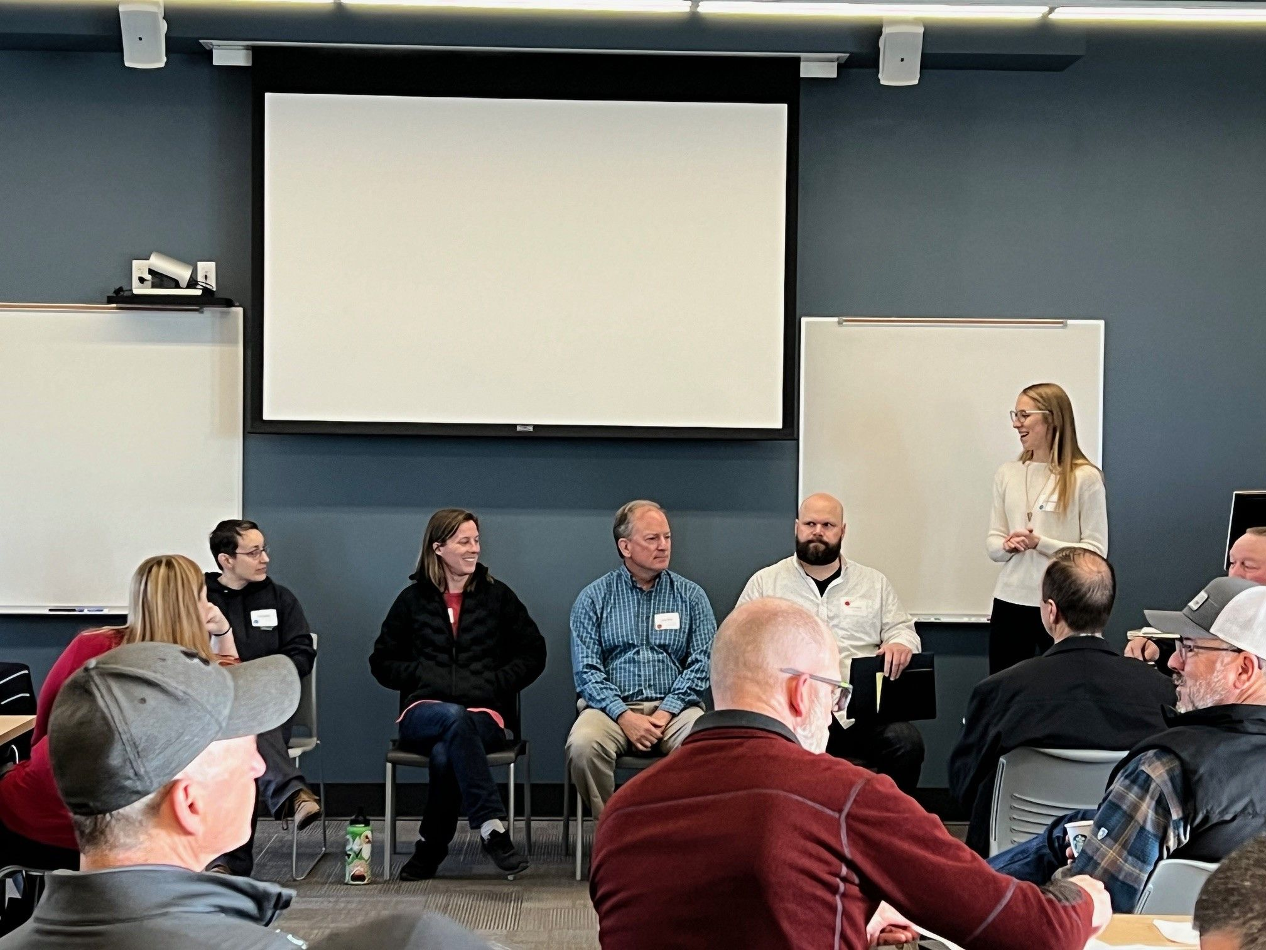
Localized Solutions for Pesticide Use in Diverse Cropping Systems:
Developing solutions for successful Endangered Species Act Implementation

Slide 34
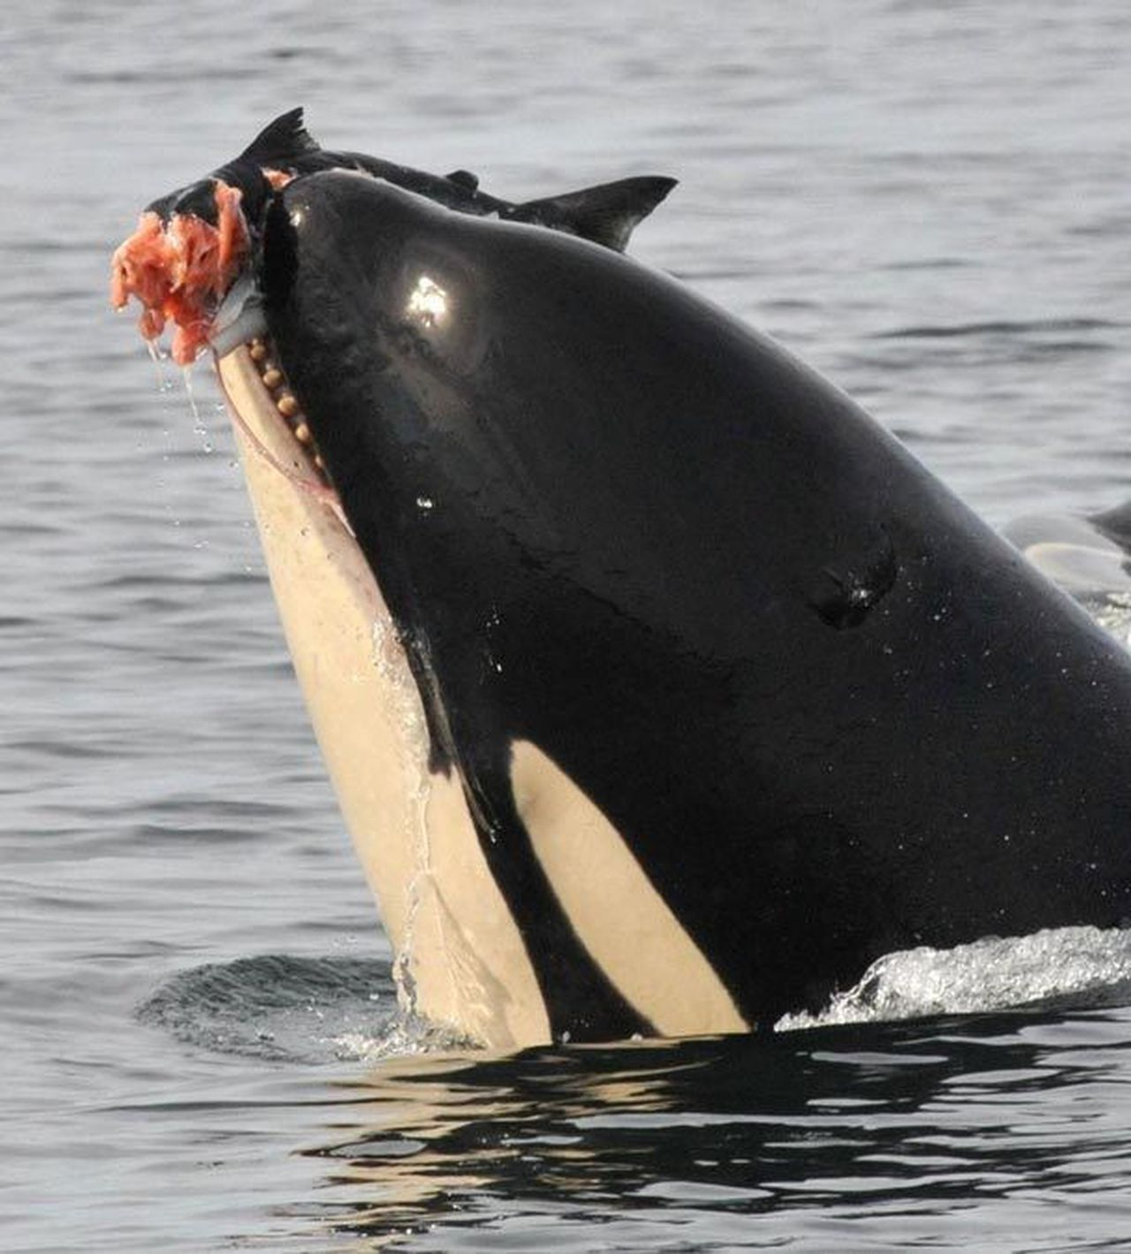
Contacts at NMFS
Tanya Dobrzynski
Chief, NMFS Interagency Cooperation Division
tanya.dobrzynski@noaa.gov
Pesticide consultation contacts:
Ryan DeWitt, M.E.S.
ryan.dewitt@noaa.gov
Tony Hawkes, Ph.D.
tony.hawkes@noaa.gov
David Baldwin, Ph.D.
david.baldwin@noaa.gov

