Slide 1
U.S. Pesticide Laws 101
Notes:
[Ask someone to introduce you (i.e., name, title, department) and read your biography.]

Slide 2
Overview
History
Laws
Regulation
Agencies
What Happens Next?
True or False
Questions?
Notes:
CropLife America, the national association for the pesticide industry, held focus groups and listening sessions in 2019 and 2021 to learn more about consumer perceptions on pesticides. The research from those sessions is reflected in this presentation.
History: We’ll discuss the history of pesticide regulation in the U.S.
Laws: What are the specific laws that govern pesticides in the U.S.?
Regulation: Did you know pesticides are one of the most highly regulated industries in the world? We’ll get into why that is!
Agencies: What federal and state regulatory agencies help ensure public and environmental safety?
What Happens Next? – Once a pesticide is registered and available sale, what enforcement is done to continue to help ensure its safe for use according to label instructions.
True or False Interactive Exercise
Questions?

Slide 3
History
Pre-Pesticide Laws
For more than 4,500 years, pesticides have protected farmers’ crops from weeds, diseases, and insects.
1910 – Federal Insecticide Act passed
1938: The Federal Food, Drug, and Cosmetic Act (FFDCA) passed
1947 – Federal Insecticide Act becomes the Federal Insecticide, Fungicide, and Rodenticide Act (FIFRA)
1970s – FIFRA updated
Silent Spring published
The U.S. Environmental Protection Agency (EPA) formed
Creation of Earth Day
1973 – Endangered Species Act created
1996 –The Food Quality Protection Act amended the FFDCA

Slide 4
Federal Insecticide, Fungicide, and Rodenticide Act
FIFRA authorizes the EPA to be the regulatory authority over the sale and use of pesticides.
Each pesticide will perform its intended function without causing any “unreasonable adverse effects on the environment.” FIFRA further defines this as:
any unreasonable risk to man or the environment, taking into account the economic, social, and environmental costs and benefits of the use of any pesticide, or
a human dietary risk from residues that result from a use of a pesticide in or on any food.
On average, only one in 10,000 discoveries will make the journey from the lab to the field.
Notes:
EPA’s evaluation determines if the pesticide is safe for human health and the environment BEFORE they can be sold and used.
EPA uses FIFRA, along with FFDCA (next slide) to strictly control pesticides.
EPA conducts a scientific risk assessment on each pesticide registration to determine if it can be approved for use.
Any potential risks are assessed through a simple formula: RISK = HAZARD X EXPOSURE.
Risk assessment is an evaluation of the potential hazards along with the possible exposure to the pesticide depending on what crops and application methods are being considered for its use.
A robust and interdisciplinary scientific process creates a framework for evaluating pesticide safety.
FIFRA requires that all approved pesticides must have accurate labels on their containers with precise instructions for using the pesticide. Without an approved label, it cannot be used in the U.S.
The labels are legally binding documents, and the EPA’s evaluation of label instructions considers whether the specific requirements of the label can be readily understood by the person using the product.
The EPA offers a Spanish Translation Guide for Pesticide Labeling to provide guidance for pesticide registrants that opt to translate their pesticide product labels into Spanish.
The EPA monitors reports which must be submitted by companies about unexpected events - accidents or incident reports - and can change the label requirements to respond to any concerns.

Slide 5
Federal Food, Drug, and Cosmetic Act
The FFDCA authorizes EPA to set tolerances, or maximum residue limits (MRLs), for pesticide residues on foods.
In the absence of a tolerance for a pesticide residue, a food containing such a residue is subject to seizure by the government.
Once a tolerance is established, the residue level in the tolerance is the trigger for enforcement actions. That is, if residues are found above that level, the commodity will be subject to seizure.

Slide 6
Notes:
In 1996, the Food Quality Protection Act (FQPA) amended the Federal Insecticide, Fungicide, and Rodenticide Act (FIFRA) and the Federal Food, Drug, and Cosmetic Act (FFDCA), essentially strengthening EPA’s pesticide regulation process. FQPA established a health-based safety standard to:
Provide more stringent parameters around use of pesticides on food crops and streamlined the approval of reduced risk pesticides.
Apply a new safety standard - reasonable certainty of no harm - to pesticide residues occurring in all foods.
Consider total or “aggregate” exposure to a pesticide from multiple sources (food, drinking water, residential uses, and other non-occupational sources) when assessing pesticide tolerances.
Consider cumulative effects of different pesticides that share a common mechanism of toxicity.
To meet the requirements under FQPA, EPA developed methodologies to perform more refined pesticide risk assessments to better reflect real-world circumstances.
Provide incentives for registrants to develop reduced risk pesticides.
Provide enhanced protection for infants and children
Consider the potentially higher susceptibility of children to pesticides by applying an additional tenfold (10X) safety factor when setting and reassessing tolerances for foods that children eat unless reliable data support a different factor. This considers potential pre- and post-natal toxicity of the pesticide residues and completeness of the data with respect to exposure and toxicity to infants and children.
What is a 10X safety factor? Think of the 10X safety factor as an extra layer of protection. For example, think about a toddler riding in a car. A seatbelt would not provide the appropriate amount of protection. Add a car seat – this is an example of increasing the safety factor many times over (10X). Add an alarm to alert the driver to anything left in the backseat, which protects the child from possibly being left in the car, which is another 10X. FQPA added a third 10X safety factor to provide even greater protection of infants and children.
Keep pesticide registrations current.
Federal regulators must review each pesticide approved for use in the U.S. every 15 years at a minimum. Each registered pesticide is also subject to continuous review whenever new scientific data becomes available.
Any newly discovered or unexpected risks (revealed by new research, incident reports, etc.) attributed to a pesticide must be reported promptly to EPA.
Accelerated the reassessment of all pesticide tolerances in effect at the time.
Using these newly developed methodologies, EPA completed the reassessment of the 9,721 pesticide tolerances in effect at that time during the 10 years after FQPA was enacted. In the process, EPA revoked or modified almost 4,000 tolerances.

Slide 7
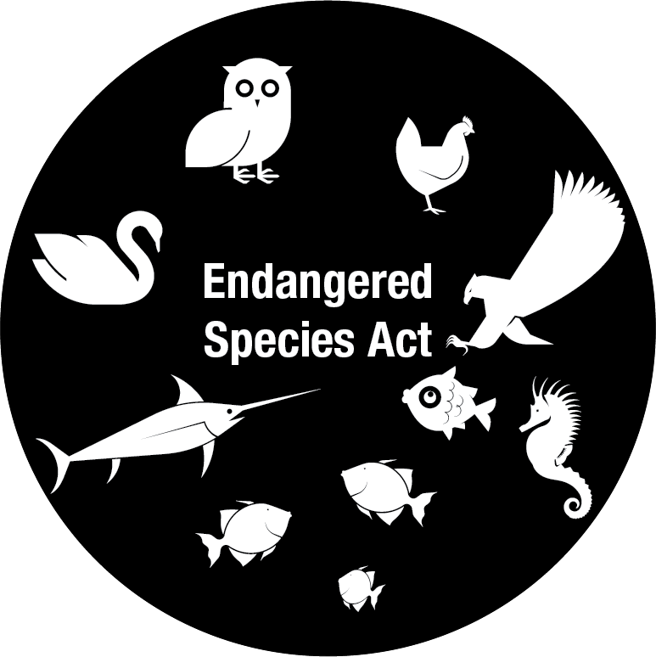
Endangered Species Act
The ESA provides a program for the conservation of threatened and endangered plants and animals and the habitats in which they are found.
U.S. Fish & Wildlife Service
EPA’s Office of Pesticide Programs
NOAA Fisheries Service
Notes:
The lead federal agencies for implementing ESA are the U.S. Fish and Wildlife Service (FWS) and U.S. National Oceanic and Atmospheric Administration (NOAA) Fisheries Service.
EPA’s Office of Pesticide Programs (OPP) implements key portions of the ESA as it pertains to pesticide registration.
OPP regulates the use of all pesticides in the U.S. and establishes maximum levels for pesticide residues in food, thereby safeguarding the nation's food supply.

Slide 8
Notes:
Here is a snapshot of the pesticide registration timeline and all the steps involved.
We’ll dive a bit more into which agencies oversee pesticide regulation and what they do.

Slide 9
How Pesticides are Regulated

Slide 10
Notes:
Similar to the process for approving vaccines, and medicines, EPA reviews hundreds of studies conducted for each pesticide by manufacturers and third parties in the U.S. and around the world…but what does that mean?
These studies provide data and results related to impacts on unintended species and the environment, and risks to human health, just to name a few. Studies assess one-time exposure as well as “prolonged and repeated exposure” assessments in order to determine risks of developing certain diseases over time.
Studies must be conducted consistent with international scientific standards, such as Good Laboratory Practices, ensuring that even studies conducted by manufacturers can be relied-upon.
Good laboratory practice or GLP is a set of principles intended to assure the quality and integrity of non-clinical laboratory studies that are intended to support research or marketing permits for products regulated by government agencies.
By law, the EPA may request whatever data they need to ensure the safety of a pesticide product. EPA’s in-house, career scientific staff experts are themselves advised by renowned independent experts, including the National Academy of Sciences, and many have worked over decades under multiple Administrations to ensure that pesticides are safe for the public and environment when used accordingly.
Through the open and transparent assessment process, all scientific assessments and public comments are available for public scrutiny, and the agency receives and considers “hundreds or even thousands” of comments from the public and independent experts for each product.
This strict regulatory process helps ensure that pesticide discoveries are not pursued if they cannot meet the high safety standards for approval.
This is the primary reason only about one in 10,000 discoveries will make the long (more than 11 years) and costly journey from the lab to the farmer’s field. To put this into perspective, a discovery made today would likely not be available to farmers until 2033.

Slide 11
Notes:
OPMP serves as the USDA lead regarding pesticide regulation and policy. They actively work with the Environmental Protection Agency (EPA) on registration of new active ingredients and pesticide registration review, ensuring that the needs of growers are represented.
The Pesticide Data Program (PDP) is a national pesticide residue monitoring program and produces the most comprehensive pesticide residue database in the U.S. The Monitoring Programs Division administers the sampling, testing, and reporting of pesticide residues on agricultural commodities in the U.S. food supply, with an emphasis on those commodities highly consumed by infants and children. PDP data:
Enable the U.S. Environmental Protection Agency to assess dietary exposure.
Facilitate the global marketing of U.S. agricultural products.
Provide guidance for the U.S. Food and Drug Administration and other governmental agencies to make informed decisions.
Organic is a labeling and marketing term that indicates that the food or other agricultural product has been produced through USDA’s outlined organic approved methods. The organic standards describe the specific requirements that must be verified by a USDA-accredited certifying agent before products can be labeled USDA organic.
Essentially, organic standards are designed to allow natural substances in organic farming while prohibiting synthetic substances.
It is important to note that whether you are buying organic, non-organic, local, or imported, your food has almost certainly been grown with the help of pesticides.

Slide 12
U.S. Food and Drug Administration’s Role
FDA is responsible under the FFDCA for enforcing tolerances established by the EPA for amounts of pesticide residues that may legally remain on food, including animal feed.
Notes:
In its regulatory pesticide residue monitoring program, FDA selectively tests a broad range of imported and domestic commodities for approximately 800 pesticide residues.
FDA also conducts focused sampling surveys for specific commodities or selected pesticide chemical residues of special interest.
Additionally, in the Total Diet Study (TDS), FDA monitors the levels of pesticide chemical residues in foods that have been prepared for consumption and represent the average U.S. diet.

Slide 13
What Happens Next?
Notes:
State review and registration – Each state leads pesticide agency reviews and approves pesticide’s federal registration for use within the state. Many states have additional data and review requirements that consider local conditions that have to be met in order for these products to registered.
Pesticide applicator certification – Professional applicators must be certified through training and testing to apply pesticides and they must participate in continuing education to keep their licenses. Private applicators (farmers) also must be tested in order be certified and purchase certain pesticide products that require higher levels of management to ensure they are used correctly.
Pesticide safety educators - Most states have pesticide safety education coordinators who are responsible for the certification of applicators and the dissemination of information to ensure that pesticides are used properly. They also develop state-specific information on local needs and coordinate their efforts with colleagues in other states through the American Association of Pesticide Safety Educators.
EPA sets residue tolerances – As part of a pesticide registration, EPA sets residue tolerance levels for fruits, vegetables, and other foods for each pesticide applied to food crops (these levels are many times greater than what would potentially cause any harm).
Label direction enforces – During the registration process, EPA evaluates and approves the language that appears on each pesticide label to ensure the directions for use and safety measures are appropriate to any potential risk. Following label directions is required by law and is necessary to ensure safe use. Additionally in each state, one agency works cooperatively with the US EPA to enforce federal pesticide regulations and respond to potential complaints.
FDA enforces pesticide tolerances – The U.S. Food and Drug Administration (FDA) employs a three-fold strategy to enforce EPA’s tolerances for pesticide chemical residues in human and animal foods. In its regulatory pesticide residue monitoring program, FDA selectively tests a broad range of imported and domestic commodities for approximately 800 pesticide residues. FDA may also carry out focused sampling surveys for specific commodities or selected pesticide chemical residues of special interest. In addition, FDA monitors the levels of pesticide chemical residues in foods prepared for consumption in its Total Diet Study (TDS), an ongoing program that monitors contaminants and nutrients in the average U.S. diet. If residues exceed the established tolerance level, FDA pursues enforcement action.

