Slide 1

The Final Insecticide Strategy
Michael Zhao, B.S., and Niranjana Krishnan, PhD,
Department of Entomology,
University of Maryland, College Park
July 7th, 2025

Slide 2
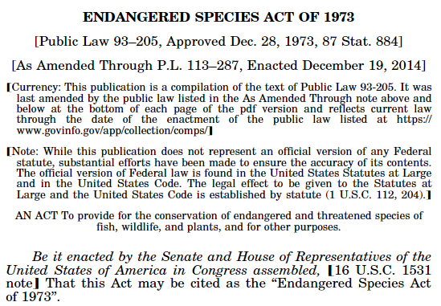
What is the Insecticide Strategy?
A plan developed by the U.S. Environmental Protection Agency (EPA) to efficiently determine whether, how much, and where mitigations are necessary to protect federally listed (endangered/threatened) species and designated critical habitat (specific areas essential for listed species conservation) from insecticide use.

Slide 3
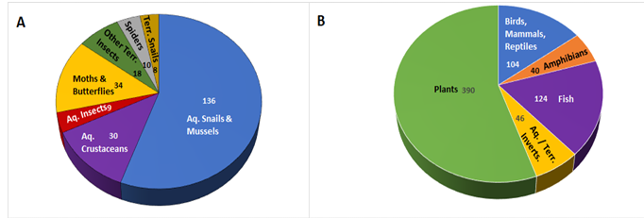
What is the Scope of the Insecticide Strategy?
Conventional insecticides, insect growth regulators, miticides used in agriculture.
950+ species listed by the U.S. Fish and Wildlife Service (FWS) in contiguous U.S.
Population-level impacts to:
  Listed aquatic and terrestrial invertebrates (direct effects; 250 species)
  Listed plants or vertebrate animals that rely on invertebrates for pollination or diet (indirect effects; 700 species).
Strategy applies to 61 listed insects that will have population-level impacts (out of 99 listed insects)

Slide 4
What are the Goals of the Insecticide Strategy?
1: Identify early mitigations for listed species likely impacted at the population-level by agricultural insecticide use.
2: Provide flexibility for implementing mitigations through FIFRA actions that would reduce major routes of insecticide exposure to listed species
3: Improve efficiency of future consultations on insecticides including, applying the final strategy to future registration and registration review actions.
4: Increase regulatory certainty for growers and other stakeholders regarding the use and availability of insecticides.

Slide 5
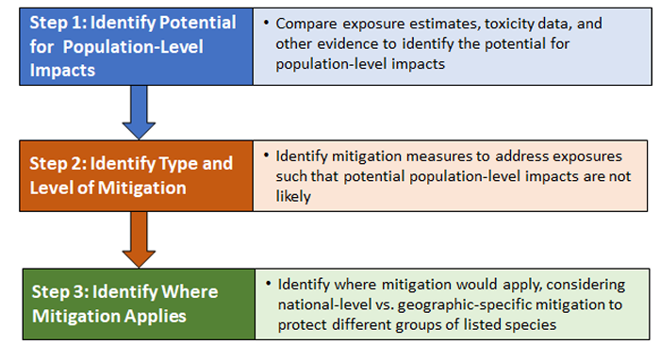
Overview of the Insecticide Strategy Framework

Slide 6
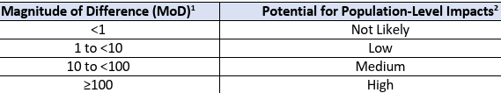
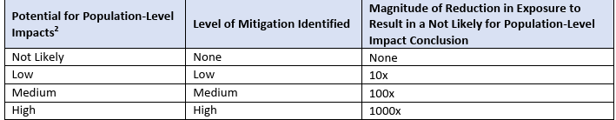
Steps 1 & 2: Potential for population-level impacts & level of mitigation needed
The EPA calculates Magnitude of Difference (MoD), which is the ratio of exposure estimate to relevant toxicity thresholds values for population-level impacts.
Lower the MoD, lower the population-level impact and lesser the level of mitigation needed.
Notes:
In Step 1, Magnitude of Difference (MoD) is calculated: insecticide exposure/toxicity threshold. Greater MoD, more potential for population-level impacts. Exposure estimates are largely derived from pesticide use patterns and exposure models.

Slide 7
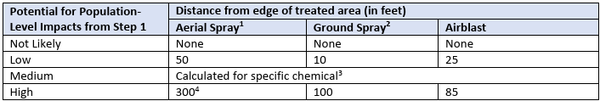
Step 2: Identify type and level of mitigation needed
I. Reducing insecticide spray drift exposure
(for foliar applications and soil treatments - excludes non-overhead chemigation, in-furrow sprays when nozzle height ≤ 8 in., tree trunk drenches and paints, tree and soil injections, <1/10 acre treated, spot treatments, solid formulations used as such)
Buffers can reduce spray drift exposure - larger buffers needed if higher population-level impacts (see table below).

Slide 8
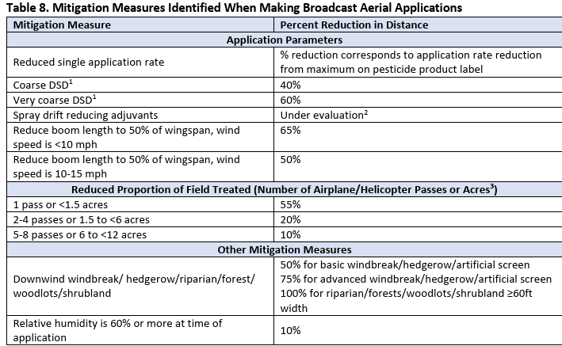
Several measures (using equipment that reduces drift, reduced application rates, increased droplet sizes, having a physical barrier, etc.) can reduce buffer distances.
1. Broadcast aerial

Slide 9
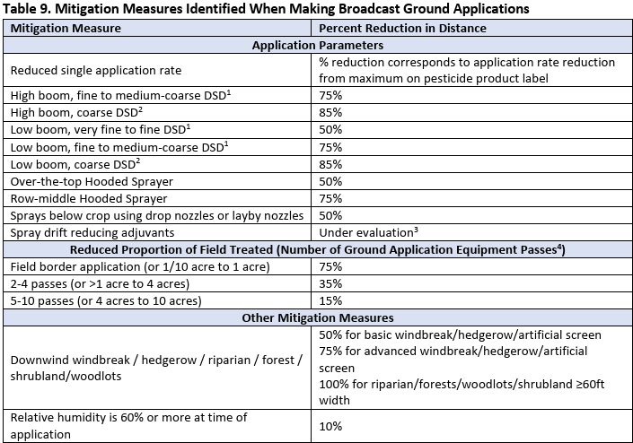
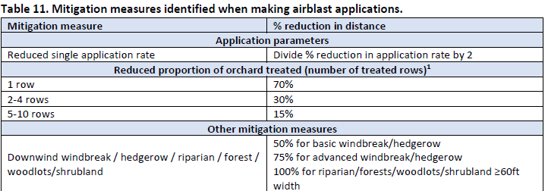
2. Broadcast ground

Slide 10
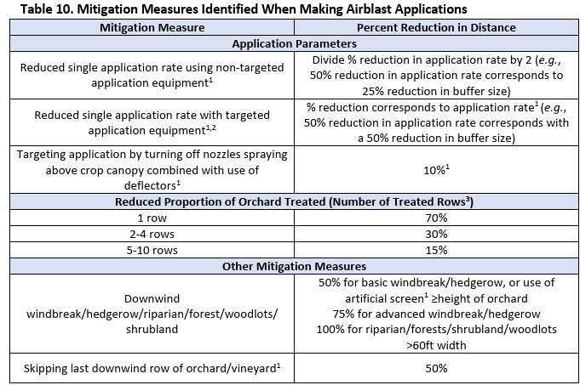
3. Airblast

Slide 11
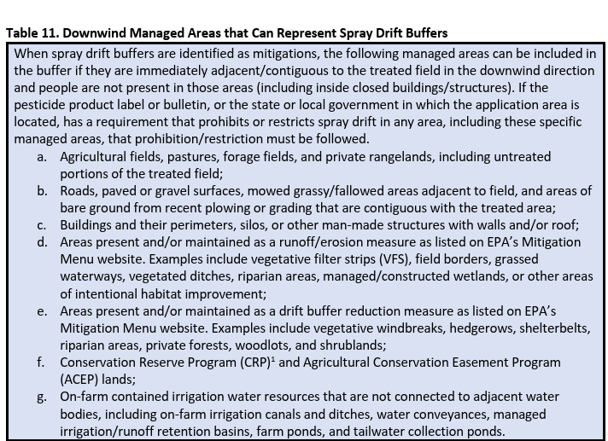

Slide 12
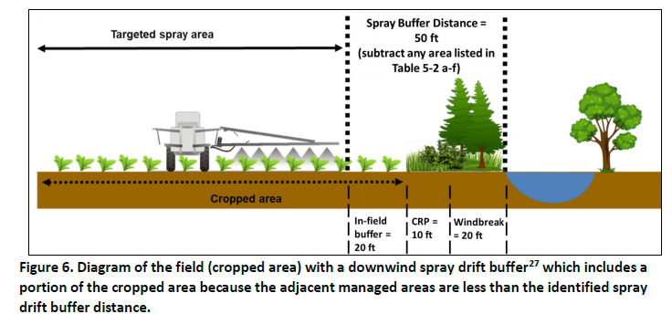
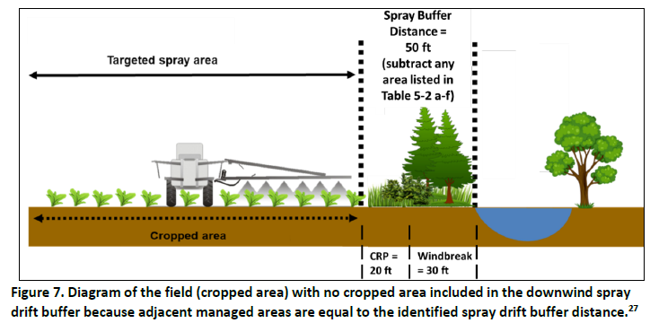
Notes:
See text in previous slide – some downwind managed areas can represent spray drit buffers

Slide 13
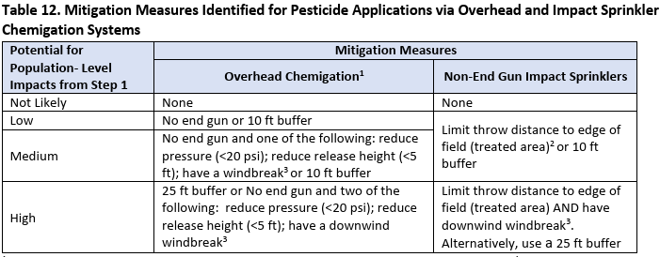
4. Overhead and Impact sprinklers

Slide 14
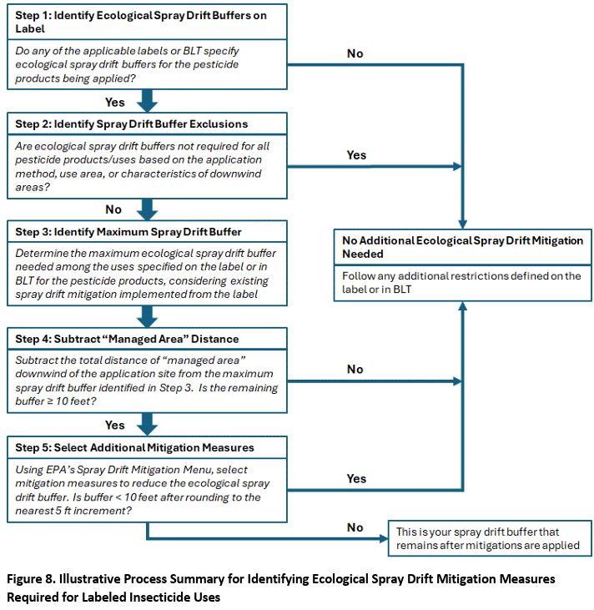
Notes:
See text in previous slide – some downwind managed areas can represent spray drit buffers

Slide 15
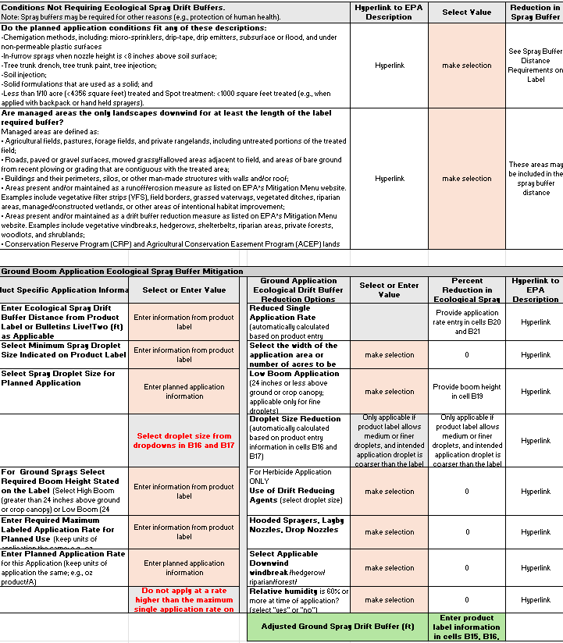
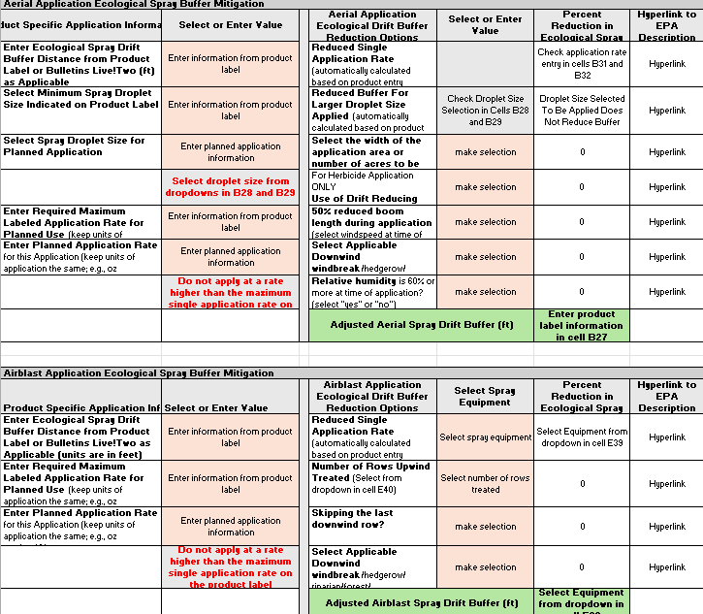

Spray Drift Calculator
Can be found in EPA’s Mitigation Menu website:
https://www.epa.gov/pesticides/mitigation-menu

Slide 16
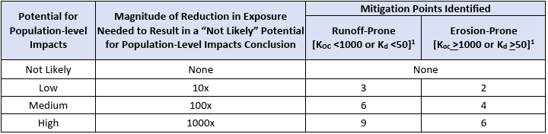
Step 2: Identify type and level of mitigation needed
II. Reducing insecticide runoff/erosion exposure
(for foliar applications, soil treatments, treated seeds, granular formulations - excludes subsurface chemigation, tree and soil injections, <1/10 acre treated and spot treatments)
To reduce runoff/erosion exposure, mitigation measures need to be applied.
An insecticide could either be more runoff-prone or erosion-prone (see table below).

Slide 17
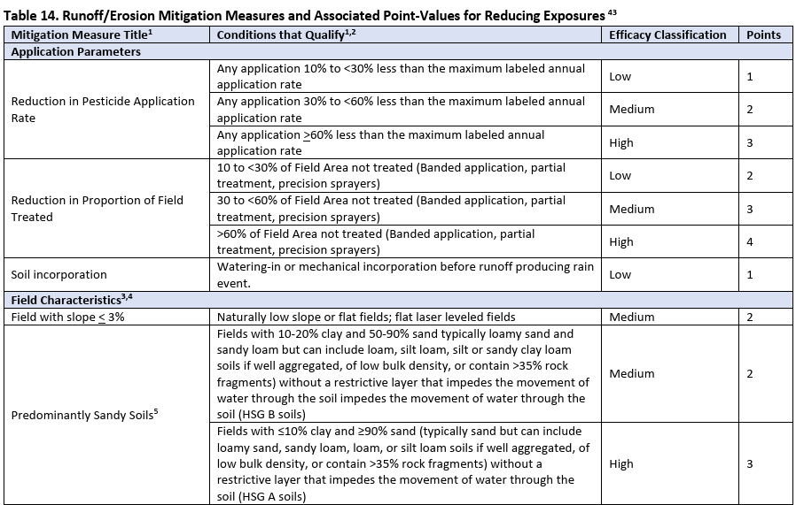
1. Application parameters
2. Field characteristics

Slide 18
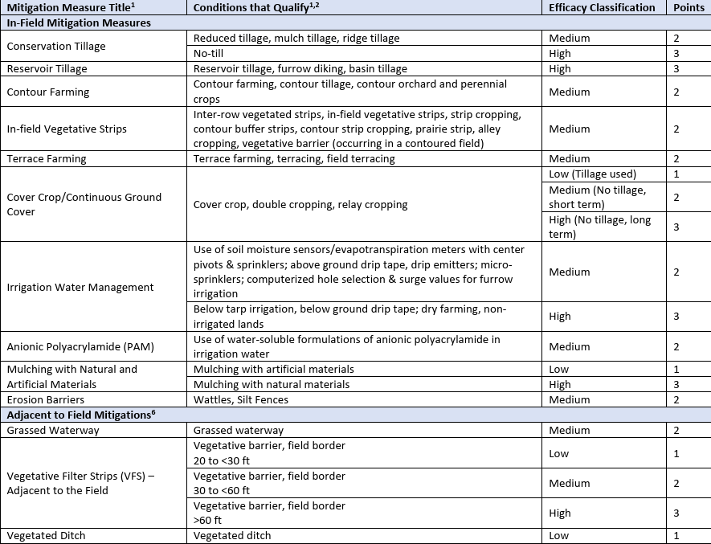
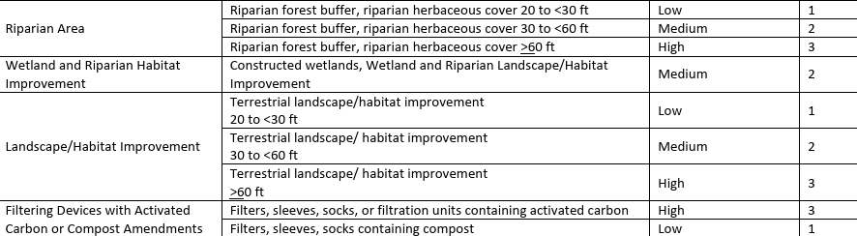
3. In-field mitigation measures
4. Adjacent to field mitigations

Slide 19
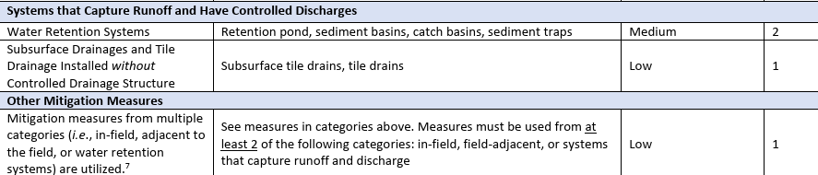
5. Systems that capture runoff and have controlled drainages
6. Other measures
The following measures, when employed alone in a field, can adequately mitigate population-level impacts (i.e., no other mitigation points needed):
Systems with permanent berms
Tailwater return systems
Subsurface tile-drains, with controlled drainage structures

Slide 20
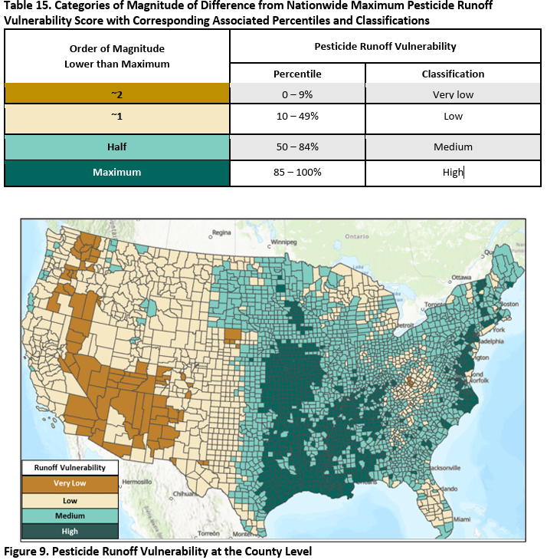
Classification | Mitigation relief points
Very low | 6 points
Low | 3 points
Medium | 2 points
High | 0 points

Slide 21
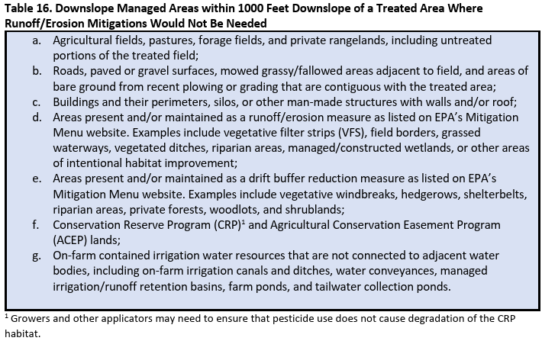

Slide 22
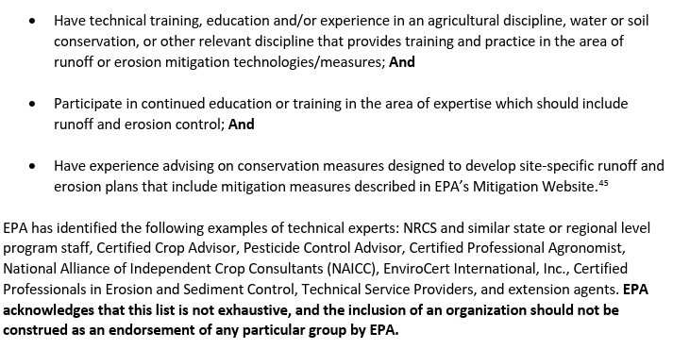
Other ways to get mitigation points
1. Follow recommendations from a runoff/erosion specialist (defined below): 1 point

Slide 23
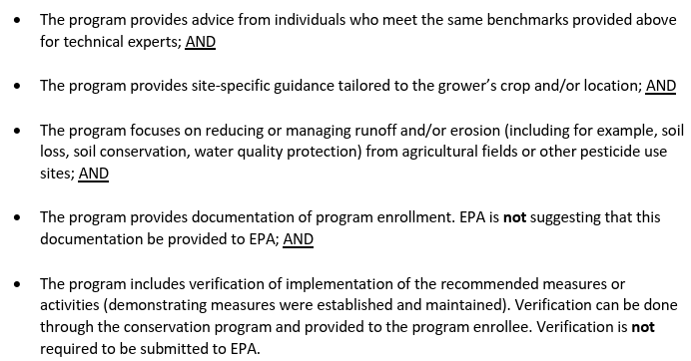
Other ways to get mitigation points
2. Participating in a conservation program (defined below): 2 points (EPA determining if some programs can achieve 9 points)
EPA has determined appropriate participation in the NRCS EQIP program, when incorporating CPS 595, can be awarded 9 points
3. Mitigation tracking (1 point)

Slide 24
Note on treated seeds
When grower/applicator uses a seed treatment on their field, the label may indicate number of mitigation points or direct to Bulletins Live! Two.
When a grower is planting a previously treated seed, the seed bag tag may direct grower to the Mitigation Menu website to identify mitigation measures and levels of mitigation needed.

Slide 25
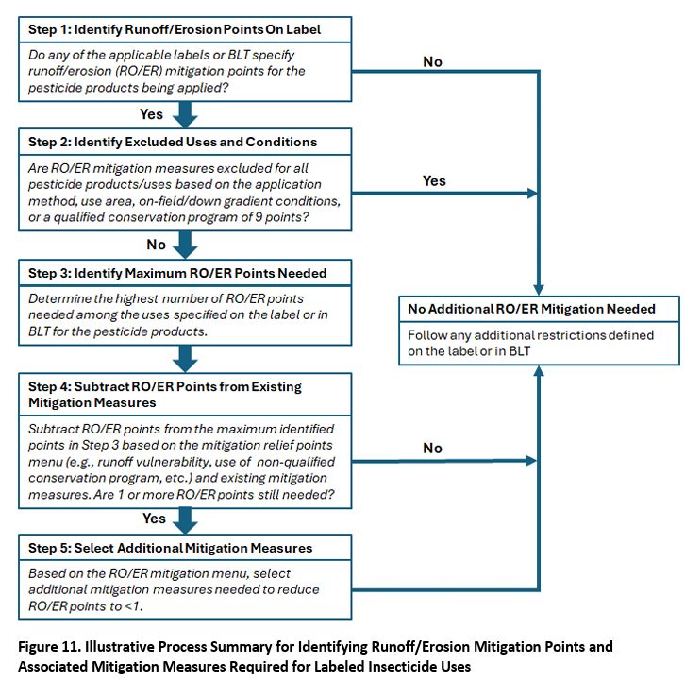
Notes:
See text in previous slide – some downwind managed areas can represent spray drit buffers

Slide 26
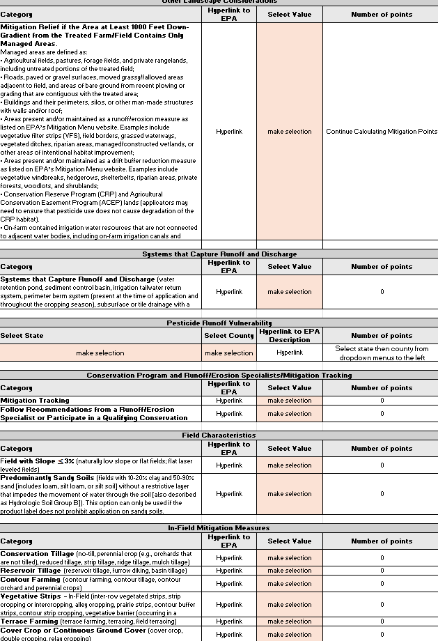
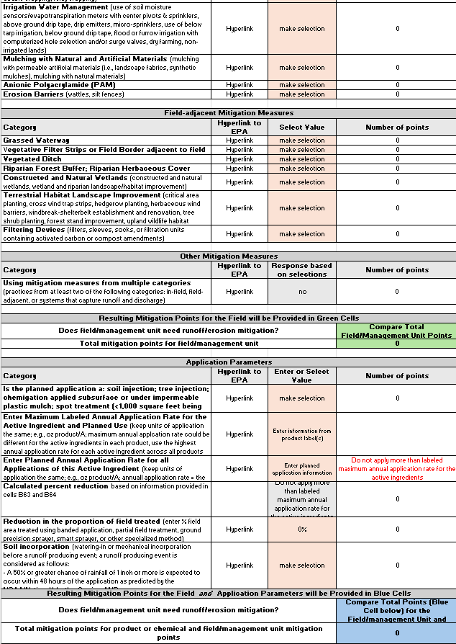
Runoff/Erosion
Calculator
Can be found in EPA’s Mitigation Menu website:
https://www.epa.gov/pesticides/mitigation-menu

Slide 27

Step 3: Identify where mitigations apply
In Step 3, the location where the different mitigations would apply is identified
  Mitigations could apply across an entire use pattern (e.g., specific crops) - general pesticide label
  AND/OR
  Mitigations could apply on geographically specific areas - Bulletins Live! Two
Bulletins Live! Two website: https://www.epa.gov/endangered-species/bulletins-live-two-view-bulletins

Slide 28
Conclusions
Listed species range maps are being refined to only include areas where mitigations are needed to conserve a listed species and its critical habitat. Buffers (≤ 1000 ft) would be added to these areas to reduce off-field insecticide exposure.
Both Bulletins Live! Two and Mitigation Menu websites will continue to be updated. Labels could direct users to either or both websites. Both websites are extensions of the pesticide label (compliance required).
Offsets are being considered if feasible mitigation measures are not adequate to protect listed species. Offsets include habitat preservation or restoration, invasive species control, and species reintroductions.
Final Insecticide Strategy: https://www.epa.gov/system/files/documents/2025-04/insecticide-strategy-final_0.pdf

