Slide 1
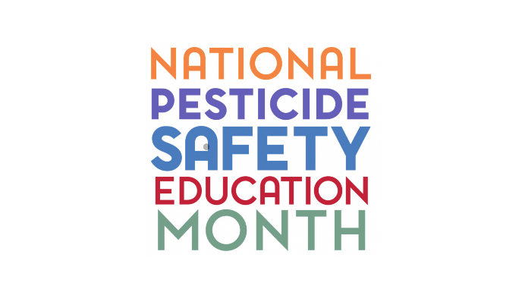
The Ninth Annual National Pesticide Safety Education Month is February 2026. The purpose of National Pesticide Safety Education Month is to reinforce core principles of safe pesticide use with many audiences and raise awareness of and support for the land-grant university Pesticide Safety Education Programs (PSEPs).

